Slide 1
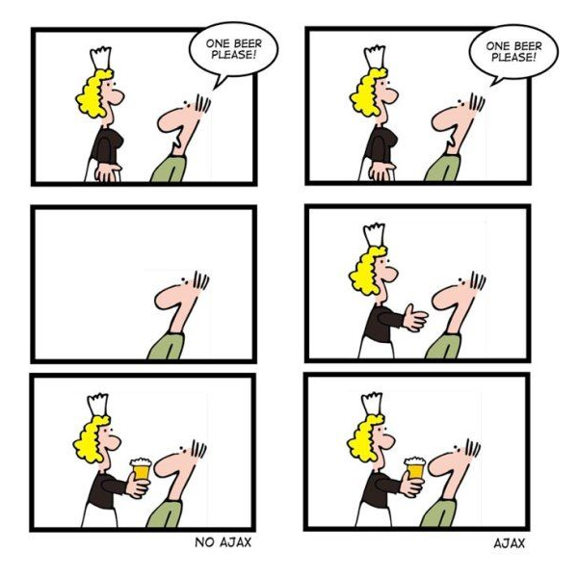
CSc 337
Lecture 12: The Fetch Api and AJAx

Slide 2
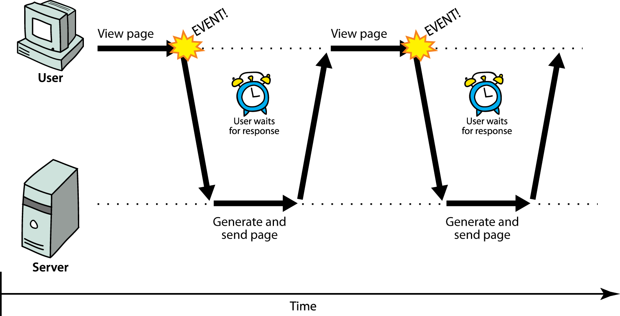
Synchronous web communication
synchronous: user must wait while new pages load
the typical communication pattern used in web pages (click, wait, refresh)

Slide 3
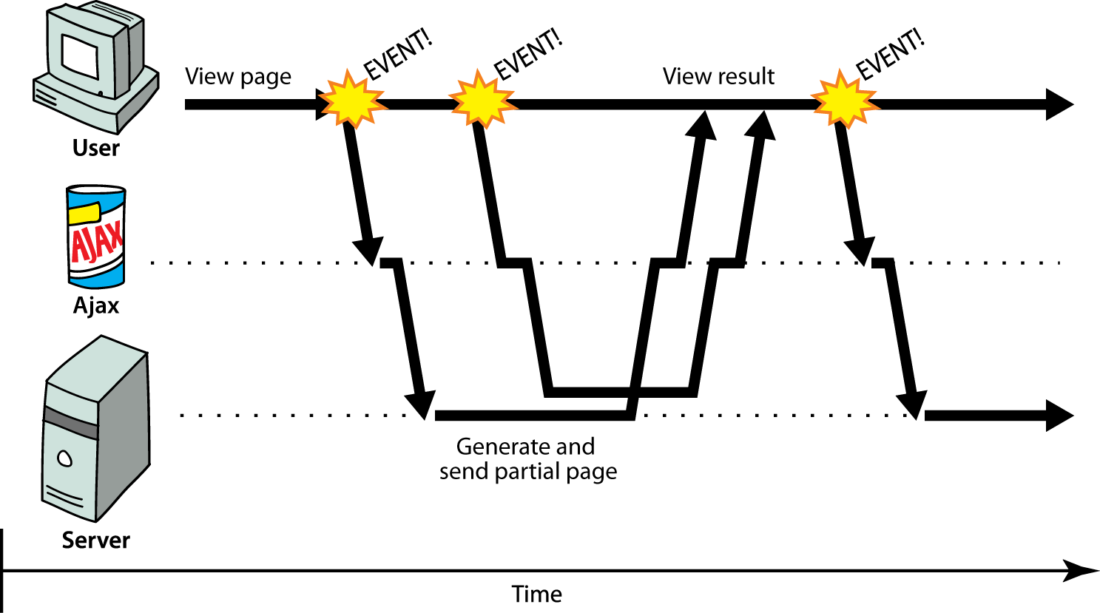
Asynchronous web communication
asynchronous: user can keep interacting with page while data loads

Slide 4
Asynchronous requests, basic idea
var ajax = new XMLHttpRequest();
ajax.onload = functionName;
ajax.open("GET", url, true);
ajax.send();
...
function functionName() {
do something with this.responseText;
} JS
attach an event handler to the load event
handler will be called when request state changes, e.g. finishes
function contains code to run when request is complete
inside your handler function, this will refer to the ajax object
you can access its responseText and other properties

Slide 5
What if the request fails?
var ajax = new XMLHttpRequest();
ajax.onload = functionName;
ajax.open("GET", "url", true);
ajax.send();
...
function functionName() {
if (this.status == 200) { // 200 means request succeeded
do something with this.responseText;
} else {
code to handle the error;
}
} JS
web servers return status codes for requests (200 means Success)
you may wish to display a message or take action on a failed request

Slide 6
Promises
Promise: A JS object that executes some code that has an uncertain outcome
Promises have three states:
- Pending
- Fulfilled
- Rejected
Example: “I promise to post homework 4” Pending: Not yet posted Fulfilled: Homework 4 posted Rejected: Wrong homework posted, or not posted in time

Slide 7
Why are they better
Help deal with uncertainty
You determine whether it is fulfilled or rejected
You define what happens when it fulfills or is rejected

Slide 8
Promise syntax
function callAjax(){
var url = ..... // put url string here
fetch(url)
.then(checkStatus)
.then(function(responseText) {
//success: do something with the responseText
})
.catch(function(error) {
//error: do something with error
});
}

Slide 9
Promise syntax
function checkStatus(response) {
if (response.status >= 200 && response.status < 300) {
return response.text();
} else {
return Promise.reject(new Error(response.status+":
"+response.statusText));
}
}

Slide 10
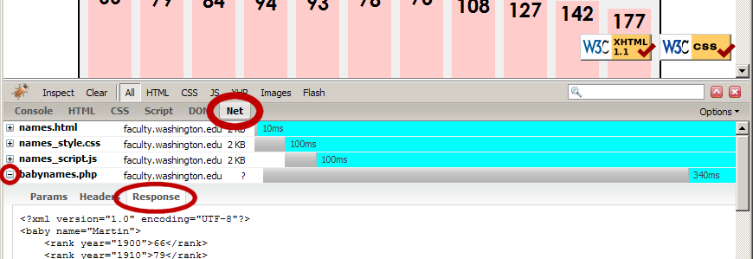
Debugging Ajax code
Firebug Net tab (or Chrome's Network tab) shows each request, parameters, response, errors
expand a request with + and look at Response tab to see Ajax result
check Console tab for any errors that are thrown by requests

Slide 11
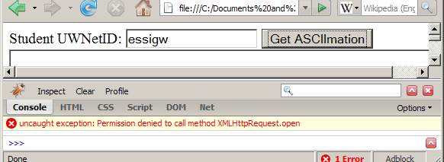
Security restrictions
Ajax must be run on a web page stored on a web server
(cannot be run from a web page stored on your hard drive)
Ajax can only fetch files from the same server that the page is on
http://www.foo.com/a/b/c.html can only fetch from http://www.foo.com

Slide 12
Node.js
We will be using node.js to run our server code (The code that generates what your fetch requests get)
Download node.js: https://nodejs.org/en/
Double click on the downloaded file and follow the instructions to install it.

Slide 13
Running node.js
You will need a command line to run node.js
Window: you can use the built in command prompt, PowerShell (recommended), or download a command line like Cygwin
Mac: there is a nice built in command line. Just search for "console"
Linux: there is a nice built in command line

Slide 14
Testing that node is installed
Open up your command line and type the following:
node -v
The version number of node on your machine should be output. If nothing is output or if there is an error node didn't install correctly.

Slide 15
Installing Express
Run the following to install Express:
npm install express

Slide 16
Node server
Copy the following code into a file and name it server1.js
// CSC 337 hello world server
const express = require("express");
const app = express();
app.use(express.static('public'));
app.get('/', function (req, res) {
res.header("Access-Control-Allow-Origin", "*");
res.send('Hello World!');
})
app.listen(3000);

Slide 17
Running the node.js server
You will need to navigate to the directory containing the file you created from the code on the last slide. To move between directories you can use:
cd <directory>
cd will move you into the directory specified. If you want to move into the parent directory, use .. as the directory name.
If you want to see what directories exists in the directory you are in use ls to list them

Slide 18
Running the node.js server
Once you have gotten to the directory that contains your server code, you can run it with the following command:
node service1.js
You will not see anything appear on the command line. To see it running open your browser and type the following in the address bar:
http://localhost:3000/

Slide 19
Writing code to fetch from the server
Write HTML and JavaScript to, when a button on the page is clicked, fetch data from the web server and inject that data into the page.

