Slide 1
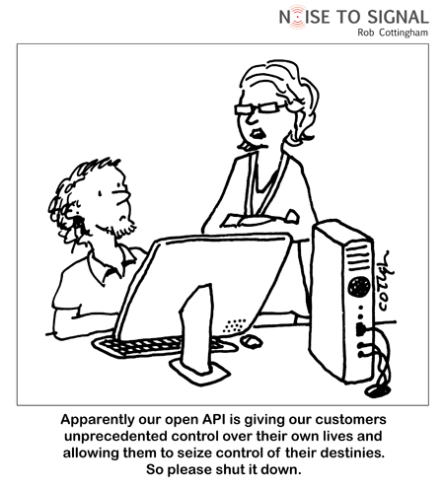
CSc 337
Lecture 13: JSON

Slide 2
The old standard: XML
<?xml version="1.0" encoding="UTF-8"?>
<note private="true">
<from>Alice Smith (alice@example.com)</from>
<to>Robert Jones (roberto@example.com)</to>
<to>Charles Dodd (cdodd@example.com)</to>
<subject>Tomorrow's "Birthday Bash" event!</subject>
<message language="english">
Hey guys, don't forget to call me this weekend!
</message>
</note> XML
fairly simple to read and understand
can be parsed by JavaScript code using XML DOM
Is there any other data format that is more natural for JS code to process?

Slide 3
Pros and cons of XML
pro:
standard open format; don't have to "reinvent the wheel" for storing new types of data
can represent almost any general kind of data (record, list, tree)
easy to read (for humans and computers)
lots of tools exist for working with XML in many languages
con:
bulky syntax/structure makes files large; can decrease performance (example)
can be hard to "shoehorn" data into a good XML format
JavaScript code to navigate the XML DOM is bulky and generally not fun

Slide 4
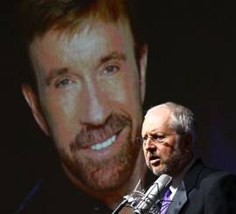
JavaScript Object Notation (JSON)
JavaScript Object Notation (JSON): Data format that represents data as a set of JavaScript objects
invented by JS guru Douglas Crockford of Yahoo!
natively supported by all modern browsers (and libraries to support it in old ones)
not yet as popular as XML, but steadily rising due to its simplicity and ease of use

Slide 5
Background: Creating a new object
var name = {
fieldName: value,
...
fieldName: value
}; JS
var pt = {
x: 4,
y: 3
};
pt.z = -1;
alert("(" + pt.x + ", " + pt.y + ", " + pt.z + ")"); // (4, 3, -1)
in JavaScript, you can create a new object without creating a class
you can add properties to any object even after it is created (z)

Slide 6
More about JavaScript object syntax
var person = {
name: "Philip J. Fry", // string
age: 23, // number
"weight": 172.5, // number
friends: ["Farnsworth", "Hermes", "Zoidberg"], // array
getBeloved: function() { return this.name + " loves Leela"; }
};
alert(person.age); // 23
alert(person["weight"]); // 172.5
alert(person.friends[2])); // Zoidberg
alert(person.getBeloved()); // Philip J. Fry loves Leela
an object can have methods (function properties) that refer to itself as this
can refer to the fields with .fieldName or ["fieldName"] syntax
field names can optionally be put in quotes (e.g. weight above)

Slide 7
Repeated: Example XML data
<?xml version="1.0" encoding="UTF-8"?>
<note private="true">
<from>Alice Smith (alice@example.com)</from>
<to>Robert Jones (roberto@example.com)</to>
<to>Charles Dodd (cdodd@example.com)</to>
<subject>Tomorrow's "Birthday Bash" event!</subject>
<message language="english">
Hey guys, don't forget to call me this weekend!
</message>
</note> XML
Could we express this message data as a JavaScript object?
Each attribute and tag could become a property or sub-object within the overall message object

Slide 8
The equivalant JSON data
{
"private": "true",
"from": "Alice Smith (alice@example.com)",
"to": [
"Robert Jones (roberto@example.com)",
"Charles Dodd (cdodd@example.com)"
],
"subject": "Tomorrow's \"Birthday Bash\" event!",
"message": {
"language": "english",
"text": "Hey guys, don't forget to call me this weekend!"
}
} JSON

Slide 9
Valid JSON
var student = { // no variable assignment
"first_name": 'Bart', // strings must be double-quoted
'last_name': "Simpson", // property names must be quoted
"birthdate": new Date("April 1, 1983"), // Date objects not supported
"enroll": function() { // Functions not supported
this.enrolled = true;
}
}; JSON
JSON has a few rules that differ from regular JS:
Strings must be quoted (in JS, single- or double-quoted are allowed)
All property/field names must be quoted
Unsupported types: Function, Date, RegExp, Error
All others supported: Number, String, Boolean, Array, Object, null
Numerous validators/formatters available: JSONLint, JSON Formatter & Validator, Free Formatter, JSON Validator

Slide 10
Browser JSON methods
method | description
JSON.parse(string) | converts the given string of JSON data into an equivalent JavaScript object and returns it
JSON.stringify(object) | converts the given object into a string of JSON data (the opposite of JSON.parse)
you can use Ajax to fetch data that is in JSON format
then call JSON.parse on it to convert it into an object
then interact with that object as you would with any other JavaScript object

Slide 11
JSON expressions exercise
Given the JSON data at right, what expressions would produce:
The window's title? (use the Console)
The image's third coordinate?
The number of messages?
The y-offset of the last message?
var data = JSON.parse(this.responseText);
{
"window": {
"title": "Sample Widget",
"width": 500,
"height": 500
},
"image": {
"src": "images/logo.png",
"coords": [250, 150, 350, 400],
"alignment": "center"
},
"messages": [
{"text": "Save", "offset": [10, 20]},
{"text": "Help", "offset": [ 0, 50]},
{"text": "Quit", "offset": [30, 15]}
],
"debug": "true"
} JSON
var title = data.window.title;
var coord = data.image.coords[2];
var len = data.messages.length;
var y = data.messages[len - 1].offset[1];

Slide 12
JSON example: Books
Suppose we have a service books_json.php about library books.
If no query parameters are passed, it outputs a list of book categories:
{ "categories": ["computers", "cooking", "finance", ...] } JSON
Supply a category query parameter to see all books in one category: http://allisonobourn.com/examples/books_json.php?category=cooking
{
"books": [
{"category": "cooking", "year": 2009, "price": 22.00,
"title": "Breakfast for Dinner", "author": "Amanda Camp"},
{"category": "cooking", "year": 2010, "price": 75.00,
"title": "21 Burgers for the 21st Century", "author": "Stuart Reges"},
...
]
} JSON

Slide 13
Parameters
Values you pass to a web service to specify what you want it to give back
Parameters have names and values
Syntax:
<url>?<name>=<value>&<name>=<value> …
Example:
www.allisonobourn.com/examples/books_json.php?category=cooking

Slide 14
JSON exercise
Write a page that processes this JSON book data.
Initially the page lets the user choose a category, created from the JSON data.
After choosing a category, the list of books in it appears:
Books in category "Cooking":
Breakfast for Dinner, by Amanda Camp (2009)
21 Burgers for the 21st Century, by Stuart Reges (2010)
The Four Food Groups of Chocolate, by Victoria Kirst (2005)

Slide 15
Working with JSON book data - solution
function showBooks() {
// add all books from the JSON data to the page's bulleted list
var data = JSON.parse(this.responseText);
for (var i = 0; i < data.books.length; i++) {
var li = document.createElement("li");
li.innerHTML = data.books[i].title + ", by " +
data.books[i].author + " (" + data.books[i].year + ")";
document.getElementById("books").appendChild(li);
}
} JS

Slide 16
Bad style: the eval function
// var data = JSON.parse(this.responseText);
var data = eval(this.responseText); // don't do this!
... JS
JavaScript includes an eval keyword that takes a string and runs it as code
this is essentially the same as what JSON.parse does,
but JSON.parse filters out potentially dangerous code; eval doesn't
eval is evil and should not be used!

