Slide 1
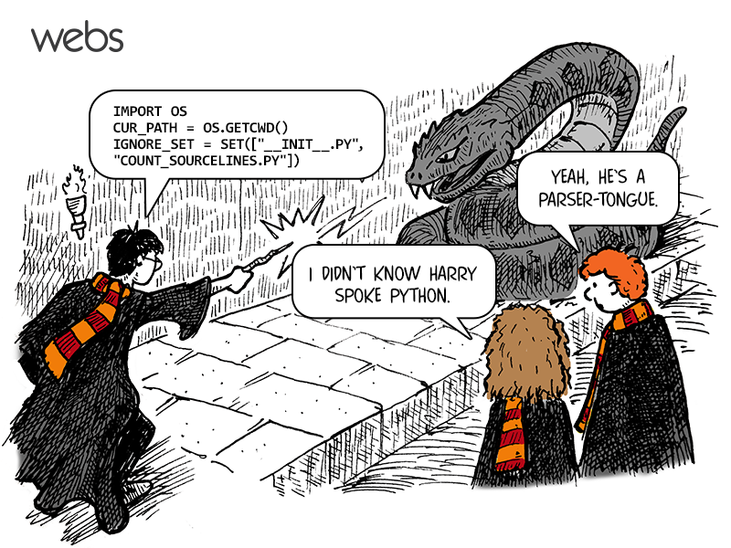
CSc 110, Spring 2018
Lecture 2: Functions

Slide 2
Escape sequences
escape sequence: A special sequence of characters used to represent certain special characters in a string.
  \t tab character
  \n new line character
  \" quotation mark character
  \' quotation mark character
  \\ backslash character
  Example:
  print("\\hello\nhow\tare \"you\"?\\\\")
  Output:
  \hello
  how are "you"?\\

Slide 3
Questions
What is the output of the following print statements?
  print("\ta\tb\tc")
  print("\\\\")
  print("'")
  print("\"\"\"")
  print("C:\nin\the downward spiral")
Write a print statement to produce this output:
  / \ // \\ /// \\\

Slide 4
Answers
Output of each print statement:
  a b c
  \\
  '
  """
  C:
  in he downward spiral
print statement to produce the line of output:
  print("/ \\ // \\\\ /// \\\\\\")

Slide 5
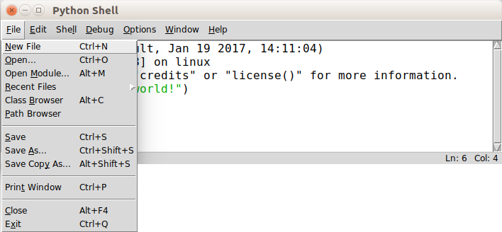
Creating a Python Program File

Slide 6
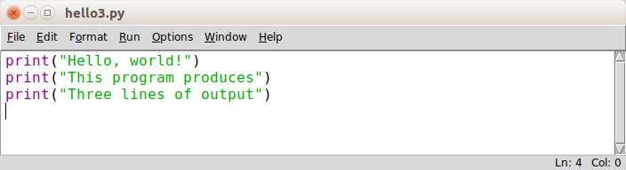
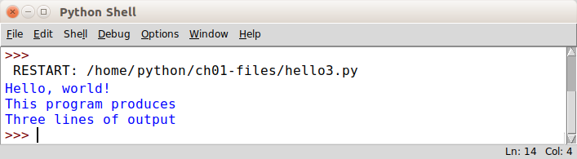
Creating a Python Program File
When Run -> Run Module is selected:

Slide 7
Comments
comment: A note written in source code by the programmer to describe or clarify the code.
  Comments are not executed when your program runs.
Syntax:
# comment text
Examples:
  # This is a one-line comment.
  # This is a very long
  # multi-line comment.

Slide 8
Comments example
# Suzy Student,
# CSc 110, Fall 2019
# Displays lyrics
# first line
print("When I first got into magic")
print("it was an underground phenomenon")
print()
# second line
print("Now everybody's like")
print("pick a card, any card")

Slide 9
functions

Slide 10
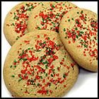
Algorithms
algorithm: A list of steps for solving a problem.
Example algorithm: "Bake sugar cookies"
  Mix the dry ingredients.
  Cream the butter and sugar.
  Beat in the eggs.
  Stir in the dry ingredients.
  Set the oven temperature.
  Set the timer for 10 minutes.
  Place the cookies into the oven.
  Allow the cookies to bake.
  Spread frosting and sprinkles onto the cookies.
  ...

Slide 11
Problems with algorithms
lack of structure: Many steps; tough to follow.
redundancy: Consider making a double batch...
  Mix the dry ingredients.
  Cream the butter and sugar.
  Beat in the eggs.
  Stir in the dry ingredients.
  Set the oven temperature.
  Set the timer for 10 minutes.
  Place the first batch of cookies into the oven.
  Allow the cookies to bake.
  Set the timer for 10 minutes.
  Place the second batch of cookies into the oven.
  Allow the cookies to bake.
  Mix ingredients for frosting.
  ...

Slide 12
Structured algorithms
structured algorithm: Split into coherent tasks.
  1 Make the batter.
  Mix the dry ingredients.
  Cream the butter and sugar.
  Beat in the eggs.
  Stir in the dry ingredients.
  2 Bake the cookies.
  Set the oven temperature.
  Set the timer for 10 minutes.
  Place the cookies into the oven.
  Allow the cookies to bake.
  3 Decorate the cookies.
  Mix the ingredients for the frosting.
  Spread frosting and sprinkles onto the cookies.
  ...

Slide 13
Removing redundancy
A well-structured algorithm can describe repeated tasks with less redundancy.
  1 Make the cookie batter.
  Mix the dry ingredients.
  ...
  2a Bake the cookies (first batch).
  Set the oven temperature.
  Set the timer for 10 minutes.
  ...
  2b Bake the cookies (second batch).
  Repeat Step 2a
  3 Decorate the cookies.
  ...

Slide 14
functions
function: A named group of statements.
    denotes the structure of a program
    eliminates redundancy by code reuse
  procedural decomposition:
  dividing a problem into functions
Writing a function is like adding
a new command to Python.
Function A
  statement
  statement
  statement
Function B
  statement
  statement
Function C
  statement
  statement
  statement

Slide 15
Declaring a function
Gives your function a name so it can be executed
Syntax:
def name():
statement
statement
...
statement
Example:
def print_warning():
print("This product causes cancer")
print("in lab rats and humans.")

Slide 16
Calling a function
Executes the function’s code
Syntax:
  name()
  You can call the same function many times if you like.
Example:
  print_warning() #separate multiple words with underscores
  Output:
  This product causes cancer
  in lab rats and humans.

Slide 17
Using functions
1. Design (think about) the algorithm.
  Look at the structure, and which commands are repeated.
  Decide what are the important overall tasks.
2. Declare (write down) the functions.
  Arrange statements into groups and give each group a name.
3. Call (run) the function.

Slide 18
Program with functions
rap() # Calling (running) the rap function
print()
rap() # Calling the rap function again
# This function prints the lyrics to my favorite song.
def rap():
print("Now this is the story all about how")
print("My life got flipped turned upside-down")
Output:
Now this is the story all about how
My life got flipped turned upside-down
Now this is the story all about how
My life got flipped turned upside-down

Slide 19
Functions calling functions
  def message1():
  print("This is message1.")
  def message2():
  print("This is message2.")
  message1()
  print("Done with message2.")
  message1()
  message2()
  print("Done with everything.")
Output:
  This is message1.
  This is message2.
  This is message1.
  Done with message2.
  Done with main.

Slide 20
Control flow
When a function is called, the program's execution...
  "jumps" into that function, executing its statements, then
  "jumps" back to the point where the function was called.
message1()
message2()
print("Done with main.")
...
def message1():
print("This is message1.")
def message2():
print("This is message2.")
message1()
print("Done with message2.")
def message1():
print("This is message1.")

Slide 21
Structure of a program
No code should be placed outside a function. Instead use a main function.
  The one exception is a call to your main function
  def main():
  message1()
  message2()
  print("Done with everything.")
  def message1():
  print("This is message1.")
  def message2():
  print("This is message2.")
  message1()
  print("Done with message2.")
  main()

Slide 22
When to use functions (besides main)
Place statements into a function if:
  The statements are related structurally, and/or
  The statements are repeated.
You should not create functions for:
  An individual print statement.
  Only blank lines.
  Unrelated or weakly related statements.
  (Consider splitting them into two smaller functions.)

Slide 23
Drawing complex figures with functions

Slide 24
Functions question
Write a program to print these figures using functions.
  ______
  / \
  / \
  \ /
  \______/
  \ /
  \______/
  +--------+
  ______
  / \
  / \
  | STOP |
  \ /
  \______/
  ______
  / \
  / \
  +--------+

Slide 25
Development strategy
  ______
  / \
  / \
  \ /
  \______/
  \ /
  \______/
  +--------+
  ______
  / \
  / \
  | STOP |
  \ /
  \______/
  ______
  / \
  / \
  +--------+
First version (unstructured):
Create an empty program.
Copy the expected output into it, surrounding each line with print syntax.
Run it to verify the output.

Slide 26
Program version 1
def main():
  print(" ______")
  print(" / \\")
  print("/ \\")
  print("\\ /")
  print(" \\______/")
  print()
  print("\\ /")
  print(" \\______/")
  print("+--------+")
  print()
  print(" ______")
  print(" / \\")
  print("/ \\")
  print("| STOP |")
  print("\\ /")
  print(" \\______/")
  print()
  print(" ______")
  print(" / \\")
  print("/ \\")
  print("+--------+")
  main()

Slide 27
Development strategy 2
  ______
  / \
  / \
  \ /
  \______/
  \ /
  \______/
  +--------+
  ______
  / \
  / \
  | STOP |
  \ /
  \______/
  ______
  / \
  / \
  +--------+
Second version (structured, with redundancy):
Identify the structure of the output.
Divide the code into functions based on this structure.

Slide 28
Output structure
  ______
  / \
  / \
  \ /
  \______/
  \ /
  \______/
  +--------+
  ______
  / \
  / \
  | STOP |
  \ /
  \______/
  ______
  / \
  / \
  +--------+
The structure of the output:
initial "egg" figure
second "teacup" figure
third "stop sign" figure
fourth "hat" figure
This structure can be represented by functions:
egg
tea_cup
stop_sign
hat

Slide 29
Program version 2
def main():
egg()
tea_cup()
stop_sign()
hat()
def egg():
print(" ______")
print(" / \\")
print("/ \\")
print("\\ /")
print(" \\______/")
print()
def tea_cup():
print("\\ /")
print(" \\______/")
print("+--------+")
print()
def stop_sign():
print(" ______")
print(" / \\")
print("/ \\")
print("| STOP |")
print("\\ /")
print(" \\______/")
print()
def hat():
print(" ______")
print(" / \\")
print("/ \\")
print("+--------+")

Slide 30
Development strategy 3
  ______
  / \
  / \
  \ /
  \______/
  \ /
  \______/
  +--------+
  ______
  / \
  / \
  | STOP |
  \ /
  \______/
  ______
  / \
  / \
  +--------+
Third version (structured, without redundancy):
Identify redundancy in the output, and create functions to eliminate as much as possible.
Add comments to the program.

Slide 31
Output redundancy
  ______
  / \
  / \
  \ /
  \______/
  \ /
  \______/
  +--------+
  ______
  / \
  /
  | STOP |
  \ /
  \______/
  ______
  / \
  / \
  +--------+
The redundancy in the output:
egg top: reused on stop sign, hat
egg bottom: reused on teacup, stop sign
divider line: used on teacup, hat
This redundancy can be fixed by functions:
egg_top
egg_bottom
line

Slide 32
Program version 3
# Draws a teacup figure.
def tea_cup():
egg_bottom()
line()
print()
# Draws a stop sign figure.
def stop_sign():
eggTop()
print("| STOP |")
egg_bottom()
print()
# Draws a figure that looks sort of like a hat.
def hat():
egg_top()
line()
# Draws a line of dashes.
def line():
print("+--------+")
# Suzy Student, CSc 110, Spring 2094
# Prints several figures, with methods for structure and redundancy.
def main():
egg()
tea_cup()
stop_sign()
hat()
# Draws the top half of an an egg figure.
def egg_top():
print(" ______")
print(" / \\")
print("/ \\")
# Draws the bottom half of an egg figure.
def egg_bottom():
print("\\ /")
print(" \\______/")
# Draws a complete egg figure.
def egg():
egg_top()
egg_bottom()
print()

