Slide 1
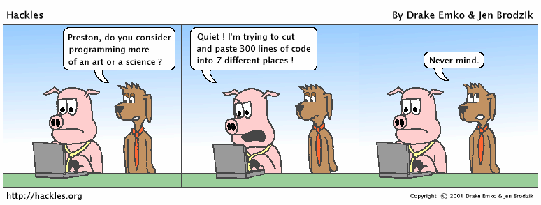
CSc 110, Spring 2018
Lecture 4: Expressions and Variables
Notes:
1

Slide 2
Data and expressions
Notes:
2

Slide 3
Data types
Internally, computers store everything as 1s and 0s
  104 → 01101000
  'hi' → 0110100001101001
  'h' → 01101000
How are h and 104 differentiated?
type: A category or set of data values.
  Constrains the operations that can be performed on data
  Many languages ask the programmer to specify types
  Examples: integer, real number, string

Slide 4
Python's number types
  Name Description Examples
  int integers 42, -3, 0, 926394
  float real numbers 3.1, -0.25
  complex
Notes:
4

Slide 5
Expressions
expression: A value or operation that computes a value.
  Examples: 1 + 4 * 5
  (7 + 2) * 6 / 3
  42.0
  The simplest expression is a literal value.
  A complex expression can use operators and parentheses.

Slide 6
Arithmetic operators
operator: Combines multiple values or expressions.
  + addition
  - subtraction (or negation)
  * multiplication
  / division
  // integer division (a.k.a. leave off any remainder)
  % modulus (a.k.a. remainder)
  ** exponent
As a program runs, its expressions are evaluated.
  1 + 1 evaluates to 2

Slide 7
Integer division with //
When we divide integers with //, the quotient is also an integer.
  14 // 4 is 3, not 3.5
3 4 52
4 ) 14 10 ) 45 27 ) 1425
12 40 135
2 5 75
54
21
More examples:
  32 // 5 is 6
  84 // 10 is 8
  156 // 100 is 1
  Dividing by 0 causes an error when your program runs.

Slide 8
Integer remainder with %
What is the result?
45 % 6
2 % 2
8 % 20
11 % 0
The % operator computes the remainder from integer division.
  14 % 4 is 2
  218 % 5 is 3
  3 43
  4 ) 14 5 ) 218
  12 20
  2 18
  15
  3
Applications of % operator:
  Obtain last digit of a number: 230857 % 10 is 7
  Obtain last 4 digits: 658236489 % 10000 is 6489
  See whether a number is odd: 7 % 2 is 1, 42 % 2 is 0
Notes:
8

Slide 9
Precedence
precedence: Order in which operators are evaluated.
  Generally operators evaluate left-to-right.
  1 - 2 - 3 is (1 - 2) - 3 which is -4
  But * / // % have a higher level of precedence than + -
  1 + 3 * 4 is 13
  6 + 8 // 2 * 3
  6 + 4 * 3
  6 + 12 is 18
  Parentheses can force a certain order of evaluation:
  (1 + 3) * 4 is 16
  Spacing does not affect order of evaluation
  1+3 * 4-2 is 11

Slide 10
Precedence examples
1 * 2.0 + 3 * 5 % 4
\_/
|
2.0 + 3 * 5 % 4
\_/
|
2.0 + 15 % 4
\___/
|
2.0 + 3
\________/
|
5.0
1 + 8 % 3 * 2 - 9
\_/
|
1 + 2 * 2 - 9
\___/
|
1 + 4 - 9
\______/
|
5 - 9
\_________/
|
-4

Slide 11
Precedence questions
What values result from the following expressions?
  9 // 5
  695 % 20
  7 + 6 * 5
  7 * 6 + 5
  248 % 100 / 5
  6 * 3 - 9 // 4
  (5 - 7) * 2 ** 2
  6 + (18 % (17 - 12))
Notes:
11
Answers:
1
15
37
47
9
16
-8
9

Slide 12
Variables
Notes:
12

Slide 13
Receipt example
What's bad about the following code?
# Calculate total owed, assuming 8% tax / 15% tip
print("Subtotal:")
print(38 + 40 + 30)
print("Tax:")
print((38 + 40 + 30) * .08)
print("Tip:")
print((38 + 40 + 30) * .15)
print("Total:")
print(38 + 40 + 30 + (38 + 40 + 30) * .15 + (38 + 40 + 30) * .08)
  The subtotal expression (38 + 40 + 30) is repeated
  So many print statements

Slide 14

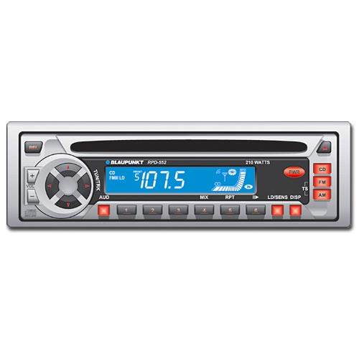
Variables
variable: A piece of the computer's memory that is given a name and type, and can store a value.
  Like preset stations on a car stereo, or cell phone speed dial:
  Steps for using a variable:
    Declare/initialize it - state its name and type and store a value into it
    Use it - print it or use it as part of an expression
Notes:
14

Slide 15
Declaration and assignment
variable declaration and assignment:
Sets aside memory for storing a value and stores a value into a variable.
  Variables must be declared before they can be used.
  The value can be an expression; the variable stores its result.
Syntax:
  name = expression
  zipcode = 90210
  myGPA = 1.0 + 2.25
zipcode | 90210
myGPA | 3.25

Slide 16
Using variables
Once given a value, a variable can be used in expressions:
  x = 3 # x is 3
  y = 5 * x - 1 # now y is 14
You can assign a value more than once:
  x = 3 # 3 here
  x = 4 + 7 # now x is 11
x | 3
x | 11

Slide 17
Assignment and algebra
Assignment uses = , but it is not an algebraic equation.
  = means, "store the value at right in variable at left"
    The right side expression is evaluated first,
    and then its result is stored in the variable at left.
What happens here?
  x = 3
  x = x + 2 # ???
x | 3
x | 5
Notes:
17

Slide 18
Receipt question
Improve the receipt program using variables.
def main():
  # Calculate total owed, assuming 8% tax / 15% tip
  print("Subtotal:")
  print(38 + 40 + 30)
  print("Tax:")
  print((38 + 40 + 30) * .08)
  print("Tip:")
  print((38 + 40 + 30) * .15)
  print("Total:")
  print(38 + 40 + 30 + (38 + 40 + 30) * .15 + (38 + 40 + 30) * .08)

Slide 19
Printing a variable's value
Use a comma to print a string and a variable's value on one line.
  grade = (95.1 + 71.9 + 82.6) / 3.0
  print("Your grade was", grade)
  students = 11 + 17 + 4 + 19 + 14
  print("There are", students,
  "students in the course.")
  Output:
  Your grade was 83.2
  There are 65 students in the course.

Slide 20
Receipt answer
def main():
  # Calculate total owed, assuming 8% tax / 15% tip
  subtotal = 38 + 40 + 30 # int
  tax = subtotal * .08 # float
  tip = subtotal * .15 # float
  total = subtotal + tax + tip # float
  print("Subtotal:", subtotal)
  print("Tax:", tax)
  print("Tip:", tip)
  print("Total:", total)

