Slide 1
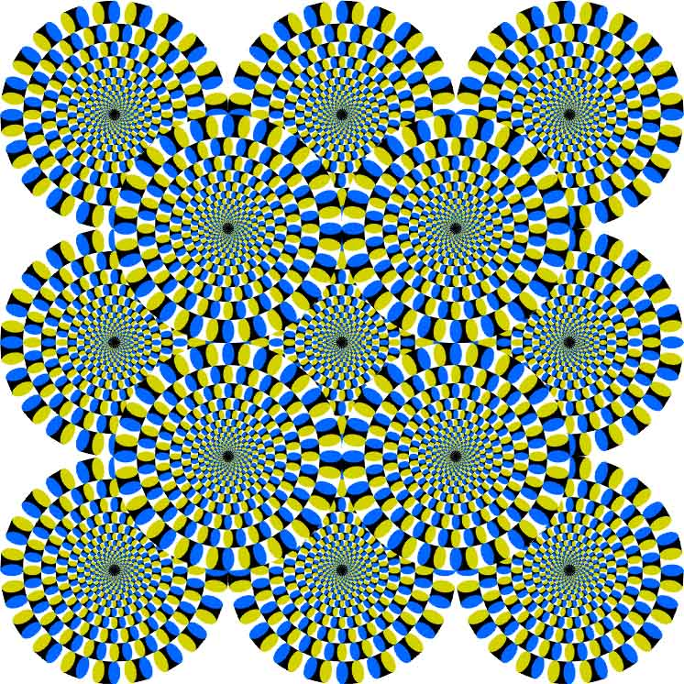
CSc 110, Spring 2018
Lecture 9: Parameters, Graphics and Random
Adapted from slides by Marty Stepp and Stuart Reges

Slide 2
Exercise: multiple parameters
def main():
print_number(4, 9)
print_number(17, 6)
print_number(8, 0)
print_number(0, 8)
def print_number(number, count):
for i in range(0, count):
print(number, end="")
print()
What does this output?

Slide 3
Value semantics
value semantics: When numbers and strings are passed as parameters, their values are copied.
  Modifying the parameter will not affect the variable passed in.
  def strange(x):
  x = x + 1
  print("1. x = ", x)
  def main():
  x = 23
  strange(x)
  print("2. x = ", x)
  ...
Output:
1. x = 24
2. x = 23

Slide 4
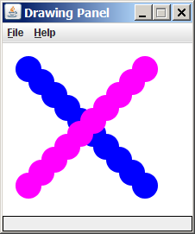
Graphical objects
We will draw graphics in Python using a new kind of object:
DrawingPanel: A window on the screen.
  Not part of Python; provided by the instructor. See class web site.

Slide 5
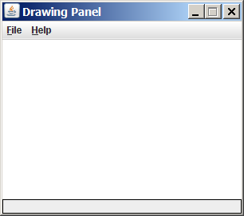
DrawingPanel
To create a window:
  <name> = DrawingPanel(<width>, <height>)
  <name> = DrawingPanel(<width>, <height>, background="color")
  Example:
  panel = DrawingPanel(300, 200)
The window has nothing on it.
  We can draw shapes and
  lines on it.
If passed the optional third parameter
it will have a background color

Slide 6
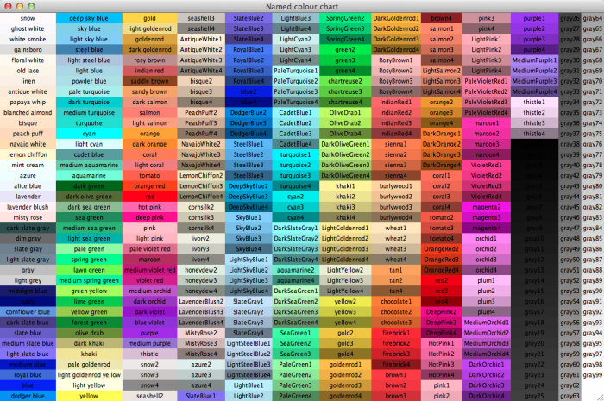
Named colors
Chart credit Smith.edu

Slide 7
Custom colors
You can construct custom colors using hex.
  # followed by six numbers 0 – 9 and letters A – F
    A is 10, B is 11 and so on
    #000000 is black
    #FFFFFF is white
    Colors get darker as the number gets lower
    The first two digits are the amount of red, the next two green, the last two blue
  panel = DrawingPanel(80, 50, background="#3367D3")

Slide 8
Drawing shapes
Function name | Description
p.draw_line(x1, y1, x2, y2) | line between points (x1, y1), (x2, y2)
p.draw_oval(x, y, width, height) | outline largest oval that fits in a box of size width * height with top-left at (x, y)
p.draw_rect(x, y, width, height) | outline of rectangle of size width * height with top-left at (x, y)
p.draw_string("text", x, y) | text with upper-left at (x, y)
p.fill_oval(x, y, width, height) | fill largest oval that fits in a box of size width * height with top-left at (x,y)
p.fill_rect(x, y, width, height) | fill rectangle of size width * height with top-left at (x, y)
p.set_color("color") | set the default color to "color"
You can pass an additional "color" to any shape as a last parameter
  p.draw_rect(50, 100, 60, 60, "red")

Slide 9
Coordinate system
Each (x, y) position is a pixel ("picture element").
(0, 0) is at the window's top-left corner.
  x increases rightward and the y increases downward.
The rectangle from (0, 0) to (200, 100) looks like this:
  (0, 0) x+
  (200, 100)
  y+

Slide 10
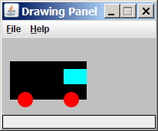
Superimposing shapes
When two shapes occupy the same pixels, the last one drawn is seen.
from DrawingPanel import *
def main():
p = DrawingPanel(200, 100, background="light gray")
p.fill_rect(10, 30, 100, 50, "black")
p.fill_oval(20, 70, 20, 20, "red")
p.fill_oval(80, 70, 20, 20, "red")
p.fill_rect(80, 40, 30, 20, "cyan")

Slide 11
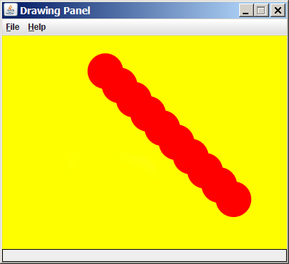
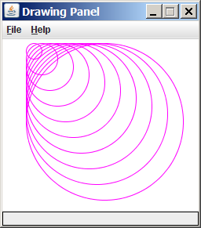
Drawing with loops
The x1, y1, w, h expression can contain the loop counter, i.
  panel = DrawingPanel(400, 300, background="yellow")
  for i in range(1, 11):
  panel.fill_oval (100 + 20 * i, 5 + 20 * i,
  50, 50, "red")
  panel = DrawingPanel(250, 220)
  for i in range(1, 11):
  panel.draw_oval (30, 5, 20 * i, 20 * i, "magenta")

Slide 12
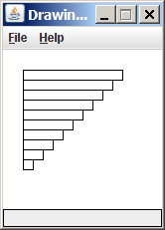
Loops that begin at 0
Beginning a loop at 0 and using < can make coordinates easier to compute.
Example:
  Draw ten stacked rectangles starting at (20, 20), height 10, width starting at 100 and decreasing by 10 each time:
  panel = DrawingPanel(160, 160)
  for i in range(10):
  panel.draw_rect(20, 20 + 10 * i, 100 – 10 * i, 10)

Slide 13
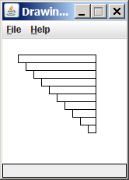
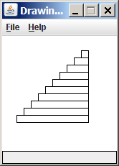
Drawing w/ loops questions
  panel = DrawingPanel(160, 160)
  for i in range(0, 10):
  panel.draw_rectangle (20, 20 + 10 * i,
  100 – 10 * i, 10)
Write variations of the above
program that draw the figures
at right as output.

Slide 14
Drawing w/ loops answers
Solution #1:
  panel = DrawingPanel(160, 160)
  for i in range(0, 10):
  panel.draw_rectangle (20 + 10 * i, 20 + 10 * i,
  100 - 10 * i, 10)
Solution #2:
  panel = DrawingPanel(160, 160)
  for i in range(0, 10):
  panel.draw_rect(110 - 10 * i, 20 + 10 * i,
  10 + 10 * i, 10)

Slide 15
Drawing with functions
To draw in multiple functions, you must pass DrawingPanel.
def main():
panel = DrawingPanel(200, 100, background="light gray")
draw_car(panel)
def draw_car(p):
p.fill_rect(10, 30, 100, 50, "black")
p.fill_oval(20, 70, 20, 20, "red")
p.fill_oval(80, 70, 20, 20, "red")
p.fill_rect(80, 40, 30, 20, "cyan")

Slide 16
Pseudo-Randomness
Computers generate numbers in a predictable way using a mathematical formula
Parameters may include current time, mouse position
  In practice, hard to predict or replicate
True randomness uses natural processes
  Atmospheric noise (http://www.random.org/)
  Lava lamps (patent #5732138)
  Radioactive decay

Slide 17
Random
Method name | Description
random.random() | returns a random float in the range [0, 1) in other words, 0 inclusive to 1 exclusive
random.randint(min, max) | returns a random integer in the range [min, max) in other words, min to max-1 inclusive
random generates pseudo-random numbers.
  random can be accessed by including the following statement:
  import random
  Example:
  import random
  random_number = random.randint(1, 10) # 1-9

Slide 18
Generating random numbers
To get a number in arbitrary range [min, max] inclusive:
  random.randint(min, max)
    Where size of range is (max – min + 1)
  Example: A random integer between 4 and 10 inclusive:
  n = random.randint(4, 10)

