Slide 1
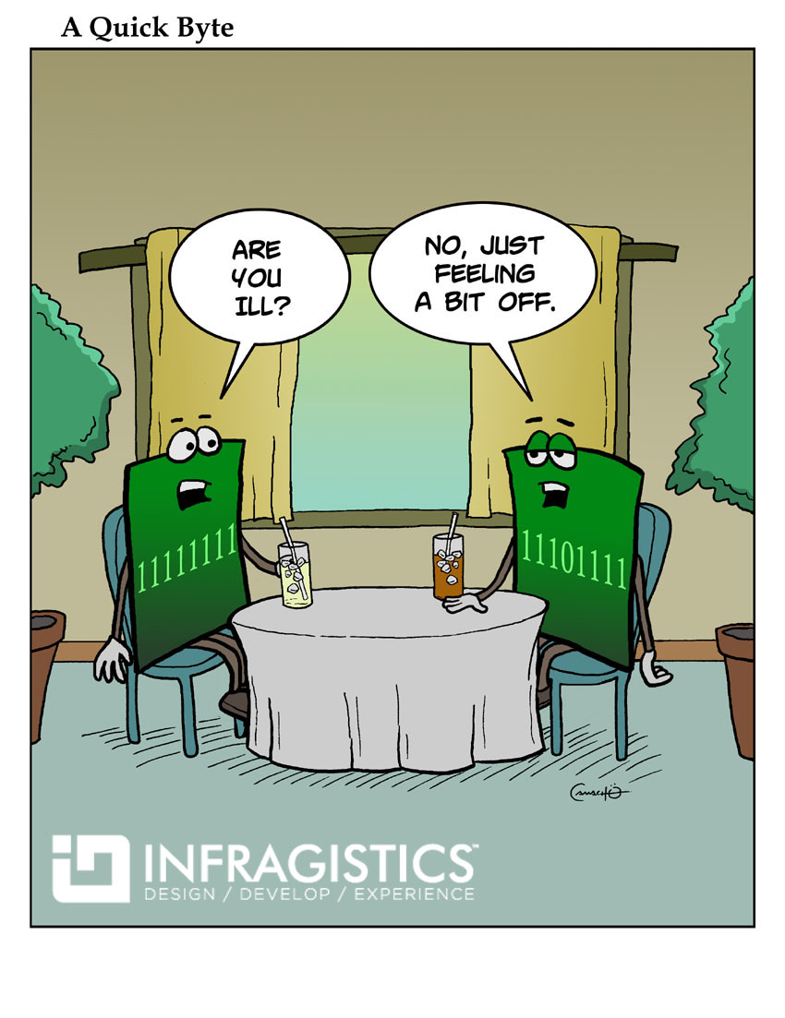
CSc 110, Spring 2018
Lecture 10: More Graphics
Adapted from slides by Marty Stepp and Stuart Reges

Slide 2
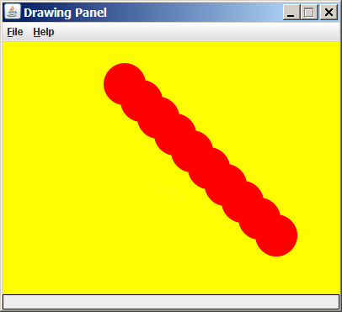
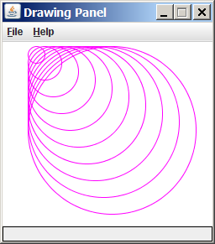
Drawing with loops
The x1, y1, w, h expression can contain the loop counter, i.
panel = DrawingPanel(400, 300, background="yellow")
for i in range(1, 11):
panel.fill_oval (100 + 20 * i, 5 + 20 * i,
50, 50, "red")
panel = DrawingPanel(250, 220)
for i in range(1, 11):
panel.draw_oval (30, 5, 20 * i, 20 * i, "magenta")

Slide 3
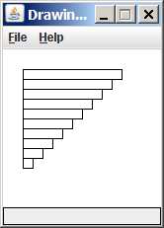
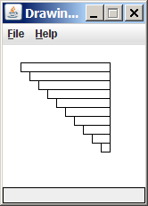
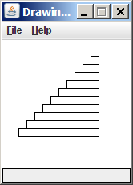
Drawing w/ loops questions
panel = DrawingPanel(160, 160)
for i in range(0, 10):
panel.draw_rectangle (20, 20 + 10 * i,
100 – 10 * i, 10)
Write variations of the above program that draw the figures at right as output.

Slide 4
Drawing w/ loops answers
Solution #1:
panel = DrawingPanel(160, 160)
for i in range(0, 10):
panel.draw_rectangle (20 + 10 * i, 20 + 10 * i,
100 - 10 * i, 10)
Solution #2:
panel = DrawingPanel(160, 160)
for i in range(0, 10):
panel.draw_rect(110 - 10 * i, 20 + 10 * i,
10 + 10 * i, 10)

Slide 5
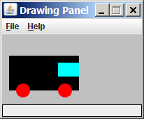
Drawing with functions
To draw in multiple functions, you must pass DrawingPanel.
def main():
panel = DrawingPanel(200, 100, background="light gray")
draw_car(panel)
def draw_car(p):
p.fill_rect(10, 30, 100, 50, "black")
p.fill_oval(20, 70, 20, 20, "red")
p.fill_oval(80, 70, 20, 20, "red")
p.fill_rect(80, 40, 30, 20, "cyan")

Slide 6
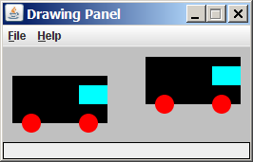
Parameterized figures
Modify the car-drawing function so that it can draw many cars, such as in the following image.
Top-left corners: (10, 30), (150, 10)
Hint: We must modify our draw_car function to accept x/y coordinates as parameters.

Slide 7
Parameterized answer
def main():
panel = DrawingPanel(260, 100, background="light gray")
draw_car(panel, 10, 30)
draw_car(panel, 150, 10)
def draw_car(p, x, y):
p.fill_rect(x, y, 100, 50, "black")
p.fill_oval(x + 10, y + 40, 20, 20, "red")
p.fill_oval(x + 70, y + 40, 20, 20, "red")
p.fill_rect(x + 70, y + 10, 30, 20, "cyan")

Slide 8
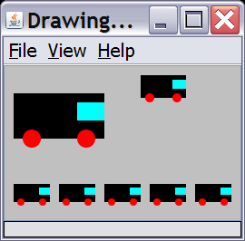
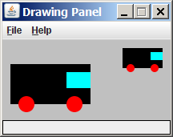
Drawing parameter question
Modify draw_car to allow the car to be drawn at any size.
Existing car: size 100. Second car: (150, 10), size 50.
Once you have this working, use a for loop with your function to draw a line of cars, like the picture at right.
Start at (10, 130), each size 40, separated by 50px.

Slide 9
Drawing parameter answer
def main():
panel = DrawingPanel(260, 100, background="light gray")
draw_car(panel, 10, 30, 100)
draw_car(panel, 150, 10, 50)
for i in range(0, 5):
draw_car(panel, 10 + i * 50, 130, 40);
def draw_car(p, x, y, size):
p.fill_rect(x, y, size, size / 2, "black")
p.fill_oval(x + size / 10, y + size / 5 * 2, size / 5, size / 5, "red")
p.fill_oval(x + size / 10 * 7, y + size / 5 * 2, size / 5, size / 5, "red")
p.fill_rect(x + size / 10 * 7, y + size / 10, size / 10 * 3, size / 5, "cyan")

Slide 10
Animation with sleep
DrawingPanel's sleep function pauses your program for a given number of milliseconds.
You can use sleep to create simple animations.
panel = DrawingPanel(250, 200)
for i in range(1, NUM_CIRCLES + 1):
panel.draw_oval(15 * i, 15 * i, 30, 30)
panel.sleep(500)
Try adding sleep commands to loops in past exercises in this chapter and watch the panel draw itself piece by piece.

