Slide 1
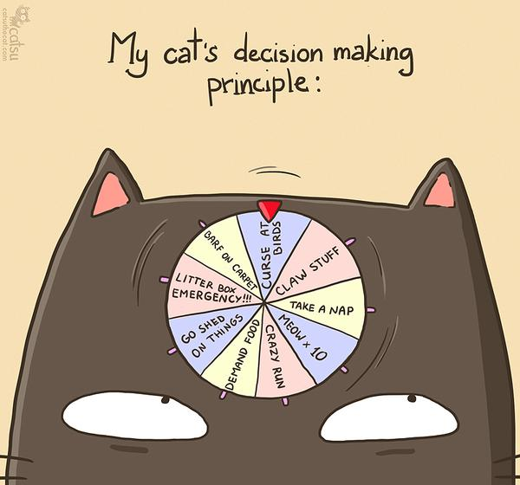
CSc 110, Spring 2018
Lecture 11: if / else
Adapted from slides by Marty Stepp and Stuart Reges

Slide 2
Exercise: what is wrong with this code?
# prints the location of a ball with an initial velocity of 25 accelerating
# due to gravity
def main():
v01 = 25
a = 9.81
for i in range(0, 60):
displacement(v0, a, t)
print(d)
def displacement(v0, a, t):
d = v0 * t + 0.5 * a * (t ** 2)
return d
main()

Slide 3
Example
If you drop two balls, which will hit the ground first?
Ball 1: height of 600m, initial velocity = 25 m/sec downward
Ball 2: height of 500m, initial velocity = 15 m/sec downward
Write a program that determines how long each ball takes to hit the ground (and draws each ball falling).
Total time is based on the force of gravity on each ball.
Acceleration due to gravity ≅ 9.81 m/s², downward
Displacement = v₀ t + ½ a t ²

Slide 4
Ball solution
# Simulates the dropping of two balls from various heights.
def main():
panel = DrawingPanel(600, 600)
ball1x = 100
ball1y = 0
v01 = 25
ball2x = 200
ball2y = 100
v02 = 15
# draw the balls at each time increment
for time in range(60):
disp1 = displacement(v01, time, 9.81)
panel.fill_oval(ball1x, ball1y + disp1, 10, 10)
disp2 = displacement(v02, time, 9.81)
panel.fill_oval(ball2x, ball2y + disp2, 10, 10)
panel.sleep(50) # pause for 50 ms
panel.fill_rect(0, 0, 600, 600, "white")
...

Slide 5
The if/else statement

Slide 6
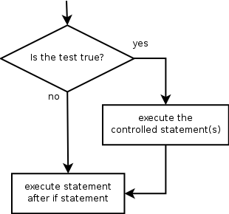
The if statement
Executes a block of statements only if a test is true
if test:
statement
...
statement
Example:
gpa = float(input("gpa? "))
if gpa >= 2.0:
print("Application accepted.")

Slide 7
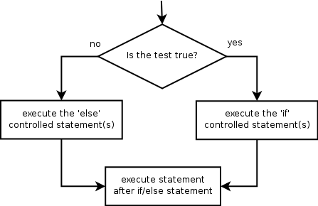
The if/else statement
Executes one block if a test is true, another if false
if test:
statement(s)
else:
statement(s)
Example:
gpa = float(input("gpa? "))
if gpa >= 2.0:
print("Welcome to Mars University!")
else:
print("Application denied.")

Slide 8
Relational expressions
if statements use logical tests.
if i <= 10: ...
These are boolean expressions
Tests use relational operators:
Operator | Meaning | Example | Value
== | equals | 1 + 1 == 2 | True
!= | does not equal | 3.2 != 2.5 | True
< | less than | 10 < 5 | False
> | greater than | 10 > 5 | True
<= | less than or equal to | 126 <= 100 | False
>= | greater than or equal to | 5.0 >= 5.0 | True
Notes:
Note that == tests equality, not = . The = is used for the assignment operator!

Slide 9
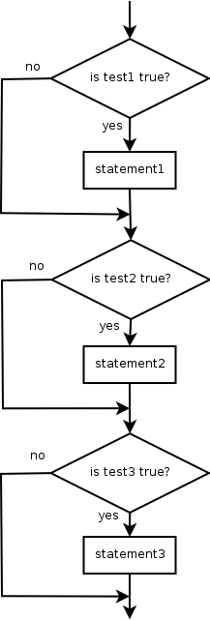
Misuse of if
What's wrong with the following code?
percent = float(input("What percentage did you earn? "))
if percent >= 90:
print("You got an A!")
if percent >= 80:
print("You got a B!")
if percent >= 70:
print("You got a C!")
if percent >= 60:
print("You got a D!")
if percent < 60:
print("You got an F!")
...

Slide 10
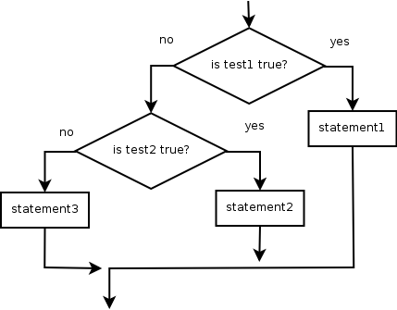
Nested if/else
Chooses between outcomes using many tests
if test:
statement(s)
elif test:
statement(s)
else:
statement(s)
Example:
if x > 0:
print("Positive")
elif x < 0:
print("Negative")
else:
print("Zero")

Slide 11
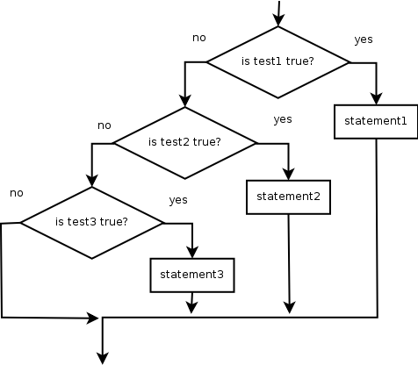
Nested if/elif/elif
If it ends with else, exactly one path must be taken.
If it ends with if, the code might not execute any path.
if test:
statement(s)
elif test:
statement(s)
elif test:
statement(s)
Example:
if place == 1:
print("Gold medal!")
elif place == 2:
print("Silver medal!")
elif place == 3:
print("Bronze medal.")

Slide 12
Nested if structures
exactly 1 path (mutually exclusive) if test: statement(s) elif test: statement(s) else: statement(s) | 0 or 1 path (mutually exclusive) if test: statement(s) elif test: statement(s) elif test: statement(s)
0, 1, or many paths (independent tests; not exclusive) if test: statement(s) if test: statement(s) if test: statement(s)

Slide 13
Which nested if/else?
(1) if/if/if (2) nested if/else (3) nested if/elif/elif
Whether a user is lower, middle, or upper-class based on income.
(2) nested if / elif / else
Whether you made the dean's list (GPA ≥ 3.8) or honor roll (3.5-3.8).
(3) nested if / elif
Whether a number is divisible by 2, 3, and/or 5.
(1) sequential if / if / if
Computing a grade of A, B, C, D, or F based on a percentage.
(2) nested if / elif / elif / elif / else

Slide 14
Nested if/else question
Write a program that produces output like the following:
This program reads data for two
people and computes their basal
metabolic rate and burn rate.
Enter next person's information:
height (in inches)? 73.5
weight (in pounds)? 230
age (in years)? 35
gender (male or female)? male
Enter next person's information:
height (in inches)? 71
weight (in pounds)? 220.5
age (in years)? 20
gender (male or female)? female
Person #1 basal metabolic rate = 2042.3
high resting burn rate
Person #2 basal metabolic rate = 1868.4
moderate resting burn rate
Basal Metabolic Rate Formula:
male BMR = 4.54545 x (weight in lb) + 15.875 x (height in inches) - 5 x (age in years) + 5
female BMR = 4.54545 x (weight in lb) + 15.875 x (height in inches) - 5 x (age in years) - 161
BMR | Burn Level
below 12000 | low
1200 to 2000 | moderate
above 2000 | high
Notes:
// This program computes two people's body mass index (BMI) and
// compares them. The code uses parameters, returns, and Scanner.
import java.util.*; // so that I can use Scanner
public class BMI {
public static void main(String[] args) {
System.out.println("This program reads in data for two people and");
System.out.println("computes their body mass index (BMI)");
System.out.println();
// finish me!
}
}

Slide 15
Nested if/else answer
# This program finds the basal metabolic rate (BMR) for two
# individuals. This variation includes several functions
# other than main.
# introduces the program to the user
def give_intro():
print("This program reads data for two")
print("people and computes their basal")
print("metabolic rate and burn rate.")
print()
# prompts for one person's statistics, returning the BMI
def get_bmr(person):
print("Enter person", person, "information:")
height = float(input("height (in inches)? "))
weight = float(input("weight (in pounds)? "))
age = float(input("age (in years)? "))
gender = input("gender (male or female)? ")
bmr = bmr_for(height, weight, age, gender)
print()
return bmr
...

Slide 16
Nested if/else, cont'd.
# this function contains the basal metabolic rate formula for
# converting the given height (in inches), weight
# (in pounds), age (in years) and gender (male or female) into a BMR
def bmr_for(height, weight, age, gender):
bmr = 4.54545 * weight + 15.875 * height - 5 * age
if gender.lower() == "male":
bmr += 5
else:
bmr -= 161
return bmr
# reports the overall bmr values and status
def report_results(bmr1, bmr2):
print("Person #1 basal metabolic rate =", round(bmr1, 1))
report_status(bmr1)
print("Person #2 basal metabolic rate =", round(bmr2, 1))
report_status(bmr2)
# reports the burn rate for the given BMR value
def report_status(bmr):
if bmr < 1200:
print("low resting burn rate");
elif bmr <= 2000:
print("moderate resting burn rate")
else: # bmr1 > 2000
print("high resting burn rate")
def main():
give_intro()
bmr1 = get_bmr(1)
bmr2 = get_bmr(2)
print(bmr1, bmr2)
report_results(bmr1, bmr2)
main()
Notes:
How would we round the BMI numbers?

