Slide 1
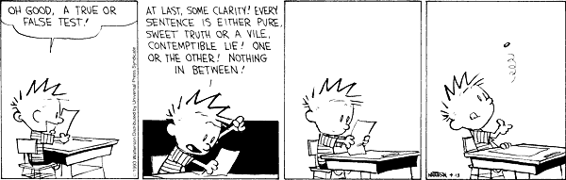
CSc 110, Spring 2018
Lecture 13: Cumulative Sum and Boolean Logic
Adapted from slides by Marty Stepp and Stuart Reges

Slide 2
Adding many numbers
How would you find the sum of all integers from 1-1000?
  # This may require a lot of typing
  sum = 1 + 2 + 3 + 4 + ...
  print("The sum is", sum)
What if we want the sum from 1 - 1,000,000?
Or the sum up to any maximum?
  How can we generalize the above code?

Slide 3
Cumulative sum loop
  sum = 0
  for i in range(1, 1001):
  sum = sum + i
  print("The sum is", sum)
cumulative sum: A variable that keeps a sum in progress and is updated repeatedly until summing is finished.
  The sum in the above code is an attempt at a cumulative sum.
  Cumulative sum variables must be declared outside the loops that update them, so that they will still exist after the loop.

Slide 4
Cumulative product
This cumulative idea can be used with other operators:
  product = 1
  for i in range(1, 21):
  product = product * 2
  print("2 ^ 20 =", product)
  How would we make the base and exponent adjustable?

Slide 5
input and cumulative sum
We can do a cumulative sum of user input:
  sum = 0
  for i in range(1, 101):
  next = int(input("Type a number: "))
  sum = sum + next
  print("The sum is", sum)

Slide 6
Cumulative sum question
Modify the receipt program from lecture 2
  Prompt for how many people, and each person's dinner cost.
  Use functions to structure the solution.
Example log of execution:
  How many people ate? 4
  Person #1: How much did your dinner cost? 20.00
  Person #2: How much did your dinner cost? 15
  Person #3: How much did your dinner cost? 30.0
  Person #4: How much did your dinner cost? 10.00
  Subtotal: $75.0
  Tax: $6.0
  Tip: $11.25
  Total: $92.25

Slide 7
Cumulative sum answer
# This program enhances our Receipt program using a cumulative sum.
def main():
subtotal = meals()
results(subtotal)
# Prompts for number of people and returns total meal subtotal.
def meals():
people = float(input("How many people ate? "))
subtotal = 0.0; # cumulative sum
for i in range(1, people + 1):
person_cost = float(input("Person #" + str(i) +
": How much did your dinner cost? "))
subtotal = subtotal + person_cost # add to sum
return subtotal
...

Slide 8
Cumulative answer, cont'd.
# Calculates total owed, assuming 8% tax and 15% tip
def results(subtotal):
tax = subtotal * .08
tip = subtotal * .15
total = subtotal + tax + tip
print("Subtotal: $" + str(subtotal))
print("Tax: $" + str(tax))
print("Tip: $" + str(tip))
print("Total: $" + str(total))

Slide 9
Factoring if/else code
factoring: Extracting common/redundant code.
  Can reduce or eliminate redundancy from if/else code.
Example:
  if a == 1:
  print(a)
  x = 3
  b = b + x
  elif a == 2:
  print(a)
  x = 6
  y = y + 10
  b = b + x
  else: # a == 3
  print(a)
  x = 9
  b = b + x
print(a)
x = 3 * a
if a == 2:
y = y + 10
b = b + x

Slide 10
Relational expressions
if statements use logical tests.
  if i <= 10: ...
  These are Boolean expressions.
Tests use relational operators:
Operator | Meaning | Example | Value
== | equals | 1 + 1 == 2 | True
!= | does not equal | 3.2 != 2.5 | True
< | less than | 10 < 5 | False
> | greater than | 10 > 5 | True
<= | less than or equal to | 126 <= 100 | False
>= | greater than or equal to | 5.0 >= 5.0 | True
Notes:
Note that == tests equality, not = . The = is used for the assignment operator!

Slide 11
Logical operators
Tests can be combined using logical operators:
"Truth tables" for each, used with logical values p and q:
Operator | Description | Example | Result
and | and | (2 == 3) and (-1 < 5) | False
or | or | (2 == 3) or (-1 < 5) | True
not | not | not (2 == 3) | True
P | q | p and q | p or q
True | True | True | True
True | False | False | True
False | True | False | True
False | False | False | False
p | not p
True | False
False | True

Slide 12
Evaluating logical expressions
Relational operators have lower precedence than math; logical operators have lower precedence than relational operators
    5 * 7 >= 3 + 5 * (7 – 1) and 7 <= 11
    5 * 7 >= 3 + 5 * 6 and 7 <= 11
    35 >= 3 + 30 and 7 <= 11
    35 >= 33 and 7 <= 11
    True and True
    True

Slide 13
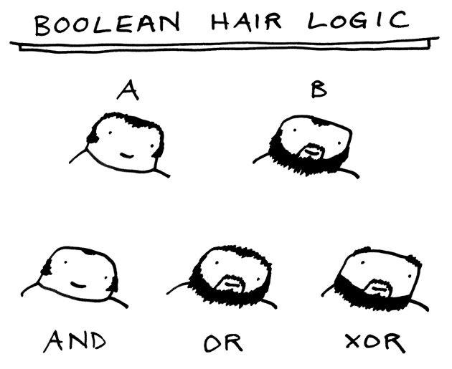
Logical questions
What is the result of each of the following expressions?
  x = 42
  y = 17
  z = 25
  y < x and y <= z
  x % 2 == y % 2 or x % 2 == z % 2
  x <= y + z and x >= y + z
  not(x < y and x < z)
  (x + y) % 2 == 0 or not((z - y) % 2 == 0)
    Answers: True, False, True, True, False

Slide 14
Type bool
bool: A logical type whose values are True and False.
  A logical test is actually a Boolean expression.
  Like other types, it is legal to:
    create a bool variable
    pass a bool value as a parameter
    return a bool value from function
    call a function that returns a bool and use it as a test
  minor = age < 21
  is_prof = "Prof" in name
  loves_csc = True
  # allow only CS-loving students over 21
  if minor or is_prof or not loves_csc:
  print("Can't enter the club!")

Slide 15
Using bool
Why is type bool useful?
  Can capture a complex logical test result and use it later
  Can write a function that does a complex test and returns it
  Makes code more readable
  Can pass around the result of a logical test (as param/return)
  good_age = age >= 27 and age < 39
  good_height = height >= 78 and height < 84
  rich = salary >= 100000.0
  if (goodAge and goodHeight) or rich:
  print("Okay, let's go out!")
  else:
  print("It's not you, it's me...")

Slide 16
Returning bool
Is this good style?
  def is_prime(n):
  factors = 0;
  for i in range(1, n + 1):
  if (n % i == 0):
  factors += 1
  if factors == 2:
  return True
  else:
  return False
Calls to functions returning bool can be used as tests:
  if is_prime(57):
  ...

Slide 17
"Boolean Zen", part 1
Students new to boolean often test if a result is True:
  if is_prime(57) == True: # bad
  ...
But this is unnecessary and redundant. Preferred:
  if is_prime(57): # good
  ...
A similar pattern can be used for a False test:
  if is_prime(57) == False: # bad
  if not is_prime(57): # good

Slide 18
"Boolean Zen", part 2
Functions that return bool often have an
if/else that returns True or False:
  def both_odd(n1, n2):
  if n1 % 2 != 0 and n2 % 2 != 0:
  return True
  else:
  return False
  But the code above is unnecessarily verbose.

Slide 19
Solution w/ bool variable
We could store the result of the logical test.
  def both_odd(n1, n2):
  test = (n1 % 2 != 0 and n2 % 2 != 0)
  if test: # test == True
  return True
  else: # test == False
  return False
  Notice: Whatever test is, we want to return that.
    If test is True, we want to return True.
    If test is False, we want to return False.

Slide 20
Solution w/ "Boolean Zen"
Observation: The if/else is unnecessary.
  The variable test stores a bool value;
  its value is exactly what you want to return. So return that!
  def both_odd(n1, n2):
  test = (n1 % 2 != 0 and n2 % 2 != 0)
  return test
An even shorter version:
  We don't even need the variable test.
  We can just perform the test and return its result in one step.
  def both_odd(n1, n2):
  return (n1 % 2 != 0 and n2 % 2 != 0)

Slide 21
"Boolean Zen" template
Replace
  def name(parameters):
  if test:
  return True
  else:
  return False
with
  def name(parameters):
  return test

Slide 22
Improve the is_prime function
How can we fix this code?
  def is_prime(n):
  factors = 0;
  for i in range(1, n + 1):
  if n % i == 0:
  factors += 1
  if factors != 2:
  return False
  else:
  return True

Slide 23
De Morgan's Law
De Morgan's Law: Rules used to negate boolean tests.
  Useful when you want the opposite of an existing test.
  Example:
Original Expression | Negated Expression | Alternative
a and b | not a or not b | not(a and b)
a or b | not a and not b | not(a or b)
Original Code | Negated Code
if x == 7 and y > 3: ... | if x != 7 or y <= 3: ...

Slide 24
Boolean practice questions
Write a function named is_vowel that returns whether a str is a vowel (a, e, i, o, or u), case-insensitively.
  is_vowel("q") returns False
  is_vowel("A") returns True
  is_vowel("e") returns True
Change the above function into an is_non_vowel that returns whether a str is any character except a vowel.
  is_non_vowel("q") returns True
  is_non_vowel("A") returns False
  is_non_vowel("e") returns False

Slide 25
Boolean practice answers
  # Enlightened version. I have seen the true way (and false way)
  def is_vowel(s):
  return s == 'a' or s == 'A' or s == 'e' or s == 'E' or s =='i' or s == 'I'
  or s == 'o' or s == 'O' or s == 'u' or s =='U'
  # Enlightened "Boolean Zen" version
  def is_non_vowel(s):
  return not(s == 'a') and not(s == 'A') and not(s == 'e') and not(s == 'E')
  and not(s =='i') and not(s == 'I') and not(s == 'o') and
  not(s == 'O') and not(s == 'u') and not(s =='U')
  # or, return not is_vowel(s)

Slide 26
When to return?
Functions with loops and return values can be tricky.
  When and where should the function return its result?
Write a function seven that uses randint to draw up to ten lotto numbers from 1-30.
  If any of the numbers is a lucky 7, the function should stop and return True. If none of the ten are 7 it should return False.
  The method should print each number as it is drawn.
    15 29 18 29 11 3 30 17 19 22 (first call)
    29 5 29 4 7 (second call)

Slide 27
Flawed solution
  # Draws 10 lotto numbers; returns True if one is 7.
  def seven():
  for i in range(10):
  num = randint(1, 30)
  print(num, " ", end='')
  if num == 7:
  return True
  else:
  return False
  The function always returns immediately after the first draw.
  This is wrong if that draw isn't a 7; we need to keep drawing.

Slide 28
Returning at the right time
  # Draws 10 lotto numbers; returns True if one is 7.
  def seven():
  for i in range(1, 11):
  num = randint(1, 30)
  print(str(num) + " ", end='')
  if num == 7: # found lucky 7; can exit now
  return True
  return False # if we get here, there was no 7
  Returns True immediately if 7 is found.
  If 7 isn't found, the loop continues drawing lotto numbers.
  If all ten aren't 7, the loop ends and we return False.

Slide 29
if/else, return question
Write a function count_factors that returns
the number of factors of an integer.
  count_factors(24) returns 8 because
  1, 2, 3, 4, 6, 8, 12, and 24 are factors of 24.
Solution:
  # Returns how many factors the given number has.
  def count_factors(number):
  count = 0
  for i in range(1, number + 1):
  if (number % i == 0):
  count += 1 # i is a factor of number
  return count

