Slide 1
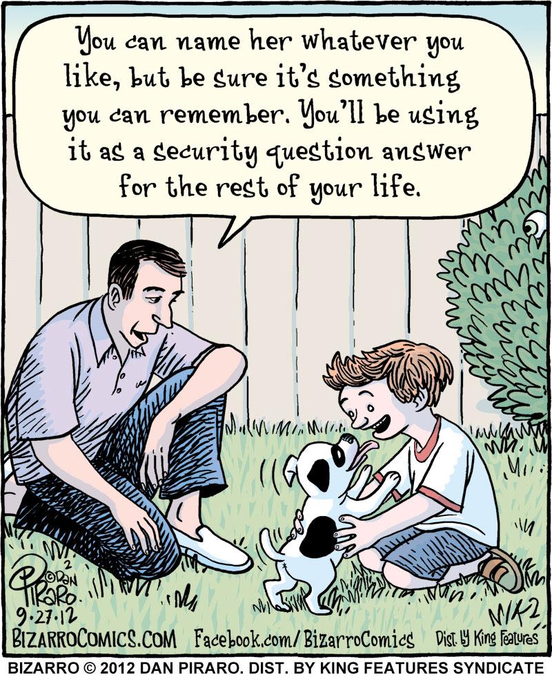
CSc 110, Spring 2018
Lecture 15: Strings
Adapted from slides by Marty Stepp and Stuart Reges

Slide 2
Name border
ALLISON
LLISON
LISON
ISON
SON
ON
N
A
AL
ALL
ALLI
ALLIS
ALLISO
ALLISON
OBOURN
BOURN
OURN
URN
RN
N
O
OB
OBO
OBOU
OBOUR
OBOURN
Prompt the user for full name
Draw out the pattern to the left
This should be resizable. Size 1 is shown and size 2 would have the first name twice followed by last name twice

Slide 3
Other String operations - length
Syntax:
length = len(string)
Example:
s = "Merlin"
count = len(s) # 6

Slide 4
Looping through a string
The for loop through a string using range:
major = "CSc"
for letter in range(0, len(major)):
print(major[letter])
You can also use a for loop to print or examine each character without range.
major = "CSc"
for letter in major:
print(letter)
Output:
C
S
c

Slide 5
String tests
Method | Description
startswith(str) | whether one contains other's characters at start
endswith(str) | whether one contains other's characters at end
name = "Voldermort"
if name.startswith("Vol"):
print("He who must not be named")
The in keyword can be used to test if a string contains another string.
example: "er" in name # true

Slide 6
String question
A Caesar cipher is a simple encryption where a message is encoded by shifting each letter by a given amount.
e.g. with a shift of 3, A → D, H → K, X → A, and Z → C
Write a program that reads a message from the user and performs a Caesar cipher on its letters:
Your secret message: Brad thinks Angelina is cute
Your secret key: 3
The encoded message: eudg wklqnv dqjholqd lv fxwh

Slide 7
Strings and ints
All char values are assigned numbers internally by the computer, called ASCII values.
Examples:
'A' is 65, 'B' is 66, ' ' is 32
'a' is 97, 'b' is 98, '*' is 42
One character long Strings and ints can be converted to each other
ord('a') is 97, chr(103) is 'g'
This is useful because you can do the following:
chr(ord('a' + 2)) is 'c'

