Slide 1
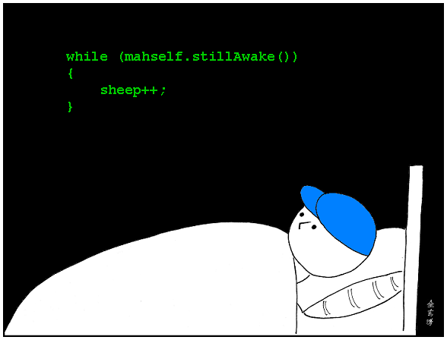
CSc 110, Spring 2018
Lecture 17: while Loops and decomposition
Adapted from slides by Marty Stepp and Stuart Reges

Slide 2
Fencepost question
Write a function print_primes that prints all prime numbers up to a max.
  Example: print_primes(50) prints
  2, 3, 5, 7, 11, 13, 17, 19, 23, 29, 31, 37, 41, 43, 47
  If the maximum is less than 2, print no output.
To help you, write a function count_factors which returns the number of factors of a given integer.
  count_factors(20) returns 6 due to factors 1, 2, 4, 5, 10, 20.

Slide 3
Fencepost answer
# Prints all prime numbers up to the given max.
def print_primes(max):
if max >= 2:
print("2", end='')
for i in range(3, max + 1):
if count_factors(i) == 2:
print(", " + str(i))
print()
# Returns how many factors the given number has.
def count_factors(number):
count = 0
for i in range(1, number + 1):
if number % i == 0:
count += 1 # i is a factor of number
return count

Slide 4
Nested if/else question
Write a program that produces output like the following:
  This program reads data for two
  people and computes their basal
  metabolic rate and burn rate.
  Enter next person's information:
  height (in inches)? 73.5
  weight (in pounds)? 230
  age (in years)? 35
  gender (male or female)? male
  Enter next person's information:
  height (in inches)? 71
  weight (in pounds)? 220.5
  age (in years)? 20
  gender (male or female)? female
  Person #1 basal metabolic rate = 2042.3
  high resting burn rate
  Person #2 basal metabolic rate = 1868.4
  moderate resting burn rate
Basal Metabolic Rate Formula:
male BMR = 4.54545 x (weight in lb) + 15.875 x (height in inches) - 5 x (age in years) + 5
female BMR = 4.54545 x (weight in lb) + 15.875 x (height in inches) - 5 x (age in years) - 161
BMR | Burn Level
below 12000 | low
1200 to 2000 | moderate
above 2000 | high
Notes:
// This program computes two people's body mass index (BMI) and
// compares them. The code uses parameters, returns, and Scanner.
import java.util.*; // so that I can use Scanner
public class BMI {
public static void main(String[] args) {
System.out.println("This program reads in data for two people and");
System.out.println("computes their body mass index (BMI)");
System.out.println();
// finish me!
}
}

Slide 5
Nested if/else answer
  # This program finds the basal metabolic rate (BMR) for two
  # individuals. This variation includes several functions
  # other than main.
  # introduces the program to the user
  def give_intro():
  print("This program reads data for two")
  print("people and computes their basal")
  print("metabolic rate and burn rate.")
  print()
  # prompts for one person's statistics, returning the BMI
  def get_bmr(person):
  print("Enter person", person, "information:")
  height = float(input("height (in inches)? "))
  weight = float(input("weight (in pounds)? "))
  age = float(input("age (in years)? "))
  gender = input("gender (male or female)? ")
  bmr = bmr_for(height, weight, age, gender)
  print()
  return bmr
  ...

Slide 6
Nested if/else, cont'd.
  # this function contains the basal metabolic rate formula for
  # converting the given height (in inches), weight
  # (in pounds), age (in years) and gender (male or female) into a BMR
  def bmr_for(height, weight, age, gender):
  bmr = 4.54545 * weight + 15.875 * height - 5 * age
  if gender.lower() == "male":
  bmr += 5
  else:
  bmr -= 161
  return bmr
  # reports the overall bmr values and status
  def report_results(bmr1, bmr2):
  print("Person #1 basal metabolic rate =", round(bmr1, 1))
  report_status(bmr1)
  print("Person #2 basal metabolic rate =", round(bmr2, 1))
  report_status(bmr2)
  # reports the burn rate for the given BMR value
  def report_status(bmr):
  if bmr < 1200:
  print("low resting burn rate");
  elif bmr <= 2000:
  print("moderate resting burn rate")
  else: # bmr1 > 2000
  print("high resting burn rate")
  def main():
  give_intro()
  bmr1 = get_bmr(1)
  bmr2 = get_bmr(2)
  print(bmr1, bmr2)
  report_results(bmr1, bmr2)
  main()
Notes:
How would we round the BMI numbers?

