Slide 1
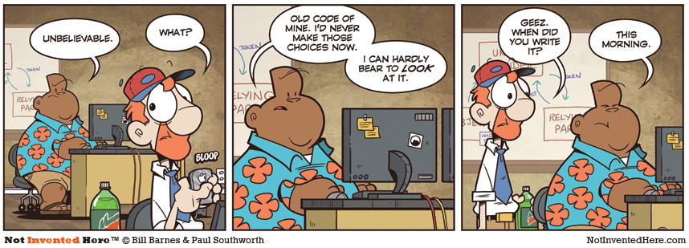
CSc 110, Spring 2018
Lecture 21: Line-Based File Input
Adapted from slides by Marty Stepp and Stuart Reges

Slide 2
Gas prices question
Write a program that reads a file gasprices.txt
Format: Belgium $/gal US $/gal date …
8.20 3.81 3/21/11 8.08 3.84 3/28/11 ...
The program should print the average gas price over all data in the file for both countries:
Belgium average: 8.3
USA average: 3.9
Notes:
I don't usually have time to do this program in lecture. It's just here in case I have extra time, or for students to look at later.

Slide 3
Multiple tokens on one line
You can use read to read the whole file into a string and the split function to break a file apart
str.split() - splits a string on blank space
str.split(other_str) - splits a string on occurrences of the
other string
>>> f = open("hours.txt")
>>> text = f.read()
'1 2\n45 6\n'
>>> f = text.split()
['1', '2', '45', '6']

Slide 4
Looping through a file
The result of split can be used in a for ... in loop
A template for reading files in Python:
file = open("filename")
text = file.read()
text = text.split()
for line in text:
statements

Slide 5
Gas prices solution
def main():
file = open("gasprices.txt")
belgium = 0
usa = 0
count = 0
lines = file.read().split()
for i in range(0, len(lines), 3):
belgium += float(lines[i])
usa += float(lines[i + 1])
print("Belgium average:", (belgium / count), "$/gal")
print("USA average:", (usa / count), "$/gal")

Slide 6
Hours question
Given a file hours.txt with the following contents:
123 Clark 12.5 8.1 7.6 3.2
456 Jordan 4.0 11.6 6.5 2.7 12
789 Faiz 8.0 8.0 8.0 8.0 7.5
Consider the task of computing hours worked by each person:
Clark (ID#123) worked 31.4 hours (7.85 hours/day)
Jordan (ID#456) worked 36.8 hours (7.36 hours/day)
Faiz (ID#789) worked 39.5 hours (7.90 hours/day)

Slide 7
Line-based file processing
Instead of using read() use readlines() to read the file
Then use split() on each line
file = open("<filename>")
lines = file.readlines()
For line in lines:
parts = line.split()
<process the parts of the line>

Slide 8
Hours answer
# Processes an employee input file and outputs each employee's hours.
def main():
file = open("hours.txt")
lines = file.readlines()
for line in lines:
process_employee(line)
def process_employee(line):
parts = line.split()
id = parts[0] # e.g. 456
name = parts[1] # e.g. "Greg"
sum = 0
count = 0
for i in range(2, len(parts)):
sum += float(parts[i])
count += 1
average = sum / count
print(name + " (ID#" + id + ") worked " +
str(sum) + " hours (" + str(average) + " hours/day)")

Slide 9
IMDb movies problem
Consider the following Internet Movie Database (IMDb) data:
1 9.1 196376 The Shawshank Redemption (1994)
2 9.0 139085 The Godfather: Part II (1974)
3 8.8 81507 Casablanca (1942)
Write a program that displays any movies containing a phrase:
Search word? part
Rank Votes Rating Title
2 139085 9.0 The Godfather: Part II (1974)
40 129172 8.5 The Departed (2006)
95 20401 8.2 The Apartment (1960)
192 30587 8.0 Spartacus (1960)
4 matches.
Is this a token or line-based problem?

Slide 10
"Chaining"
main should be a concise summary of your program.
It is bad if each function calls the next without ever returning (we call this chaining):
A better structure has main make most of the calls.
Functions must return values to main to be passed on later.
main
functionA
functionB
functionC
functionD
main
functionA
functionB
functionD
functionD

Slide 11
Bad IMDb "chained" code 1
# Displays IMDB's Top 250 movies that match a search string.
def main():
get_word()
# Asks the user for their search word and returns it.
def get_word():
search_word = input("Search word: ")
search_word = search_word.lower()
print()
file = open("imdb.txt")
search(file, search_word)
# Breaks apart each line, looking for lines that match the search word.
def search(file, search_word):
matches = 0
for line in file:
line_lower = line.lower() # case-insensitive match
if (search_word in line_lower):
matches += 1
print("Rank\tVotes\tRating\tTitle")
display(line)

Slide 12
Bad IMDb "chained" code 2
# Displays the line in the proper format on the screen.
def display(line):
parts = line.split()
rank = parts[0]
rating = parts[1]
votes = parts[2]
title = ""
for i in range(3, len(parts)):
title += parts[i] + " " # the rest of the line
print(rank + "\t" + votes + "\t" + rating + "\t" + title)

Slide 13
Better IMDb answer 1
# Displays IMDB's Top 250 movies that match a search string.
def main():
search_word = get_word()
file = open("imdb.txt")
line = search(file, search_word)
if (len(line) > 0):
print("Rank\tVotes\tRating\tTitle")
matches = 0
while (len(line) > 0):
display(line)
line = search(file, search_word)
matches += 1
print(str(matches) + " matches.")
# Asks the user for their search word and returns it.
def get_word():
search_word = input("Search word: ")
search_word = search_word.lower()
print()
return search_word
...

Slide 14
Better IMDb answer 2
...
# Breaks apart each line, looking for lines that match the search word.
def search(file, search_word):
for line in file:
line_lower = line.lower() # case-insensitive match
if (search_word in line):
return line
return "" # not found
# displays the line in the proper format on the screen.
def display(line):
parts = line.split()
rank = parts[0]
rating = parts[1]
votes = parts[2]
title = ""
for i in range(3, len(parts)):
title += parts[i] + " " # the rest of the line
print(rank + "\t" + votes + "\t" + rating + "\t" + title)

