Slide 1
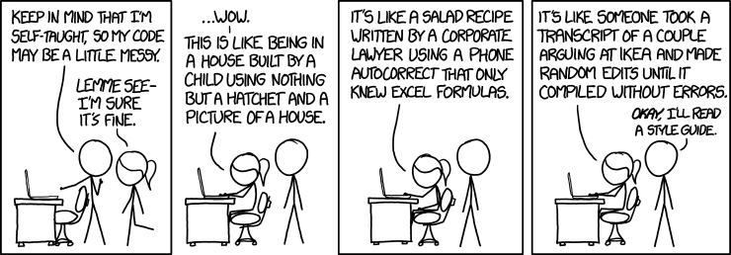
CSc 110, Spring 2018
Lecture 27: Lists that change size and File Output
Adapted from slides by Marty Stepp and Stuart Reges

Slide 2
Assertion example
Which of the following assertions are
true at which point(s) in the code?
Choose ALWAYS, NEVER, or SOMETIMES.
 | y > 0 | y % 2 == 0
Point A
Point B
Point C
Point D
Point E
Point F
Point G
 | y > 0 | y % 2 == 0
Point A | SOMETIMES | SOMETIMES
Point B | ALWAYS | SOMETIMES
Point C | ALWAYS | ALWAYS
Point D | ALWAYS | SOMETIMES
Point E | ALWAYS | NEVER
Point F | SOMETIMES | ALWAYS
Point G | NEVER | ALWAYS
  # Assumes y >= 0, and returns x^y
  def pow(x, y):
  prod = 1
  # Point A
  while y > 0:
  # Point B
  if y % 2 == 0:
  # Point C
  x = x * x
  y = y // 2
  # Point D
  else:
  # Point E
  prod = prod * x
  y -= 1
  # Point F
  # Point G
  return prod

Slide 3
List functions
Function | Description
append(x) | Add an item to the end of the list. Equivalent to a[len(a):] = [x].
extend(L) | Extend the list by appending all the items in the given list. Equivalent to a[len(a):] = L
insert(i, x) | Inserts an item at a given position. i is the index of the element before which to insert, so a.insert(0, x) inserts at the front of the list.
remove(x) | Removes the first item from the list whose value is x. Errs if there is no such item.
pop(i) | Removes the item at the given position in the list, and returns it. a.pop() removes and returns the last item in the list.
clear() | Remove all items from the list.
index(x) | Returns the index in the list of the first item whose value is x. Errs if there is no such item.
count(x) | Returns the number of times x appears in the list.
sort() | Sort the items of the list
reverse() | Reverses the elements of the list
copy() | Return a copy of the list.

Slide 4
Lists that change size
Sometimes we don't know how big we want our list to be when our program starts
  It can be useful to create an empty list and fill it up.
  data = []
  data.append("hello")
  data.append("world")
  print(data) # ['hello', 'world']
How would we insert another word in the middle?

Slide 5
Exercise
Write a function called remove_duplicates that takes a sorted list of numbers and removes any duplicates. For example, if it is called on the following list:
data = [-2, 1, 1, 3, 3, 3, 4, 5, 6, 78, 78, 79]
after the call the list should be
data = [-2, 1, 3, 4, 5, 6, 78, 79]

Slide 6
Looping and removing
When you loop through a list and remove elements you change the length of the list. This means you need to change your upper bound as you are looping.
  You must use a while loop when removing items from a list
  A for i in range loop won't work as it can't adjust when the length of the list changes
  A for num in data loop won't work as it cannot alter the list.

Slide 7
Solution
def remove_duplicates(data):
i = 0
while i < len(data) - 1:
if data[i] == data[i + 1]:
data.pop(i)
else: # we don't want to move on
i += 1 # to the next element if we
# remove as that will me we
# will skip the one that
# just moved back into the one
# we removed's place

Slide 8
Output to files
Open a file in write or append mode
  'w' - write mode – replaces everything in the file
  'a' – append mode – adds to the bottom of the file preserving what is already in it
  name = open("filename", "w") # write
name = open("filename", "a") # append

Slide 9
Output to files
name.write(str) - writes the given string to the file
name.close() - closes file once writing is done
Example:
  out = open("output.txt", "w")
  out.write("Hello, world!\n")
  out.write("How are you?")
  out.close()
  text = open("output.txt").read() # Hello, world!\nHow are you?
Notes:
common PrintStream bug:
- declaring it in a method that gets called many times. This causes the file to be re-opened and wipes the past contents. So only the last line shows up in the file.

