Slide 1
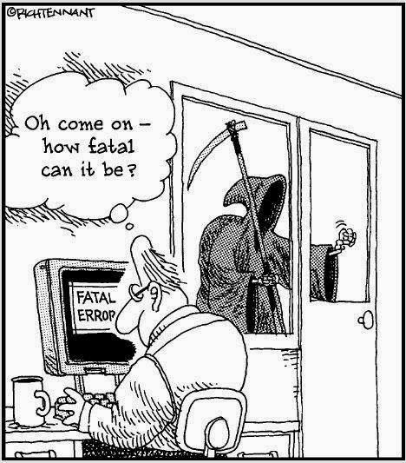
CSc 110, Spring 2018
Lecture 28: Testing
Thanks to Atif Memon from UMD for disaster examples

Slide 2
Why talk about testing?
Mars Climate Orbiter
Purpose: to relay signals from the Mars Polar Lander once it reached the surface of the planet
Disaster: smashed into the planet instead of reaching a safe orbit
Why: Software bug - failure to convert English measures to metric values

Slide 3
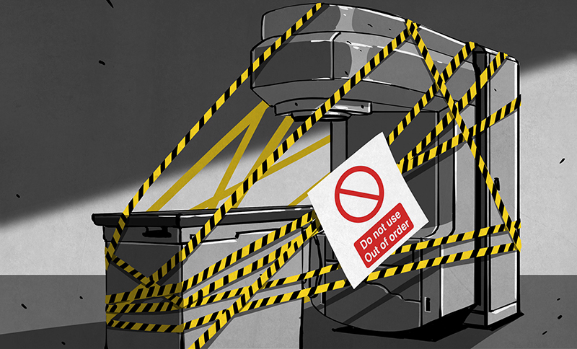
Why talk about testing?
THERAC-25 Radiation Therapy
1986: two cancer patients at the East Texas Cancer Center in Tyler received fatal radiation overdose
Why: Software bug - mishandled race condition (i.e., miscoordination between concurrent tasks)

Slide 4
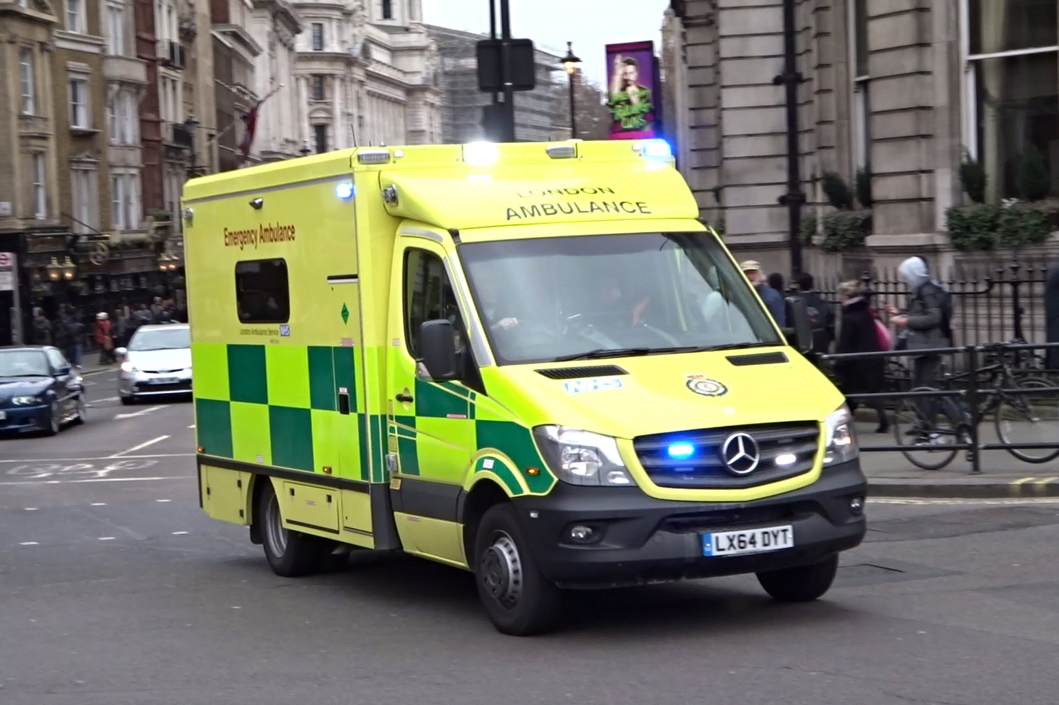
Why talk about testing?
London Ambulance Service
Purpose: automate many of the human-intensive processes of manual dispatch systems associated with ambulance services in the UK – functions: Call taking
Failure of the London Ambulance Service on 26 and 27 November 1992
Load increased, emergencies accumulated, system made incorrect allocations

Slide 5
Industry comparison
“If the automobile industry had developed like the software industry, we would all be driving $25 cars that get 1,000 miles to the gallon.”
“Yeah, and if cars were like software, they would crash twice a day for no reason, and when you called for service, they’d tell you to reinstall the engine.”
Now days you can get a job as a software engineer developing cars!

Slide 6
Why talk about testing?
You will spend a lot of time testing and debugging
You can get a job as a Software Engineer in Test
Terrible things can happen if you don't test well enough!

Slide 7
Types of testing
Black box testing: testing the program does what the specification requires
White box testing: examining code for potential problems
Unit testing: verifies correctness of a small piece of testable code in isolation
Integration test: verifies different small already tested components of the program work together correctly
Regression testing: a complete retesting of a modified program
Stress testing: tests the behavior under peak user volumes
Performance, security, usability and many more

Slide 8
Testing example
def main():
data = [3, 5, 2, 7, 45, 43, 5, 3] remove_bad_pairs(data)
print(data)
remove_bad_pairs(list):
if (len(list) % 2 != 0):
v.remove(list[-1])
i = 0
while(i < len(list)):
if (i % 2 != 0 and list[i - 1] > list[i]):
list.remove(i - 1)
list.remove(i)

