Slide 1
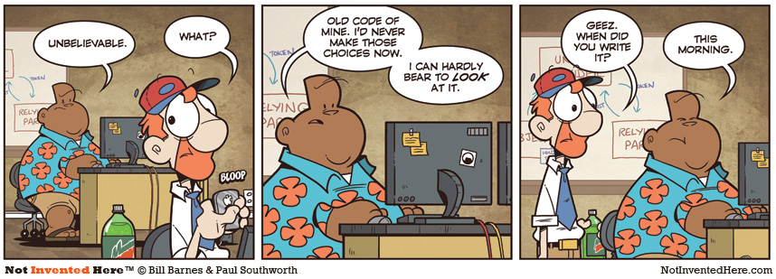
CSc 110, Spring 2018
Lecture 35: 2D Structures
Adapted from slides by Marty Stepp and Stuart Reges

Slide 2
Exercise
Consider the following function:
def mystery(alls, letters):
for i in range(len(alls)):
if alls[i] in letters.values():
if alls[i] not in letters.keys():
letters[alls[i]] = i
else:
letters[alls[i]] = i + 1
What is in the dictionary after calls with the following parameters?
all: [b, l, u, e] letters: {s:b, p:t, o:u, t:t}
dictionary:_{'o': 'u', 'p': 't', 'b': 0, 's': 'b', 'u': 2, 't': 't'} __
all: [k, e, e, p] letters: {s:y, a:k, f:e, e:f}
dictionary:_ {'s': 'y', 'a': 'k', 'f': 'e', 'e': 3, 'k': 0} ____
all: [s, o, b, e, r] letters: {b:b, o:o, o:o, k:k, s:s}
dictionary:__ {'o': 2, 'k': 'k', 's': 1, 'b': 3} __

Slide 3
What is the right structure?
The grades for all students in a class
All books in a store arranged by category
Many recipes each containing many steps
Phone numbers that have been called this month on a phone plan divided by area and country code for billing simplicity

Slide 4
Exercise
We would like to store data for the class so that we can:
  Access the entire class list easily
  Access a section list easily
What structure is appropriate for this problem?
  Sometimes it can be helpful to store a structure inside another structure

Slide 5
2d Structure Access
Given the following structure:
  grades = {'Ali':[10, 16, 20, 13, 3, 17],
  'Ken':[9, 16, 8, 19, 20, 20],
  'Daniel':[8, 10, 20, 20, 20, 20]}
How can I access Ken's grade on project 3?
How can I find out how many students are in my class / grades?
How can I find out how many projects a student has done?

Slide 6
Exercise
What does the following code produce?
def main():
grades = {'Ali':[10, 16, 20, 13, 3, 17],
'Ken':[9, 16, 8, 19, 20, 20],
'Daniel':[8, 10, 20, 20, 20, 20]}
print(mystery(grades, 2))
def mystery(grades, i):
total = 0
for student in grades:
total += grades[student][i]
return total / len(grades)

Slide 7
Exercise
Write a function to calculate the average grade of all students on all assignments.
  How can we get access to each grade?
  How can we know how many grades we need to sum?

Slide 8
Exercise
Write a function that returns a list where each element in the list is the average score for that particular assignment number.

Slide 9
Exercise
Write a function that takes a student name as a parameter and returns the project number that the student scored highest on.

