Slide 1
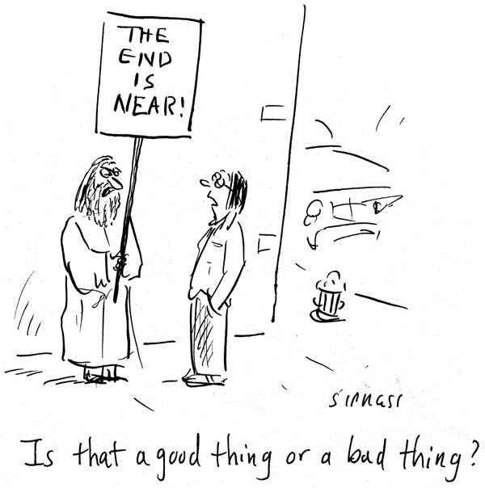
CSc 110, Spring 2018
Lecture 41: Goodbye, world!

Slide 2
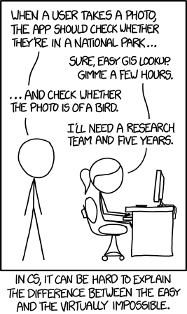

Slide 3
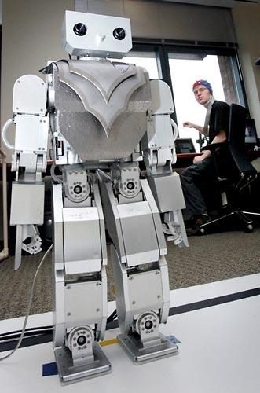
Beyond programming
Mind-controlled robots
http://www.youtube.com/watch?v=TQ7EOpPNQyw
Muscle-controlled interfaces
http://www.youtube.com/watch?v=pktVSTwC8qo
3D models from pictures
http://www.youtube.com/watch?v=25Yifq70elY
Face aging
http://www.youtube.com/watch?v=fLQtssJDMMc
Animation
http://www.youtube.com/watch?v=b4kkPlLdMvI
Security
http://www.pbs.org/wgbh/nova/tech/tadayoshi-kohno.html

Slide 4
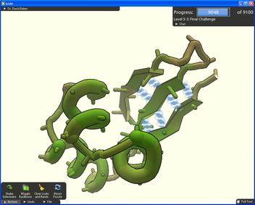
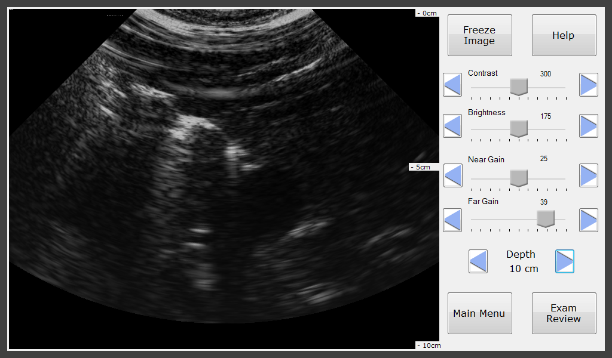
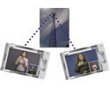
Computing for good
Foldit
Open Data Kit
Mobile Midwives’ Ultrasound
MobileASL
Tactile Graphics

Slide 5
Explore Big Ideas
Historical context
Key algorithms
Privacy
Automate all the things

Slide 6
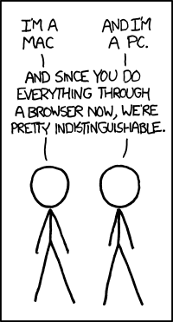
Take CSC 337!
CSC 337 = Web Programming
prerequisite: CSC 110
learn how to make web sites

