Slide 1
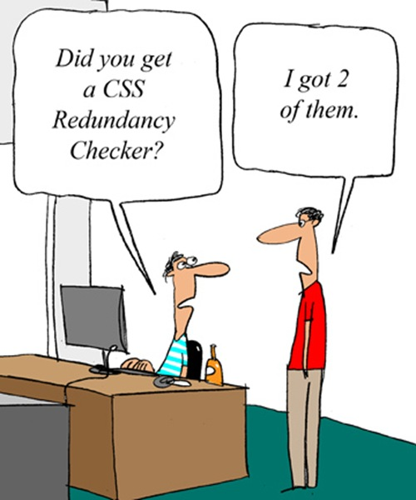
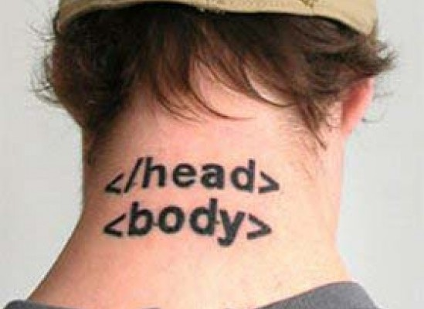
CSc 337
Lecture 2: More HTML and CSS

Slide 2
Activity: match this page
Page Text:
Koala Bears
Koalas are marsupials and not actually bears.
Food
Koalas eat eucalyptus.
Dangers
(Koalas are an endangered species)
Dingos & Deforestation & Roads & Disease.
Pictures
*('O')*

Slide 3
Block and inline elements
block elements contain an entire large region of content
examples: paragraphs, lists, table cells
the browser places a margin of whitespace between block elements for separation
inline elements affect a small amount of content
examples: bold text, code fragments, images
the browser allows many inline elements to appear on the same line
must be nested inside a block element

Slide 4
Nesting tags
<p>
HTML is <em>really,
<strong>REALLY</em> lots of</strong> fun!
</p>
tags must be correctly nested
(a closing tag must match the most recently opened tag)
the browser may render it correctly anyway, but it is invalid HTML
(how would we get the above effect in a valid way?)

Slide 5
Comments: <!-- ... -->
comments to document your HTML file or "comment out" text
<!-- My web page, by Suzy Student
CSE 190 D, Spring 2048 -->
<p>CSE courses are <!-- NOT --> a lot of fun!</p>
CSE courses are a lot of fun!
many web pages are not thoroughly commented (or at all)
still useful at top of page and for disabling code
comments cannot be nested and cannot contain a --

Slide 6
Unordered list: <ul>, <li>
<ul>
<li>No shoes</li>
<li>No shirt</li>
<li>No problem!</li>
</ul> HTML
No shoes
No shirt
No problem! output
ul represents a bulleted list of items (block)
li represents a single item within the list (block)

Slide 7
More about unordered lists
<ul>
<li>Harry Potter characters:
<ul>
<li>Harry Potter</li>
<li>Hermione</li>
<li>Ron</li>
</ul>
</li>
<li>LOTR characters:
<ul>
<li>Frodo</li>
<li>Bilbo</li>
<li>Sam</li>
</ul>
</li>
</ul> HTML
Harry Potter characters:
Harry Potter
Hermione
Ron
LOTR characters:
Frodo
Bilbo
Sam
output

Slide 8
Ordered list <ol>
<p>Apple business model:</p>
<ol>
<li>Beat Microsoft</li>
<li>Beat Google</li>
<li>Conquer the world!</li>
</ol> HTML
Apple business model:
Beat Microsoft
Beat Google
Conquer the world output
ol represents a numbered list of items
we can make lists with letters or Roman numerals using CSS (later)

Slide 9
Definition list <dl>, <dt>, <dd>
<dl>
<dt>newbie</dt> <dd>one who does not have mad skills</dd>
<dt>own</dt> <dd>to soundly defeat (e.g. I owned that newbie!)</dd>
<dt>frag</dt> <dd>a kill in a shooting game</dd>
</dl> HTML
newbie
one who does not have mad skills
own
to soundly defeat (e.g. I owned that newbie!)
frag
a kill in a shooting game output
dl represents a list of definitions of terms
dt represents each term, and dd its definition

Slide 10
Web page metadata: <meta>
information about your page (for a browser, search engine, etc.)
<meta charset="utf-8" />
<meta name="description“ content="Authors' web site for Building Java Programs." />
<meta name="keywords" content="java, textbook" /> HTML
placed in the head section of your HTML page
meta tags often have both the name and content attributes
some meta tags use the http-equiv attribute instead of name
the meta tag with charset attribute indicates language/character encodings
using a meta tag Content-Type stops validator "tentatively valid" warnings

Slide 11
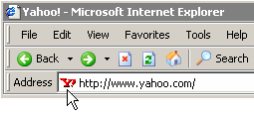
Favorites icon ("favicon")
<link href="filename" type="MIME type" rel="shortcut icon" /> HTML
<link href="yahoo.gif" type="image/gif" rel="shortcut icon" /> HTML
output
the link tag, placed in the head section, attaches another file to the page
in this case, an icon to be placed in the browser title bar and bookmarks
IE6: Doesn't work; must put a file favicon.ico in the root of the web server

Slide 12
Web Standards
It is important to write proper HTML code and follow proper syntax.
Why use valid HTML and web standards?
more rigid and structured language
more interoperable across different web browsers
more likely that our pages will display correctly in the future
can be interchanged with other XML data: SVG (graphics), MathML, MusicML, etc.

Slide 13
W3C HTML Validator
<p>
<a href="http://validator.w3.org/check/referer">
<img src="http://webster.cs.washington.edu/w3c-html.png" alt="Validate" />
</a>
</p>
validator.w3.org
checks your HTML code to make sure it follows the official HTML syntax
more picky than the browser, which may render bad HTML correctly

Slide 14
Cascading Style Sheets (CSS): <link>
<head>
...
<link href="filename" type="text/css" rel="stylesheet" />
...
</head> HTML
CSS describes the appearance and layout of information on a web page (as opposed to HTML, which describes the content of the page)
can be embedded in HTML or placed into separate .css file (preferred)

Slide 15
Basic CSS rule syntax
selector {
property: value;
property: value;
...
property: value;
}
p {
font-family: sans-serif;
color: red;
}
a CSS file consists of one or more rules
a rule's selector specifies HTML element(s) and applies style properties
a selector of * selects all elements

Slide 16
Inline styles: the style attribute (BAD!)
<p style="font-family: sans-serif; color: red;">
This is a paragraph</p>
HTML
This is a paragraph
output
higher precedence than embedded or linked styles
used for one-time overrides and styling a particular element
this is bad style; DO NOT DO THIS (why?)

Slide 17
Embedding style sheets: <style> (BAD!)
<head>
<style type="text/css">
p { font-family: sans-serif; color: red; }
h2 { background-color: yellow; }
</style>
</head>
HTML
CSS code can be embedded within the head of an HTML page
this is bad style; DO NOT DO THIS (why?)

Slide 18
Content vs. presentation
HTML is for content; what is on the page (heading; list; code; etc.)
CSS is for presentation; how to display the page (bold; centered; 20px margin; etc.)
keeping content separate from presentation is a very important web design principle
If the HTML contains no styles, its entire appearance can be changed by swapping .css files
see also: CSS Zen Garden

Slide 19
Activity: match this page
The headings are Verdana, Geneva, Arial or any sans-serif font on the machine.
The overall heading is 5ems big, not bold and has a 5 by 5 green shadow.

Slide 20
CSS properties for colors
p {
color: red;
background-color: yellow;
}
This paragraph uses the style above.
Property | Description
color | color of an element’s text
background-color | color that will appear behind the element

Slide 21
Specifying colors
p { color: red; }
h2 { color: rgb(128, 0, 196); }
h4 { color: #FF8800; }
This paragraph uses the first style above.
This h2 uses the second style above.
This h4 uses the third style above.
color names: aqua, black, blue, fuchsia, gray, green, lime, maroon, navy, olive, purple, red, silver, teal, white (white), yellow
RGB codes: red, green, and blue values from 0 (none) to 255 (full)
hex codes: RGB values in base-16 from 00 (0, none) to FF (255, full)

Slide 22
CSS properties for fonts
property | description
font-family | which font will be used
font-size | how large the letters will be drawn
font-style | used to enable/disable italic style
font-weight | used to enable/disable bold style
Complete list of font properties

Slide 23
font-size
p {
font-size: 14pt;
}
This paragraph uses the style above.
units: pixels (px) vs. point (pt) vs. m-size (em)
16px, 16pt, 1.16em
vague font sizes: xx-small, x-small, small, medium, large, x-large, xx-large, smaller, larger
percentage font sizes, e.g.: 90%, 120%

Slide 24
font-family
p {
font-family: Georgia;
}
h2 {
font-family: "Courier New";
}
This paragraph uses the first style above.
This h2 uses the second style above.
enclose multi-word font names in quotes

Slide 25
More about font-family
p {
font-family: Garamond, "Times New Roman", serif;
}
This paragraph uses the above style.
can specify multiple fonts from highest to lowest priority
generic font names:
serif, sans-serif, cursive, fantasy, monospace

Slide 26
font-weight, font-style
p {
font-weight: bold;
font-style: italic;
}
This paragraph uses the style above.
either of the above can be set to normal to turn them off (e.g. headings)

Slide 27
CSS properties for text
property | description
text-align | alignment of text within its element
text-decoration | decorations such as underlining
line-height, word-spacing, letter-spacing | gaps between the various portions of the text
text-indent | indents the first letter of each paragraph
Complete list of text properties (http://www.w3schools.com/css/css_reference.asp#text)

Slide 28
text-align
blockquote { text-align: justify; }
h2 { text-align: center; } CSS
The Emperor's Quote
[TO LUKE SKYWALKER] The alliance... will die. As will your friends. Good, I can feel your anger. I am unarmed. Take your weapon. Strike me down with all of your hatred and your journey towards the dark side will be complete. output
can be left, right, center, or justify (which widens all full lines of the element so that they occupy its entire width)

Slide 29
Text-decoration
p {
text-decoration: underline;
} CSS
This paragraph uses the style above.
output
can also be overline, line-through, blink, or none
effects can be combined:
text-decoration: overline underline;

Slide 30
text-shadow
p {
font-weight: bold;
text-shadow: 2px 2px gray;
} CSS
This paragraph uses the style above. output
shadow is specified as an X-offset, a Y-offset, and an optional color

Slide 31
The list-style-type property
ol { list-style-type: lower-roman; } CSS
Possible values:
i. none : No marker
ii. disc (default), circle, square
iii. Decimal: 1, 2, 3, etc.
iv. decimal-leading-zero: 01, 02, 03, etc.
v. lower-roman: i, ii, iii, iv, v, etc.
vi. upper-roman: I, II, III, IV, V, etc.
vii. lower-alpha: a, b, c, d, e, etc.
viii. upper-alpha: A, B, C, D, E, etc.
x. lower-greek: alpha, beta, gamma, etc.
others: hebrew, armenian, georgian, cjk-ideographic, hiragana…

Slide 32
CSS properties for backgrounds
property | description
background-color | color to fill background
background-image | image to place in background
background-position | placement of bg image within element
background-repeat | whether/how bg image should be repeated
background-attachment | whether bg image scrolls with page
background | shorthand to set all background properties

Slide 33
background-image
body {
background-image: url("images/draft.jpg");
}
CSS
background image/color fills the element's content area

Slide 34
background-repeat
body {
background-image: url("images/draft.jpg");
background-repeat: repeat-x;
} CSS
can be repeat (default), repeat-x, repeat-y, or no-repeat

Slide 35
background-position
body {
background-image: url("images/draft.jpg");
background-repeat: no-repeat;
background-position: 370px 20px;
} CSS
value consists of two tokens, each of which can be top, left, right, bottom, center, a percentage, or a length value in px, pt, etc.
value can be negative to shift left/up by a given amount

Slide 36
The visibility property
p.secret {
visibility: hidden;
} CSS
output
property | description
visibility | sets whether an element should be shown onscreen; can be visible (default) or hidden
hidden elements will still take up space onscreen, but will not be shown
to make it not take up any space, set display to none instead
can be used to show/hide dynamic HTML content on the page in response to events

Slide 37
The opacity property
body { background-image: url("images/marty-mcfly.jpg");
background-repeat: repeat; }
p { background-color: yellow;}
p.mcfly1 { opacity: 0.75; }
p.mcfly2 { opacity: 0.50; }
p.mcfly3 { opacity: 0.25; } CSS
property | description
opacity | how not-transparent the element is; value ranges from 1.0 (opaque) to 0.0 (transparent)

Slide 38
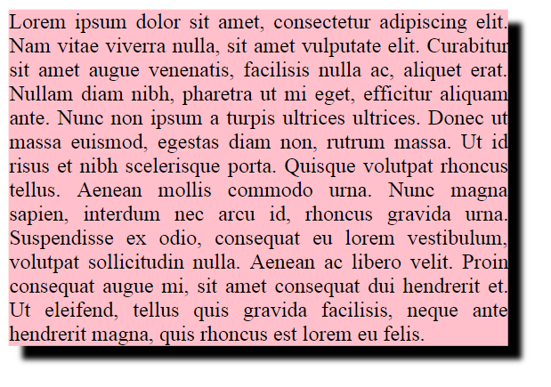
box-shadow
box-shadow: h-shadow v-shadow blur; CSS
box-shadow: 10px 10px 5px; CSS

Slide 39
Grouping styles
p, h1, h2 {
color: green;
}
h2 {
background-color: yellow;
} CSS
This paragraph uses the above style.
output
This h2 uses the above styles.
A style can select multiple elements separated by commas
The individual elements can also have their own styles

Slide 40
CSS comments: /* ... */
/* This is a comment.
It can span many lines in the CSS file. */
p {
color: red;
background-color: aqua;
} CSS
CSS (like HTML) is usually not commented as much as code such as Java
the // single-line comment style is NOT supported in CSS
the <!-- ... --> HTML comment style is also NOT supported in CSS

Slide 41
W3C CSS Validator
<p>
<a href="http://jigsaw.w3.org/css-validator/check/referer">
<img src="http://jigsaw.w3.org/css-validator/images/vcss"
alt="Valid CSS!" /></a>
</p> HTML
output
jigsaw.w3.org/css-validator/
checks your CSS to make sure it meets the official CSS specifications
more picky than the web browser, which may render malformed CSS correctly

