Slide 1
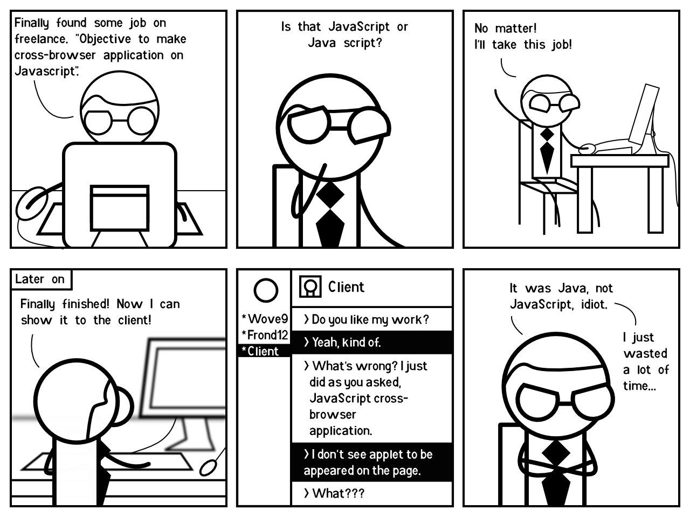
CSc 337
Lecture 5: Grid layout

Slide 2
The position property
div#ad {
position: fixed;
right: 10%;
top: 45%;
} CSS
Here I am!
property | value | description
position | static | default position
 | relative | offset from its normal static position
 | absolute | a fixed position within its containing element
 | fixed | a fixed position within the browser window
top, bottom, left, right | positions of box's corners

Slide 3
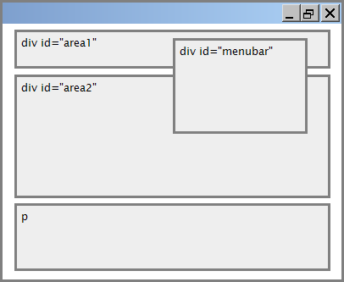
Absolute positioning
#menubar {
position: absolute;
left: 400px;
top: 50px;
} CSS
removed from normal flow (like floating ones)
positioned relative to the block element containing them (assuming that block also uses absolute or relative positioning)
actual position determined by top, bottom, left, right values
should often specify a width property as well

Slide 4
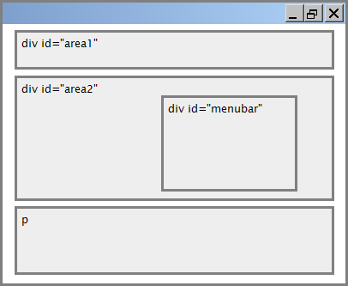
Relative positioning
#area2 { position: relative; } CSS
absolute-positioned elements are normally positioned at an offset from the corner of the overall web page
to instead cause the absolute element to position itself relative to some other element's corner, wrap the absolute element in an element whose position is relative

Slide 5
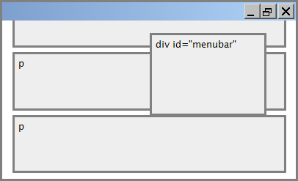
Fixed positioning
removed from normal flow (like floating ones)
positioned relative to the browser window
even when the user scrolls the window, element will remain in the same place

Slide 6
Complex Layouts
Flexbox - designed for one-dimensional layouts
Grid - designed for two-dimensional layouts

Slide 7
Grid Layout
Use if you want rows and columns
Works similarly to Flexbox
outer container display: grid
inner items end up in a grid

Slide 8
Grid Layout
By default all items are in one column
to change the number of rows and columns specify the grid template in the container CSS:
grid-template-rows: width width …
grid-template-columns: width width …
width is the width of the column
write a width as many times as columns you want

Slide 9
Grid Layout Example
Example:
.container {
display: grid;
grid-template-rows: 200px 200px 200px;
grid-template-columns: 200px 200px 200px;
}
Creates a grid with three rows and three columns

Slide 10
fr Unit
Calculates percentages of the container for you
Example:
grid-template-rows: 2fr 3fr
gives you 2 rows
first takes up 2/5 of vertical space
second takes up 3/5 of vertical space

Slide 11
Specifying many columns
Tedious to write out widths many times
repeat Example:
grid-template-rows: repeat(3, 1fr);
Creates 3 rows of equal height

Slide 12
Template shorthand
Create a grid template in one line:
grid-template: rows / columns;
Example:
grid-template: repeat(3, 1fr) / repeat(3, 1fr);

Slide 13
Alignment vs. float vs flexbox vs grid vs. position
if possible, lay out an element by aligning its content
horizontal alignment: text-align
set this on a block element; it aligns the content within it (not the block element itself)
vertical alignment: vertical-align
set this on an inline element, and it aligns it vertically within its containing element
if alignment won't work and you want a one-dimensional layout try flexbox
if alignment won't work and you want a two-dimensional layout try grid
if flexbox and grid won't work, try floating
if floating won't work, try positioning the element
absolute/fixed positioning are a last resort and should not be overused

Slide 14
The display property
h2 { display: inline; background-color: yellow; } CSS
output
This is a heading
This is another heading
property | description
display | sets the type of CSS box model an element is displayed with
values: none, inline, block, run-in, compact, ...
use very sparingly, because it can radically alter the page layout

Slide 15
Displaying block elements as inline
<ul id="topmenu">
<li>Item 1</li>
<li>Item 2</li>
<li>Item 3</li>
</ul> HTML
#topmenu li {
display: inline;
border: 2px solid gray;
margin-right: 1em;
} CSS
output
Item 1
Item 2
Item 3
lists and other block elements can be displayed inline
flow left-to-right on same line
width is determined by content (block elements are 100% of page width)

Slide 16
Details about inline boxes
size properties (width, height, min-width, etc.) are ignored for inline boxes
margin-top and margin-bottom are ignored, but margin-left and margin-right are not
the containing block box's text-align property controls horizontal position of inline boxes within it
text-align does not align block boxes within the page
each inline box's vertical-align property aligns it vertically within its block box

Slide 17
Exercise - Boxes
Generate the appearance on the next slide, starting from this HTML and CSS code.
<div id="outer">
<div class="box"></div>
<div class="box"></div>
<div class="box"></div>
<div class="box"></div>
<div class="box"></div>
<div class="box"></div>
</div>
#outer {
border: 2px dashed black;
padding: 10px;
}
.box {
width: 100px;
height: 100px;
background-color: black;
margin: 10px;
}

Slide 18
Exercise - Boxes

Slide 19
Exercise - nested boxes
Given the code below, write boxes.css to make the appearance on the next slide.
<!DOCTYPE html>
<html>
<head>
<link href="boxes.css" type="text/css" rel="stylesheet" />
</head>
<body>
<div id="outer-box">
<div id="inner-box"></div>
</div>
</body>
</html>

Slide 20
Exercise - nested boxes
The outer border of the box is red, the inner border of the box is black, and the inner background color of the box is yellow.
Both the outer and inner borders have a width of 50 pixels. The yellow portion of the box has a width and height of 200 pixels. The overall box has a width and height of 400 pixels.

Slide 21
Combination layouts
Most pages use many different layouts
Combine and nest as needed.
Example:
https://www.cs.arizona.edu/

Slide 22
Layout Practice
Games to practice your CSS layout skills:
FlexBox: https://flexboxfroggy.com/
Grid: https://cssgridgarden.com/

