Slide 1
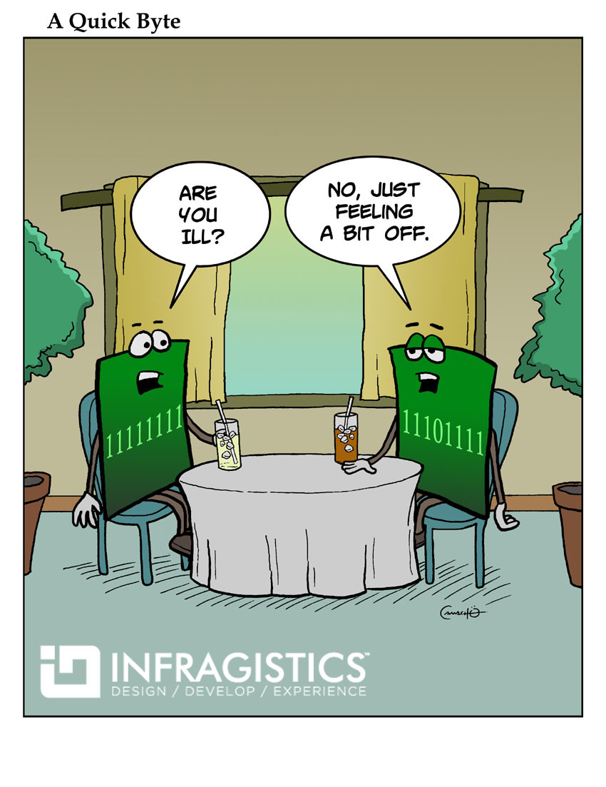
CSc 337
Lecture 7: Unobtrusive JavaScript

Slide 2
Unobtrusive JavaScript
JavaScript event code seen previously was obtrusive, in the HTML; this is bad style
now we'll see how to write unobtrusive JavaScript code
HTML with no JavaScript code inside the tags
uses the JS DOM to attach and execute all JavaScript event handlers
allows separation of web site into 3 major categories:
content (HTML) - what is it?
presentation (CSS) - how does it look?
behavior (JavaScript) - how does it respond to user interaction?

Slide 3
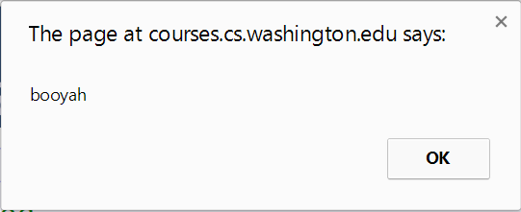
Obtrusive event handlers (bad)
<button onclick="okayClick();">OK</button> HTML
// called when OK button is clicked
function okayClick() {
alert("booyah");
} JS
output
this is bad style (HTML is cluttered with JS code)
goal: remove all JavaScript code from the HTML body

Slide 4
Attaching an event handler in JavaScript code
objectName.onevent = function; JS
<button id="ok">OK</button> HTML
var okButton = document.getElementById("ok");
okButton.onclick = okayClick; JS
it is legal to attach event handlers to elements' DOM objects in your JavaScript code
notice that you do not put parentheses after the function's name
this is better style than attaching them in the HTML

Slide 5
When does my code run?
<html>
<head>
<script src="myfile.js" type="text/javascript"></script>
</head>
<body> ... </body> </html> HTML
var x = 3;
function f(n) { return n + 1; }
function g(n) { return n - 1; }
x = f(x); JS
your file's JS code runs the moment the browser loads the script tag
any variables are declared immediately
any functions are declared but not called, unless your global code explicitly calls them
at this point in time, the browser has not yet read your page's body
none of the DOM objects for tags on the page have been created yet

Slide 6
A failed attempt at being unobtrusive
<html>
<head>
<script src="myfile.js" type="text/javascript"></script>
</head>
<body>
<div><button id="ok">OK</button></div> HTML
var ok = document.getElementById("ok");
ok.onclick = okayClick; // error: null JS
problem: global JS code runs the moment the script is loaded
script in head is processed before page's body has loaded
no elements are available yet or can be accessed yet via the DOM
we need a way to attach the handler after the page has loaded...

Slide 7
The window.onload event
function functionName() {
// code to initialize the page
...
}
// run this function once the page has finished loading
window.onload = functionName;
there is a global event called window.onload event that occurs at the moment the page body is done being loaded
if you attach a function as a handler for window.onload, it will run at that time

Slide 8
An unobtrusive event handler
<button id="ok">OK</button> <!-- (1) --> HTML
// called when page loads; sets up event handlers
function pageLoad() {
var ok = document.getElementById("ok"); // (3)
ok.onclick = okayClick;
}
function okayClick() {
alert("booyah"); // (4)
}
window.onload = pageLoad; // (2) JS
output

Slide 9
Common unobtrusive JS errors
event names are all lowercase, not capitalized like most variables
window.onLoad = pageLoad;
window.onload = pageLoad;
you shouldn't write () when attaching the handler (if you do, it calls the function immediately, rather than setting it up to be called later)
ok.onclick = okayClick();
ok.onclick = okayClick;
our JSLint checker will catch this mistake
related: can't directly call functions like alert; must enclose in your own function
ok.onclick = alert("booyah");
ok.onclick = okayClick;
function okayClick() { alert("booyah"); }

Slide 10
Anonymous functions
function(parameters) {
statements;
} JS
JavaScript allows you to declare anonymous functions
quickly creates a function without giving it a name
can be stored as a variable, attached as an event handler, etc.

Slide 11
Anonymous function example
window.onload = function() {
var ok = document.getElementById("ok");
ok.onclick = okayClick;
};
function okayClick() {
alert("booyah");
} JS
output
or the following is also legal (though harder to read and bad style):
window.onload = function() {
document.getElementById("ok").onclick = function() {
alert("booyah");
};
};

Slide 12
Unobtrusive styling
function okayClick() {
this.style.color = "red";
this.className = "highlighted";
} JS
.highlighted { color: red; } CSS
well-written JavaScript code should contain as little CSS as possible
use JS to set CSS classes/IDs on elements
define the styles of those classes/IDs in your CSS file

Slide 13
The danger of global variables
var count = 0;
function incr(n) {
count += n;
}
function reset() {
count = 0;
}
incr(4);
incr(2);
console.log(count);
JS
globals can be bad; other code and other JS files can see and modify them
How many global symbols are introduced by the above code?
3 global symbols: count, incr, and reset

Slide 14
Enclosing code in a function
function everything() {
var count = 0;
function incr(n) {
count += n;
}
function reset() {
count = 0;
}
incr(4);
incr(2);
console.log(count);
}
everything();
// call the function to run the code
the above example moves all the code into a function; variables and functions declared inside another function are local to it, not global
How many global symbols are introduced by the above code?
1 global symbol: everything (can we get it down to 0?)

Slide 15
The "module pattern"
(function() {
statements;
})(); JS
wraps all of your file's code in an anonymous function that is declared and immediately called
0 global symbols will be introduced!
the variables and functions defined by your code cannot be messed with externally

Slide 16
Module pattern example
(function() {
var count = 0;
function incr(n) {
count += n;
}
function reset() {
count = 0;
}
incr(4);
incr(2);
console.log(count);
})();
JS
How many global symbols are introduced by the above code?
0 global symbols

Slide 17
JavaScript "strict" mode
"use strict";
your code...
writing "use strict"; at the very top of your JS file turns on strict syntax checking:
shows an error if you try to assign to an undeclared variable
stops you from overwriting key JS system libraries
forbids some unsafe or error-prone language features
You should always turn on strict mode for your code in this class!

Slide 18
Exercise: random colors
Create a page with a button on it. Whenever that button is pressed, turn the background of the page a different random color.
Hints:
Math.random() will give you a random number between 0 and 1
Multiply that by the range of random numbers you want: Math.random() * 10
Turn that into an integer using Math.floor(): Math.floor(Math.random() * 10)
You can create a random color by generating 3 random numbers between 0 and 256 and setting your css as: background-color: rgb(23, 234, 4)

Slide 19
Checkboxes: <input>
yes/no choices that can be checked and unchecked (inline)
<input type="checkbox" name="lettuce" /> Lettuce
<input type="checkbox" name="tomato" checked="checked" /> Tomato
<input type="checkbox" name="pickles" checked="checked" /> Pickles HTML
output
none, 1, or many checkboxes can be checked at same time
when sent to server, any checked boxes will be sent with value on:
http://webster.cs.washington.edu/params.php?tomato=on&pickles=on
use checked="checked" attribute in HTML to initially check the box

Slide 20
Radio buttons: <input>
sets of mutually exclusive choices (inline)
<input type="radio" name="cc" value="visa" checked="checked" /> Visa
<input type="radio" name="cc" value="mastercard" /> MasterCard
<input type="radio" name="cc" value="amex" /> American Express HTML
output
grouped by name attribute (only one can be checked at a time)
must specify a value for each one or else it will be sent as value on

Slide 21
Text labels: <label>
<label><input type="radio" name="cc" value="visa" checked="checked" /> Visa</label>
<label><input type="radio" name="cc" value="mastercard" /> MasterCard</label>
<label><input type="radio" name="cc" value="amex" /> American Express</label> HTML
output
associates nearby text with control, so you can click text to activate control
can be used with checkboxes or radio buttons
label element can be targeted by CSS style rules

Slide 22
Drop-down list: <select>, <option>
menus of choices that collapse and expand (inline)
<select name="favoritecharacter">
<option>Jerry</option>
<option>George</option>
<option selected="selected">Kramer</option>
<option>Elaine</option>
</select> HTML
output
option element represents each choice
select optional attributes: disabled, multiple, size
optional selected attribute sets which one is initially chosen

Slide 23
Using <select> for lists
<select name="favoritecharacter[]" size="3" multiple="multiple">
<option>Jerry</option>
<option>George</option>
<option>Kramer</option>
<option>Elaine</option>
<option selected="selected">Newman</option>
</select> HTML
output
optional multiple attribute allows selecting multiple items with shift- or ctrl-click
must declare parameter's name with [] if you allow multiple selections
option tags can be set to be initially selected

Slide 24
Option groups: <optgroup>
<select name="favoritecharacter">
<optgroup label="Major Characters">
<option>Jerry</option>
<option>George</option>
<option>Kramer</option>
<option>Elaine</option>
</optgroup>
<optgroup label="Minor Characters">
<option>Newman</option>
<option>Susan</option>
</optgroup>
</select> HTML
output
What should we do if we don't like the bold appearance of the optgroups?

Slide 25
Grouping input: <fieldset>, <legend>
groups of input fields with optional caption (block)
<fieldset>
<legend>Credit cards:</legend>
<input type="radio" name="cc" value="visa" checked="checked" /> Visa
<input type="radio" name="cc" value="mastercard" /> MasterCard
<input type="radio" name="cc" value="amex" /> American Express
</fieldset> HTML
output
fieldset groups related input fields, adds a border; legend supplies a caption

Slide 26
Styling form controls
element[attribute="value"] {
property : value;
property : value;
...
property : value;
} CSS
input[type="text"] {
background-color: yellow;
font-weight: bold;
} CSS
output
attribute selector: matches only elements that have a particular attribute value
useful for controls because many share the same element (input)

Slide 27
More about form controls
<select id="captain">
<option value="kirk">James T. Kirk</option>
<option value="picard">Jean-Luc Picard</option>
<option value="cisco">Benjamin Cisco</option>
</select>
<label> <input id="trekkie" type="checkbox" /> I'm a Trekkie </label> HTML
output
when talking to a text box or select, you usually want its value
when talking to a checkbox or radio button, you probably want to know if it's checked (true/false)

Slide 28
The innerHTML property
<button onclick="addText();">Click me!</button>
<span id="output">Hello </span> HTML
function addText() {
var span = document.getElementById("output");
span.innerHTML += " bro";
} JS
output
can change the text inside most elements by setting the innerHTML property

Slide 29
Abuse of innerHTML
// bad style!
var paragraph = document.getElementById("welcome");
paragraph.innerHTML =
"<p>text and <a href=\"page.html\">link</a>";
JS
innerHTML can inject arbitrary HTML content into the page
however, this is prone to bugs and errors and is considered poor style
we forbid using innerHTML to inject HTML tags; inject plain text only
(later, we'll see a better way to inject content with HTML tags in it)

Slide 30
Exercise: tip calculator
Create a page that allows the user to input a price and a percentage they would like to tip. Your page should show the user the total cost (original price plus tip) when the user clicks a button.
Turn the tip red if the percentage is less than 15.
Hint: use console.log() to output variables and help you find bugs in your page

