Slide 1
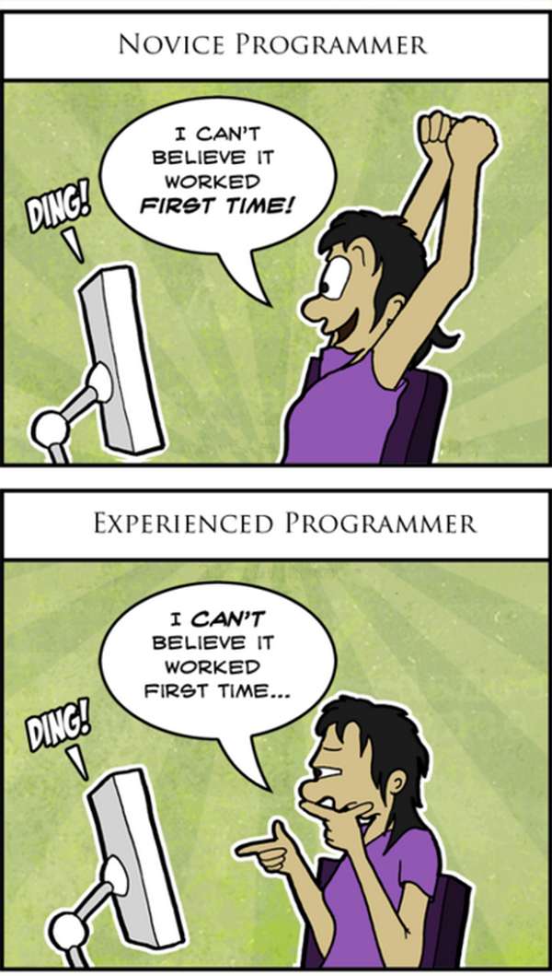
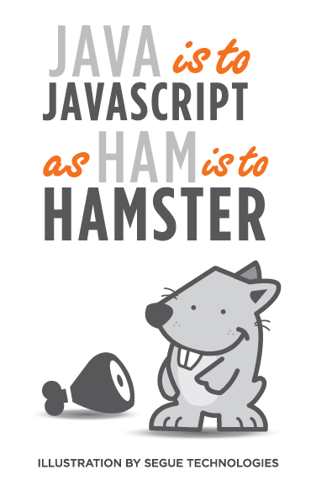
CSc 337
Lecture 11: Keyboard Events

Slide 2
Multiple window.onload listeners
window.onload = function;
window.addEventListener("load", function); JS
it is considered bad form to directly assign to window.onload
multiple .js files could be linked to the same page, and if they all need to run code when the page loads, their window.onload statements will override each other
by calling window.addEventListener instead, all of them can run their code when the page is loaded

Slide 3
Mouse events
click | user presses/releases mouse button on the element
dblclick | user presses/releases mouse button twice on the element
mousedown | user presses down mouse button on the element
mouseup | user releases mouse button on the element
clicking
mouseover | mouse cursor enters the element's box
mouseout | mouse cursor exits the element's box
mousemove | mouse cursor moves around within the element's box
movement

Slide 4
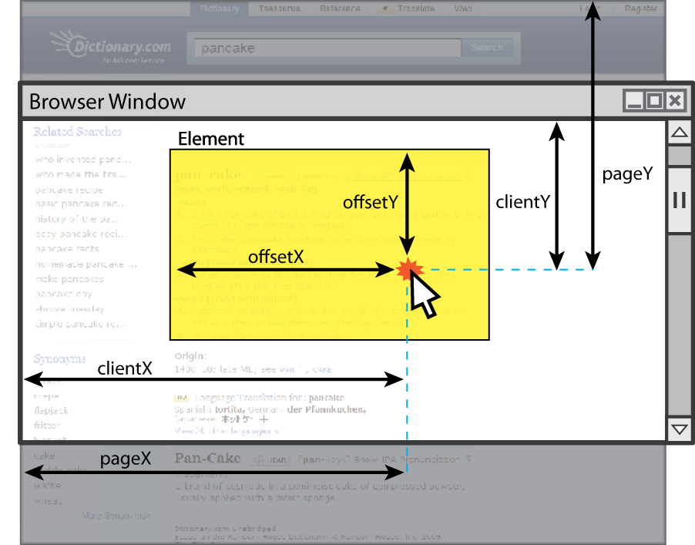
Mouse event objects
The event passed to a mouse handler has these properties:
property/method | description
clientX clientY | coordinates in browser window
screenX screenY | coordinates in screen
offsetX offsetY | coordinates in element (non-standard)
button | integer representing which button was pressed (0=Left, 1=Middle, 2=Right)

Slide 5
Keyboard/text events
name | description
focus | this element gains keyboard focus (attention of user's keyboard)
blur | this element loses keyboard focus
keydown | user presses a key while this element has keyboard focus
keyup | user releases a key while this element has keyboard focus
keypress | user presses and releases a key while this element has keyboard focus
select | this element's text is selected or deselected

Slide 6
Key event objects
property name | description
keyCode | ASCII integer value of key that was pressed (convert to char with String.fromCharCode)
altKey, ctrlKey, shiftKey | true if Alt/Ctrl/Shift key is being held
issue: if the event you attach your listener to doesn't have the focus, you won't hear the event
possible solution: attach key listener to entire page body, document, an outer element, etc.

Slide 7
Key event example
document.getElementById("textbox").onkeydown = textKeyDown;
...
function textKeyDown(event) {
var key = String.fromCharCode(event.keyCode);
if (key == 'S' && event.altKey) {
alert("Save the document!");
this.value = this.value.split("").join("-");
}
} JS
each time you push down any key, even a modifier such as Alt or Ctrl, the keydown event fires
if you hold down the key, the keydown event fires repeatedly
keypress event is a bit flakier and inconsistent across browsers

Slide 8
Stopping an event
event method name | description
preventDefault | stops the browser from doing its normal action on an event; for example, stops the browser from following a link when <a> tag is clicked, or stops browser from submitting a form when submit button is clicked
stopPropagation | stops the browser from showing this event to any other objects that may be listening for it
you can also return false; from your event handler to stop an event

Slide 9
Stopping an event, example
<form id="exampleform" action="http://foo.com/foo.php">...</form>
window.onload = function() {
var form = document.getElementById("exampleform");
form.onsubmit = checkData;
};
function checkData(event) {
if (document.getElementById("state").length != 2) {
alert("Error, invalid city/state."); // show error message
event.preventDefault();
return false; // stop form submission
}
} JS

Slide 10
Some useful key codes
keyboard key | event keyCode
Backspace | 8
Tab | 9
Enter | 13
Escape | 27
Page Up, Page Down, End, Home | 33, 34, 35, 36
Left, Up, Right, Down | 37, 38, 39, 40
Insert, Delete | 45, 46
Windows/Command | 91
F1 - F12 | 112 - 123

Slide 11
Page/window events
name | description
contextmenu | the user right-clicks to pop up a context menu
error | an error occurs when loading a document or an image
load, unload | the browser loads the page
resize | the browser window is resized
scroll | the user scrolls the viewable part of the page up/down/left/right
unload | the browser exits/leaves the page
The above can be handled on the window object

Slide 12
Removing a node from the page
function slideClick() {
var bullet = document.getElementById("removeme");
bullet.parentNode.removeChild(bullet);
} JS
odd idiom: obj.parentNode.remove(obj);

Slide 13
Getting/setting CSS classes
function highlightField() {
// turn text yellow and make it bigger
var text = document.getElementById("text");
if (!text.className) {
text.className = "highlight";
} else if (text.className.indexOf("invalid") < 0) {
text.className += " highlight"; // awkward
}
} JS
JS DOM's className property corresponds to HTML class attribute
somewhat clunky when dealing with multiple space-separated classes as one big string

Slide 14
Getting/setting CSS classes with classList
function highlightField() {
// turn text yellow and make it bigger
var text = document.getElementById("text");
if (!text.classList.contains("invalid")) {
text.classList.add("highlight");
}
} JS
classList collection has methods add, remove, contains, toggle to manipulate CSS classes
similar to existing className DOM property, but don't have to manually split by spaces

Slide 15
Activity: Mouse Maze

Slide 16
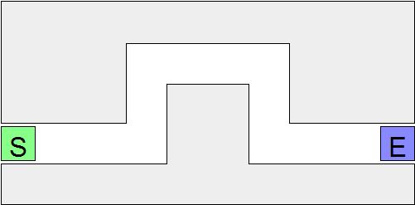
Mouse Maze
This lab practices unobtrusive JavaScript events and the Document Object Model (DOM). We'll write a page with a "maze" to navigate with the mouse. You will write maze.js to implement the maze behavior.

Slide 17
Info about the maze
Download the file below (right-click, Save Target As...) to get started: maze.html
The difficulty is in having the dexterity to move the mouse through without touching any walls. When the mouse cursor touches a wall, all walls turn red and a "You lose" message shows. Touching the Start button with the mouse removes the red coloring from the walls.
The maze walls are 5 div elements. Our provided CSS puts the divs into their proper places.
<div id="maze">
<div id="start">S</div>
<div class="boundary" id="boundary1"></div>
<div class="boundary"></div>
<div class="boundary"></div>
<div class="boundary"></div>
<div class="boundary"></div>
<div id="end">E</div>
</div>

Slide 18
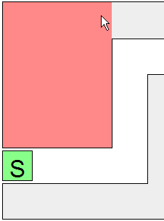
Exercise : Single boundary turns red
Write code so that when the user moves the mouse onto a single one of the maze's walls (onmouseover), that wall will turn red. Use the top-left wall; it is easier because it has an id of boundary1.
Write your JS code unobtrusively, without modifying maze.html.
Write a window.onload handler that sets up any event handlers.
Handle the event on the wall by making it turn red.
Turn the wall red by setting it to have the provided CSS class you lose,
using the classList property.

Slide 19
Exercise : All boundaries glow red on hover
Make it so that all maze walls turn red when the mouse enters any one of them.
You'll need to attach an event handler to each div that represents a wall of the maze.
It is harder to select all of these divs, since they do not have id attributes.
But they do all have a class of boundary. Use the document.querySelectorAll function to access them all.

Slide 20
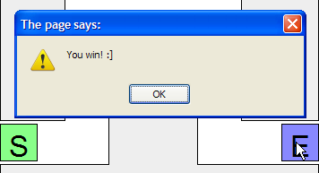
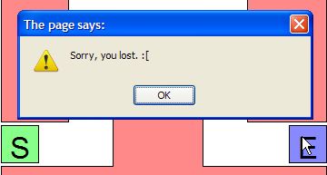
Exercise : Alert on completion of maze
Make it so that if the user reaches the end of the maze, a "You win!" alert message appears.
The end of the maze is a div with an id of end.
Don't pop up "You win!" unless the user makes it to the end without touching any walls.
Keep track of whether any walls were hit, so you'll know what to do when the end square is hit.

Slide 21
Exercise : Restartable maze
Make it so that when the user clicks the mouse on the Start square (a div with an id of start), the maze state will reset. That is, if the maze boundary walls are red, they will all return to their normal color, so that the user can try to get through the maze again.
You'll need to use the document.querySelectorAll function again to select all of the squares to set their color.

Slide 22
Exercise : JSLint
Verify your JavaScript code by making sure it passes JSLint with no errors.

Slide 23
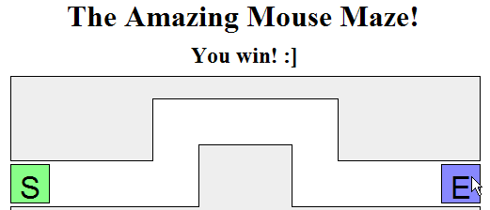
Exercise : On-page status updates
Instead of an alert, make the "You win" and "You lose" messages appear in the page itself.
The page has an (initially empty) h2 element on the page with an id of status. Put the win/lose text into that div when the user finishes the maze.

Slide 24
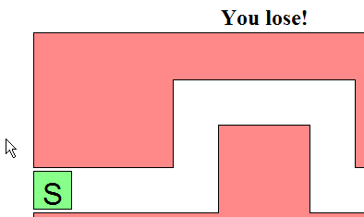
Exercise : Disallow cheating
It's too easy to cheat: Just move your mouse around the outside of the maze!
Fix this by making it so that if the user moves the mouse anywhere outside the maze after clicking the Start area, the walls will light up red and the player will lose the game.
To do this, you'll need to listen to other kinds of mouse events on other elements.

Slide 25
Exercise : Additional Features
Add a timer to the page so that once you start playing the maze, it starts the timer, and stops it when you complete the maze. Pop up the time in an alert message to the user.
Modify the timer so that instead of popping up an alert, the timer is displayed in the page, and updates every second. When the maze ends, the timer on the page stops.
Implement a "lives" system - start out the user with 5 lives, and decrement each time they lose.
Implement the Konami Code - Make the user type "Up Up Down Down Left Right Left Right B A" to unlock 999 lives.

