Slide 1
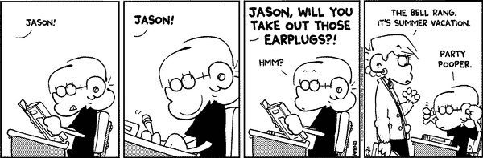
CSc 337
Lecture 18: Canvas

Slide 2
Canvas
HTML 5 tag
  creates a canvas that you can draw on
    similar to DrawingPanel in CSC 110
  Flexible, powerful, useful but may not be fully implemented by all browsers
  <canvas width="100" height="100"></canvas>

Slide 3
Canvas
To access your canvas:
var canvas = document.getElementById(id);
var ctx = canvas.getContext("2d");
The context is like a pen. You can use it to draw on your canvas.

Slide 4
Drawing Shapes
Setting colors:
ctx.fillStyle = colorString;
ctx.strokeStyle = colorString;
Rectangle
ctx.fillRect(x, y, width, height);
Circle
ctx.beginPath();
ctx.arc(x, y, radius, startAngle, endAngle);
ctx.stroke();
Line
ctx.moveTo(startX, startY);
ctx.lineTo(endX, endY);
ctx.stroke();

Slide 5
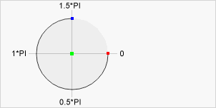
Drawing Circles
var c = document.getElementById("myCanvas");
var ctx = c.getContext("2d");
ctx.beginPath();
ctx.arc(100, 75, 50, 0, 2 * Math.PI);
ctx.stroke();

Slide 6
Animation
setInterval
  This works fine but it is not as good
window.requestAnimationFrame(function)
  better because it only draws when the browser wants to draw
function update() {
var canvas = document.getElementById("myCanvas");
var ctx = canvas.getContext("2d");
draw stuff
window.requestAnimationFrame(update);
}

Slide 7
Activity
Write code to draw a circle on a canvas and make it move downward by one pixel every half second until it hits the bottom of the canvas. Once it hits the bottom make it move up by one pixel until it hits the top.

Slide 8
Other Canvas Context Methods
Full list: https://www.w3schools.com/tags/ref_canvas.asp
moveTo(x, y) | Moves the path to the specified point in the canvas, without creating a line
lineTo(x, y) | Adds a new point and creates a line to that point from the last specified point in the canvas

Slide 9
Activity: Drawing Program
Create a web page that allows the user to draw with the mouse on a canvas.

