Slide 1
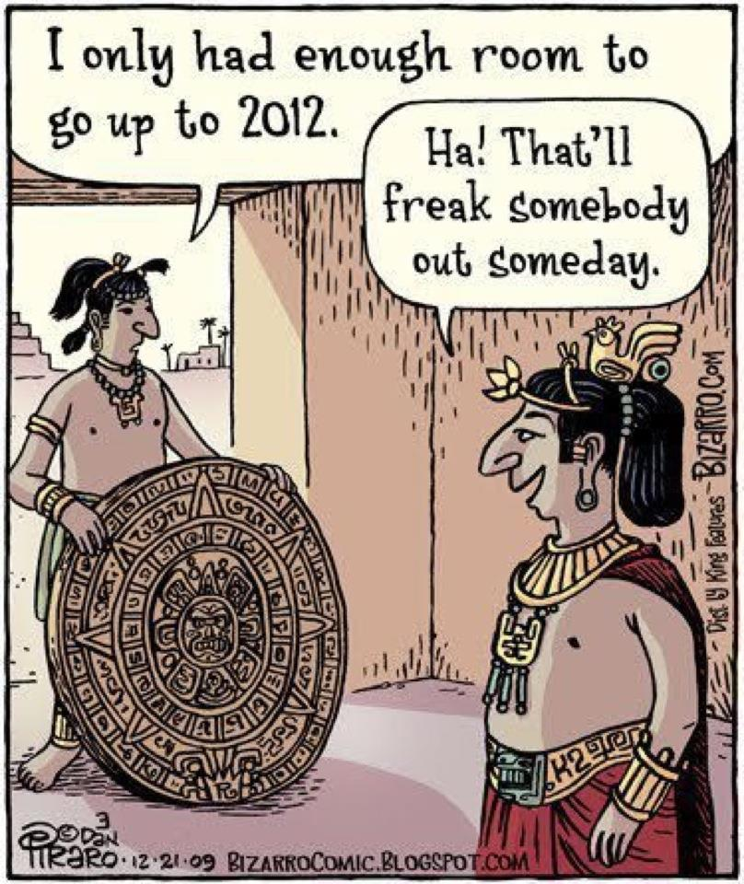
CSc 337
Lecture 19: Canvas

Slide 2
Canvas and Events
You can attach an event listener to a canvas just like you can anything else
Activity: Make a line of 10 circles follow your mouse when it moves over a canvas

Slide 3
Moving the Canvas
What happens if the canvas isn't in the upper left hand corner of the page?

Slide 4
Incorrect clientX and clientY solution
You can get the location of the canvas using the following code:
let rect = canvas.getBoundingClientRect();
This contains data about the left and top. You can find the actual location of the mouse using the following:
X position: event.clientX - rect.left
Y position: event.clientY - rect.top

Slide 5
Other Canvas Context Methods
Full list: https://www.w3schools.com/tags/ref_canvas.asp
moveTo(x, y) | Moves the path to the specified point in the canvas, without creating a line
lineTo(x, y) | Adds a new point and creates a line to that point from the last specified point in the canvas

Slide 6
Drawing a line with the mouse
How can you draw a line with the mouse?
Where should you begin the path?
context.beginPath();
context.lineTo(x, y);
context.stroke()

Slide 7
Activity: Drawing a line
Create a web page that draws a line under the mouse as it moves across the canvas.

Slide 8
Gradients
createLinearGradient() | Creates a linear gradient (to use on canvas content)
createPattern() | Repeats a specified element in the specified direction
createRadialGradient() | Creates a radial/circular gradient (to use on canvas content)
addColorStop() | Specifies the colors and stop positions in a gradient object
All called on the context.

Slide 9
Linear Gradient
Linear gradient takes 4 parameters: start x, start y, stop x, stop y
Example:
let context = canvas.getContext("2d");
let gradient = context.createLinearGradient(0, 0, 100, 0);

Slide 10
Linear Gradient
Add colors to the gradient using addColorStop.
Code to create a black -> white gradient:
var gradient = context.createLinearGradient(0,0,170,0);
gradient.addColorStop(0, "black");
gradient.addColorStop(1, "white");
context.fillStyle = gradient;
context.fillRect(20,20,150,100);
Note that you must set the fillStyle to the gradient you created and actually draw the shape with it.

Slide 11
Activity: create a gradient
Create a horizontal gradient that goes from red to green to blue. Create a vertical gradient over the top of it that goes from 0 opacity to black total opacity.

Slide 12
Getting a canvas pixel
You can get the value of pixels on a canvas using getImageData. It takes an x location, a y location, a width and a height as parameters.
let context = canvas.getContext("2d");
let data = context.getImageData(50, 50, 1, 1);
console.log("red: " + data.data[0] + "green: " +
data.data[1] + "blue: " + data.data[2]);

Slide 13
Activity
Get the color of your canvas (the one that you drew a gradient on) when the user clicks on it. Turn the background of your page that color.

