Slide 1
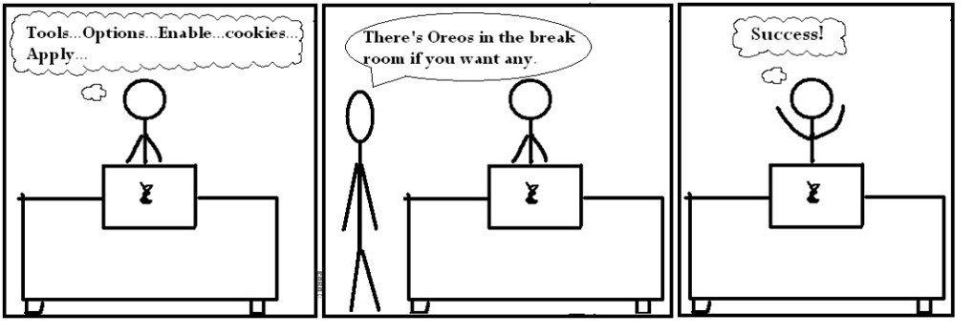
CSC 337
Lecture 20: Relational Databases and SQL

Slide 2
Relational databases
relational database: A method of structuring data as tables associated to each other by shared attributes.
a table row corresponds to a unit of data called a record; a column corresponds to an attribute of that record
relational databases typically use Structured Query Language (SQL) to define, manage, and search data

Slide 3
Why use a database?
powerful: can search it, filter data, combine data from multiple sources
fast: can search/filter a database very quickly compared to a file
big: scale well up to very large data sizes
safe: built-in mechanisms for failure recovery (e.g. transactions)
multi-user: concurrency features let many users view/edit data at same time
abstract: provides layer of abstraction between stored data and app(s)
many database programs understand the same SQL commands

Slide 4
Why use SQL?
Better for relational data
Still more popular
Strong opinion about this? Let me know!

Slide 5
Database software
Oracle
Microsoft SQL Server (powerful) and Microsoft Access (simple)
PostgreSQL (powerful/complex free open-source database system)
SQLite (transportable, lightweight free open-source database system)
MySQL (simple free open-source database system)
many servers run "LAMP" (Linux, Apache, MySQL, and PHP)
Wikipedia is run on PHP and MySQL
we will use MySQL in this course

Slide 6
Example csc337simpsons database
id | name | email
123 | Bart | bart@fox.com
456 | Milhouse | milhouse@fox.com
888 | Lisa | lisa@fox.com
404 | Ralph | ralph@fox.com
id | name
1234 | Krabappel
5678 | Hoover
9012 | Obourn
id | name | teacher_id
10001 | Computer Science 142 | 1234
10002 | Computer Science 143 | 5678
10003 | Computer Science 154 | 9012
10004 | Informatics 100 | 1234
student_id | course_id | grade
123 | 10001 | B-
123 | 10002 | C
456 | 10001 | B+
888 | 10002 | A+
888 | 10003 | A+
404 | 10004 | D+
teachers
students
courses
grades
to test queries on this database, use username csc337homer, password d0ughnut

Slide 7
Example csc337world database
code | name | continent | independence_year | population | gnp | head_of_state | ...
AFG | Afghanistan | Asia | 1919 | 22720000 | 5976.0 | Mohammad Omar | ...
NLD | Netherlands | Europe | 1581 | 15864000 | 371362.0 | Beatrix | ...
... | ... | ... | ... | ... | ... | ... | ...
countries (Other columns: region, surface_area, life_expectancy, gnp_old, local_name, government_form, ca pital, code2)
id | name | country_code | district | population
3793 | New York | USA | New York | 8008278
1 | Los Angeles | USA | California | 3694820
... | ... | ... | ... | ...
country_code | language | official | percentage
AFG | Pashto | T | 52.4
NLD | Dutch | T | 95.6
... | ... | ... | ...
cities
languages
to test queries on this database, use username csc337traveler, password packmybags

Slide 8
Example imdb database
id | first_name | last_name | gender
433259 | William | Shatner | M
797926 | Britney | Spears | F
831289 | Sigourney | Weaver | F
...
id | name | year | rank
112290 | Fight Club | 1999 | 8.5
209658 | Meet the Parents | 2000 | 7
210511 | Memento | 2000 | 8.7
...
actor_id | movie_id | role
433259 | 313398 | Capt. James T. Kirk
433259 | 407323 | Sgt. T.J. Hooker
797926 | 342189 | Herself
...
actors
movies
roles
movie_id | genre
209658 | Comedy
313398 | Action
313398 | Sci-Fi
...
id | first_name | last_name
24758 | David | Fincher
66965 | Jay | Roach
72723 | William | Shatner
...
director_id | movie_id
24758 | 112290
66965 | 209658
72723 | 313398
...
movies_genres
directors
movies_directors
also available, imdb_small with fewer records (for testing queries)

Slide 9
SQL basics
SELECT name FROM cities WHERE id = 17; SQL
INSERT INTO countries VALUES ('SLD', 'ENG', 'T', 100.0); SQL
Structured Query Language (SQL): a language for searching and updating a database
a standard syntax that is used by all database software (with minor incompatibilities)
generally case-insensitive
a declarative language: describes what data you are seeking, not exactly how to find it

Slide 10
The SQL SELECT statement
SELECT column(s) FROM table; SQL
SELECT name, code FROM countries; SQL
name | code
China | CHN
United States | IND
Indonesia | USA
Brazil | BRA
Pakistan | PAK
... | ...
the SELECT statement searches a database and returns a set of results
the column name(s) written after SELECT filter which parts of the rows are returned
table and column names are case-sensitive

Slide 11
The DISTINCT modifier
SELECT DISTINCT column(s) FROM table; PHP
eliminates duplicates from the result set
SELECT language
FROM languages; SQL
language
Dutch
English
English
Papiamento
Spanish
Spanish
Spanish
...
SELECT DISTINCT language
FROM languages; SQL
language
Dutch
English
Papiamento
Spanish
...

Slide 12
The WHERE clause
SELECT column(s) FROM table WHERE condition(s); SQL
SELECT name, population FROM cities WHERE country_code = "FSM";
name | population
Weno | 22000
Palikir | 8600
WHERE clause filters out rows based on their columns' data values
in large databases, it's critical to use a WHERE clause to reduce the result set size
suggestion: when trying to write a query, think of the FROM part first, then the WHERE part, and lastly the SELECT part

Slide 13
More about the WHERE clause
WHERE column operator value(s) SQL
SELECT name, gnp FROM countries WHERE gnp > 2000000; SQL
the WHERE portion of a SELECT statement can use the following operators:
=, >, >=, <, <=
<> : not equal
BETWEEN min AND max
LIKE pattern
IN (value, value, ..., value)
code | name | gnp
JPN | Japan | 3787042.00
DEU | Germany | 2133367.00
USA | United States | 8510700.00
... | ... | ...

Slide 14
Multiple WHERE clauses: AND, OR
SELECT * FROM cities WHERE code = 'USA' AND population >= 2000000;
id | name | country_code | district | population
3793 | New York | USA | New York | 8008278
3794 | Los Angeles | USA | California | 3694820
3795 | Chicago | USA | Illinois | 2896016
... | ... | ... | ... | ...
multiple WHERE conditions can be combined using AND and OR

Slide 15
Approximate matches: LIKE
WHERE column LIKE pattern SQL
SELECT code, name, population FROM countries WHERE name LIKE 'United%'; SQL
LIKE 'text%' searches for text that starts with a given prefix
LIKE '%text' searches for text that ends with a given suffix
LIKE '%text%' searches for text that contains a given substring
code | name | population
ARE | United Arab Emirates | 2441000
GBR | United Kingdom | 59623400
USA | United States | 278357000
UMI | United States Minor Outlying Islands | 0

Slide 16
Sorting by a column: ORDER BY
ORDER BY column(s) SQL
SELECT code, name, population FROM countries
WHERE name LIKE 'United%' ORDER BY population; SQL
code | name | population
UMI | United States Minor Outlying Islands | 0
ARE | United Arab Emirates | 2441000
GBR | United Kingdom | 59623400
USA | United States | 278357000
can write ASC or DESC to sort in ascending (default) or descending order:
SELECT * FROM countries ORDER BY population DESC; SQL
can specify multiple orderings in decreasing order of significance:
SELECT * FROM countries ORDER BY population DESC, gnp; SQL

Slide 17
Limiting rows: LIMIT
LIMIT number SQL
SELECT name FROM cities WHERE name LIKE 'K%' LIMIT 5; SQL
name
Kabul
Khulna
Kingston upon Hull
Koudougou
Kafr al-Dawwar
can be used to get the top-N of a given category (ORDER BY and LIMIT)
also useful as a sanity check to make sure your query doesn't return 10⁷ rows

Slide 18
Querying databases in Node.js
You will need to install the node package called mysql.
npm install mysql

Slide 19
Connecting to a database
var mysql = require('mysql');
var con = mysql.createConnection({
host: hostname,
database: databasename,
user: username,
password: password,
debug: "true"
});
con.connect(function(err) {
if (err) throw err;
console.log("Connected!");
});

Slide 20
Connecting to a Database Example
var mysql = require('mysql');
var con = mysql.createConnection({
host: "mysql.allisonobourn.com",
database: "csc337world",
user: "csc337traveler",
password: "packmybags",
debug: "true"
});
con.connect(function(err) {
if (err) throw err;
console.log("Connected!");
});

Slide 21
Querying a Database
var mysql = require('mysql');
var con = mysql.createConnection({
host: "mysql.allisonobourn.com",
database: "csc337world",
user: "csc337traveler",
password: "packmybags",
debug: "true"
});
con.connect(function(err) {
if (err) throw err;
console.log("Connected!");
con.query("SELECT * FROM cities WHERE name='london'",
function (err, result, fields) {
if (err) throw err;
console.log("Result: " + result[0]["name"]);
});
});

Slide 22
Querying a Database Result
The result object returned by the query is a list of the rows that match the query.
Data for each column can be gotten by accessing the row at the column name.
result[0]["name"] from the last slide returns the name of the city in the first returned row.

Slide 23
HTML tables: <table>, <tr>, <td>
A 2D table of rows and columns of data (block element)
<table>
<tr><td>1,1</td><td>1,2 okay</td></tr>
<tr><td>2,1 real wide</td><td>2,2</td></tr>
</table> HTML
output
1,1 | 1,2 okay
2,1 real wide | 2,2
table defines the overall table, tr each row, and td each cell's data
tables are useful for displaying large row/column data sets
NOTE: tables are sometimes used by novices for web page layout, but this is not proper semantic HTML and should be avoided

Slide 24
Table headers, captions: <th>, <caption>
<table>
<caption>My important data</caption>
<tr><th>Column 1</th><th>Column 2</th></tr>
<tr><td>1,1</td><td>1,2 okay</td></tr>
<tr><td>2,1 real wide</td><td>2,2</td></tr>
</table> HTML
output
My important data
Column 1 | Column 2
1,1 | 1,2 okay
2,1 real wide | 2,2
th cells in a row are considered headers; by default, they appear bold
a caption at the start of the table labels its meaning

Slide 25
Styling tables
table { border: 2px solid black; caption-side: bottom; }
tr { font-style: italic; }
td { background-color: yellow; text-align: center; width: 30%; }
output
Column 1 | Column 2
1,1 | 1,2 okay
2,1 real wide | 2,2
My important data
all standard CSS styles can be applied to a table, row, or cell
table specific CSS properties:
border-collapse, border-spacing, caption-side, empty-cells, table-layout

Slide 26
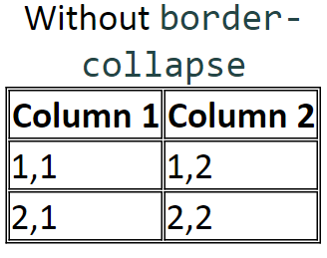
The border-collapse property
table, td, th { border: 2px solid black; }
table { border-collapse: collapse; } CSS
With border-collapse
Column 1 | Column 2
1,1 | 1,2
2,1 | 2,2
by default, the overall table has a separate border from each cell inside
the border-collapse property merges these borders into one

Slide 27
The rowspan and colspan attributes
<table>
<tr><th>Column 1</th><th>Column 2</th><th>Column 3</th></tr>
<tr><td colspan="2">1,1-1,2</td>
<td rowspan="3">1,3-3,3</td></tr>
<tr><td>2,1</td><td>2,2</td></tr>
<tr><td>3,1</td><td>3,2</td></tr>
</table> HTML
HTML
Column 1 | Column 2 | Column 3
1,1-1,2 |  | 1,3-3,3
2,1 | 2,2
3,1 | 3,2
colspan makes a cell occupy multiple columns; rowspan multiple rows
text-align and vertical-align control where the text appears within a cell

Slide 28
Column styles: <col>, <colgroup>
<table>
<col class="urgent" />
<colgroup class="highlight" span="2"></colgroup>
<tr><th>Column 1</th><th>Column 2</th><th>Column 3</th></tr>
<tr><td>1,1</td><td>1,2</td><td>1,3</td></tr>
<tr><td>2,1</td><td>2,2</td><td>2,3</td></tr>
</table> HTML
output
Column 1 | Column 2 | Column 3
1,1 | 1,2 | 1,3
2,1 | 2,2 | 2,3
col tag can be used to define styles that apply to an entire column (self-closing)
colgroup tag applies a style to a group of columns (NOT self-closing

Slide 29
Don't use tables for layout!
(borderless) tables appear to be an easy way to achieve grid-like page layouts
many "newbie" web pages do this (including many UW CSE web pages...)
but, a table has semantics; it should be used only to represent an actual table of data
instead of tables, use divs, widths/margins, floats, etc. to perform layout
tables should not be used for layout!
tables should not be used for layout!!
TABLES SHOULD NOT BE USED FOR LAYOUT!!!
TABLES SHOULD NOT BE USED FOR LAYOUT!!!!

Slide 30
Designing a query
Figure out the proper SQL queries in the following way:
Which table(s) contain the critical data? (FROM)
Which columns do I need in the result set? (SELECT)
How are tables connected (JOIN) and values filtered (WHERE)?
Test on a small data set (imdb_small).
Confirm on the real data set (imdb).
Try out the queries first in the MySQL console.
Write the Node.js code to run those same queries.
Make sure to check for SQL errors at every step!!

