Slide 1
CSc 337
Lecture 22: Creating a Database and More joins

Slide 2
Creating a database
In the command line in mysql:
CREATE DATABASE name;
To get to your database:
USE name

Slide 3
Creating a Database
CREATE TABLE name (
columnName type constraints,
...
columnName type constraints
);
CREATE TABLE students (
sid INTEGER UNSIGNED NOT NULL PRIMARY KEY,
name VARCHAR(20),
email VARCHAR(32)
);
adds/deletes an entire new table from this database
you can add constraints such as NOT NULL for a field that cannot be blank or PRIMARY KEY for a column that must be unique for every row
related commands: CREATE DATABASE, DROP TABLE, ALTER TABLE

Slide 4
Inserting into a database
INSERT INTO table VALUES ('value1', 'value2', …);

Slide 5
example.sql
create table zipcodes (
zip integer(5) primary key,
city varchar(30),
State varchar(20));
create table employees (
eno varchar(10) primary key,
ename varchar(30),
zip integer(5) references zipcodes,
hire_date date);
insert into zipcodes values (98225, 'Bellingham', 'WA');
insert into zipcodes values (95388, 'Winton', 'CA');
insert into zipcodes values (44242, 'Stow', 'OH');
insert into zipcodes values (61536, 'Hanna city', 'IL');
insert into zipcodes values (01254, 'Richmond', 'MA');
insert into zipcodes values (95124, 'San Jose', 'CA');
insert into zipcodes values (95382, 'Turlock', 'MA');
insert into zipcodes values (95380, 'Turlock', 'CA');
insert into employees values ('P0239400', 'Jones Hoffer',98225, '2000-12-12');
insert into employees values ('P0239401', 'Jeffrey Prescott',95388, '2006-01-01');
insert into employees values ('P0239402', 'Fred NcFaddeb',95124, '2008-09-01');

Slide 6
SQL data types
BOOLEAN
INTEGER
FLOAT
VARCHAR : a string
DATE, TIME, DATETIME
BLOB : binary data
quick reference

Slide 7
Database Design 1
name | email | course | grade
Bart | bart@fox.com | Computer Science 142 | B-
Bart | bart@fox.com | Computer Science 143 | C
Milhouse | milhouse@fox.com | Computer Science 142 | B+
Lisa | lisa@fox.com | Computer Science 143 | A+
Lisa | lisa@fox.com | Computer Science 190M | A+
Ralph | ralph@fox.com | Informatics 100 | D+
what's good and bad about this design?

Slide 8
Database Design 2
id | name | email
123 | Bart | bart@fox.com
456 | Milhouse | milhouse@fox.com
888 | Lisa | lisa@fox.com
404 | Ralph | ralph@fox.com
id | name
10001 | Computer Science 142
10002 | Computer Science 143
10003 | Computer Science 190M
10004 | Informatics 100
student_id | course_id | grade
123 | 10001 | B-
123 | 10002 | C
456 | 10001 | B+
888 | 10002 | A+
888 | 10003 | A+
404 | 10004 | D+
splitting data into multiple tables avoids redundancy
normalizing: splitting tables to improve structure and remove redundancy / anomalies
normalized tables are often linked by unique integer IDs

Slide 9
Related Tables and Keys
id | name | email
123 | Bart | bart@fox.com
456 | Milhouse | milhouse@fox.com
888 | Lisa | lisa@fox.com
404 | Ralph | ralph@fox.com
id | name
10001 | Computer Science 142
10002 | Computer Science 143
10003 | Computer Science 190M
10004 | Informatics 100
student_id | course_id | grade
123 | 10001 | B-
123 | 10002 | C
456 | 10001 | B+
888 | 10002 | A+
888 | 10003 | A+
404 | 10004 | D+
records of one table may be associated with record(s) in another table
record in Student table with student_id of 888 is Lisa Simpson's student info
records in Grade table with student_id of 888 are Lisa Simpson's course grades
primary key: a table column guaranteed to be unique for each record

Slide 10
Designing a query
Figure out the proper SQL queries in the following way:
Which table(s) contain the critical data? (FROM)
Which columns do I need in the result set? (SELECT)
How are tables connected (JOIN) and values filtered (WHERE)?
Test on a small data set (imdb_small).
Confirm on the real data set (imdb).
Try out the queries first in the query tool.
Write the NodeJS code to run those same queries.
Make sure to check for SQL errors at every step!!

Slide 11
Example imdb database
id | first_name | last_name | gender
433259 | William | Shatner | M
797926 | Britney | Spears | F
831289 | Sigourney | Weaver | F
...
id | name | year | rank
112290 | Fight Club | 1999 | 8.5
209658 | Meet the Parents | 2000 | 7
210511 | Memento | 2000 | 8.7
...
actor_id | movie_id | role
433259 | 313398 | Capt. James T. Kirk
433259 | 407323 | Sgt. T.J. Hooker
797926 | 342189 | Herself
...
actors
movies
roles
movie_id | genre
209658 | Comedy
313398 | Action
313398 | Sci-Fi
...
id | first_name | last_name
24758 | David | Fincher
66965 | Jay | Roach
72723 | William | Shatner
...
director_id | movie_id
24758 | 112290
66965 | 209658
72723 | 313398
...
also available, imdb_small with fewer records (for testing queries)
movies_genres
directors
movies_directors

Slide 12
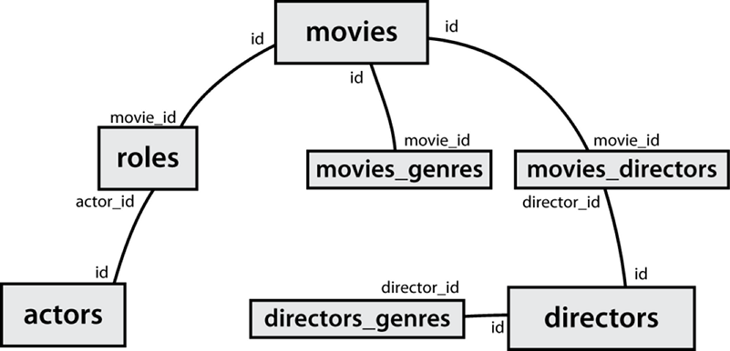
IMDb table relationships / ids

Slide 13
IMDb practice queries
What are the names of all movies released in 1995?
How many people played a part in the movie "Lost in Translation"?
What are the names of all the people who played a part in the movie "Lost in Translation"?
Who directed the movie "Fight Club"?
How many movies has Clint Eastwood directed?
What are the names of all movies Clint Eastwood has directed?
What are the names of all directors who have directed at least one horror film?
What are the names of every actor who has appeared in a movie directed by Christopher Nolan?

