Slide 1
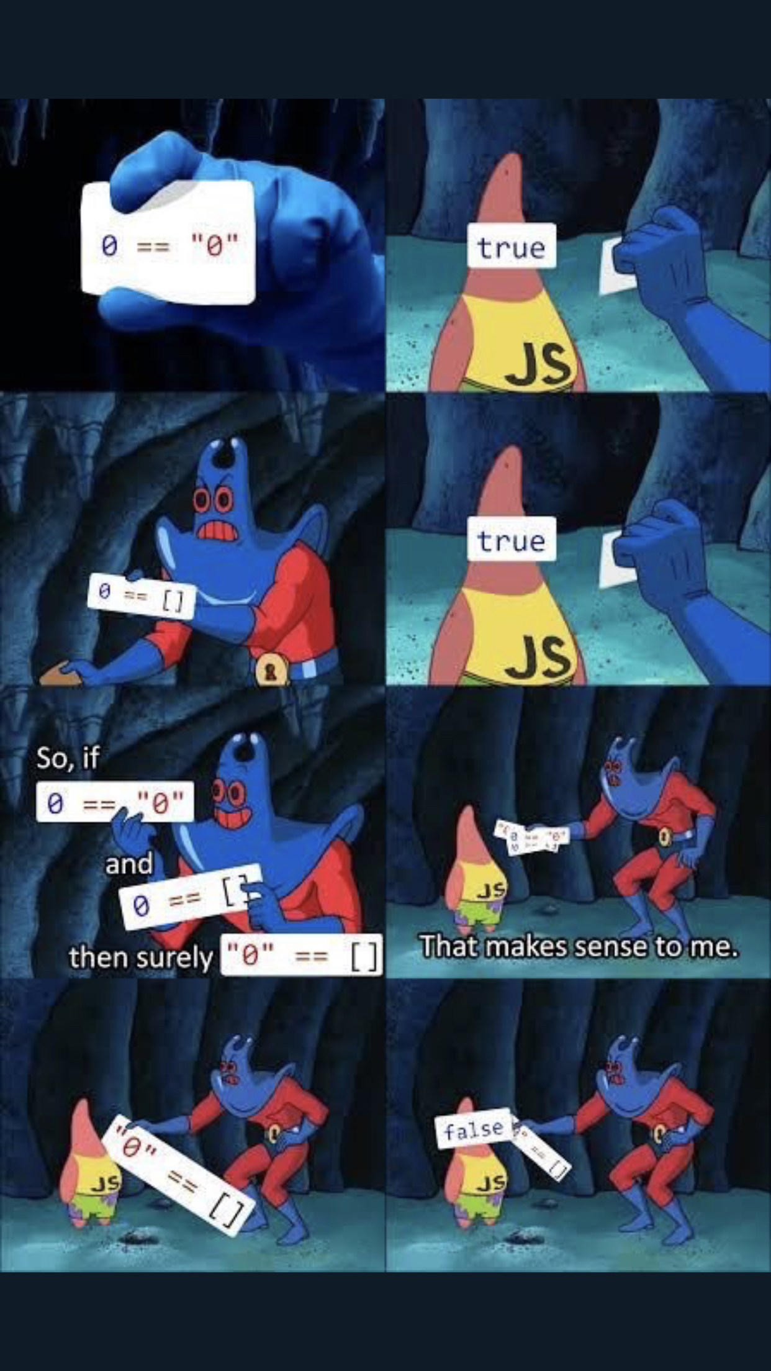
CSc 337
Lecture 23: Regular Expressions

Slide 2
What is form validation?
validation: ensuring that form's values are correct
some types of validation:
preventing blank values (email address)
ensuring the type of values
integer, real number, currency, phone number, Social Security number, postal address, email address, date, credit card number, ...
ensuring the format and range of values (ZIP code must be a 5-digit integer)
ensuring that values fit together (user types email twice, and the two must match)

Slide 3
A real form that uses validation

Slide 4
Client vs. server-side validation
Validation can be performed:
client-side (before the form is submitted)
can lead to a better user experience, but not secure (why not?)
server-side (in PHP code, after the form is submitted)
needed for truly secure validation, but slower
both
best mix of convenience and security, but requires most effort to program

Slide 5
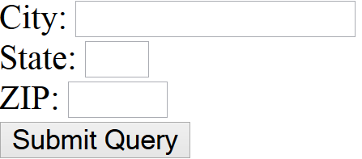
An example form to be validated
<div>
City: <input name="city" /> <br />
State: <input name="state" size="2" maxlength="2" /> <br />
ZIP: <input name="zip" size="5" maxlength="5" /> <br />
<input type="submit" />
</div>
output
Let's validate this form's data on the server...

Slide 6
Regular expressions
/^[a-zA-Z_\-]+@(([a-zA-Z_\-])+\.)+[a-zA-Z]{2,4}$/
regular expression ("regex"): a description of a pattern of text
can test whether a string matches the expression's pattern
can use a regex to search/replace characters in a string
regular expressions are extremely powerful but tough to read (the above regular expression matches email addresses)
regular expressions occur in many places:
Java: Scanner, String's split method (CSE 143 sentence generator)
supported by PHP, JavaScript, and other languages
many text editors (TextPad) allow regexes in search/replace
The site Rubular is useful for testing a regex.

Slide 7
Basic regular expressions
/abc/
in Node, regexes are strings that begin and end with /
the simplest regexes simply match a particular substring
the above regular expression matches any string containing "abc":
YES: "abc", "abcdef", "defabc", ".=.abc.=.", ...
NO: "fedcba", "ab c", "PHP", ...

Slide 8
Wildcards: .
A dot . matches any character except a \n line break
/.oo.y/ matches "Doocy", "goofy", "LooNy", ...
A trailing i at the end of a regex (after the closing /) signifies a case-insensitive match
/all/i matches “Allison Obourn", “small", “JANE GOODALL", ...

Slide 9
Special characters: |, (), \
| means OR
/abc|def|g/ matches "abc", "def", or "g"
There's no AND symbol. Why not?
() are for grouping
/(Homer|Marge) Simpson/ matches "Homer Simpson" or "Marge Simpson"
\ starts an escape sequence
many characters must be escaped to match them literally: / \ $ . [ ] ( ) ^ * + ?
/<br \/>/ matches lines containing <br /> tags

Slide 10
Quantifiers: *, +, ?
* means 0 or more occurrences
/abc*/ matches "ab", "abc", "abcc", "abccc", ...
/a(bc)*/ matches "a", "abc", "abcbc", "abcbcbc", ...
/a.*a/ matches "aa", "aba", "a8qa", "a!?xyz__9a", ...
+ means 1 or more occurrences
/Hi!+ there/ matches "Hi! there", "Hi!!! there", ...
/a(bc)+/ matches "abc", "abcbc", "abcbcbc", ...
? means 0 or 1 occurrences
/a(bc)?/ matches "a" or "abc"

Slide 11
More quantifiers: {min,max}
{min,max} means between min and max occurrences (inclusive)
/a(bc){2,4}/ matches "abcbc", "abcbcbc", or "abcbcbcbc"
min or max may be omitted to specify any number
{2,} means 2 or more
{,6} means up to 6
{3} means exactly 3

Slide 12
Practice exercise
When you search Google, it shows the number of pages of results as "o"s in the word "Google". What regex matches strings like "Google", "Gooogle", "Goooogle", ...? (try it) (data)
Answer: /Goo+gle/ (or /Go{2,}gle/)

Slide 13
Anchors: ^ and $
^ represents the beginning of the string or line; $ represents the end
/Jess/ matches all strings that contain Jess; /^Jess/ matches all strings that start with Jess; /Jess$/ matches all strings that end with Jess; /^Jess$/ matches the exact string "Jess" only
/^Alli.*Obourn$/ matches “AlliObourn", “Allie Obourn", “Allison E Obourn", ... but NOT “Allison Obourn stinks" or "I H8 Allison Obourn"
(on the other slides, when we say, /PATTERN/ matches "text", we really mean that it matches any string that contains that text)

Slide 14
Character sets: []
[] group characters into a character set; will match any single character from the set
/[bcd]art/ matches strings containing "bart", "cart", and "dart"
equivalent to /(b|c|d)art/ but shorter
inside [], many of the modifier keys act as normal characters
/what[!*?]*/ matches "what", "what!", "what?**!", "what??!", ...
What regular expression matches DNA (strings of A, C, G, or T)?
/[ACGT]+/

Slide 15
Character ranges: [start-end]
inside a character set, specify a range of characters with -
/[a-z]/ matches any lowercase letter
/[a-zA-Z0-9]/ matches any lower- or uppercase letter or digit
an initial ^ inside a character set negates it
/[^abcd]/ matches any character other than a, b, c, or d
inside a character set, - must be escaped to be matched
/[+\-]?[0-9]+/ matches an optional + or -, followed by at least one digit

Slide 16
Practice Exercises
What regular expression matches letter grades such as A, B+, or D- ? (try it) (data)
What regular expression would match UA Student ID numbers? (try it) (data)
What regular expression would match a sequence of only consonants, assuming that the string consists only of lowercase letters? (try it) (data)

Slide 17
Escape sequences
special escape sequence character sets:
\d matches any digit (same as [0-9]); \D any non-digit ([^0-9])
\w matches any word character (same as [a-zA-Z_0-9]); \W any non-word char
\s matches any whitespace character ( , \t, \n, etc.); \S any non-whitespace
What regular expression matches names in a "Last, First M." format with any number of spaces?
/\w+,\s+\w+\s+\w\./

Slide 18
Regular expressions in HTML forms
How old are you?
<input type="text" name="age" size="2" pattern="[0-9]+" title="an integer" />
HTML
output
HTML5 adds a new pattern attribute to input elements
the browser will refuse to submit the form unless the value matches the regex

Slide 19
Regular expressions in JavaScript
var str = "The rain in SPAIN stays mainly in the plain"; var res = str.match(/ain/g);
- The match function takes a regular expression as a parameter and returns the matches as an Array object
- The g option means global match
without it you will only get the first match in the string
- Note that there are no quotes around the regex

Slide 20
