Slide 1
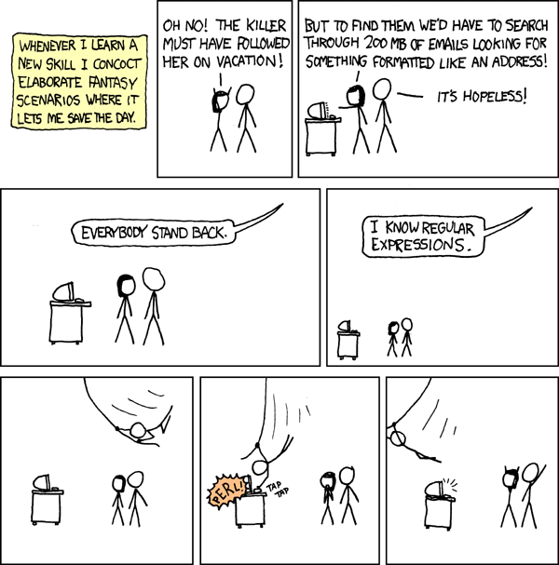
CSc 337
Lecture 24: Security

Slide 2
Our current view of security
until now, we have assumed:
valid user input
non-malicious users
nothing will ever go wrong
this is unrealistic!

Slide 3
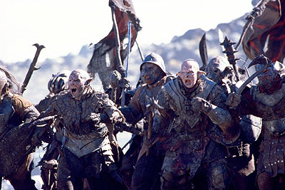
The real world
in order to write secure code, we must assume:
invalid input
evil users
incompetent users
everything that can go wrong, will go wrong
everybody is out to get you
botnets, hackers, script kiddies, KGB, etc. are out there
the security mindset: assume nothing; trust no one

Slide 4
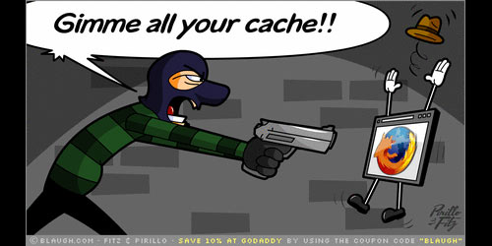
Attackers' goals
Why would an attacker target my site?
Read private data (user names, passwords, credit card numbers, grades, prices)
Change data (change a student's grades, prices of products, passwords)
Spoofing (pretending to be someone they are not)
Damage or shut down the site, so that it cannot be successfully used by others
Harm the reputation or credibility of the organization running the site
Spread viruses and other malware

Slide 5
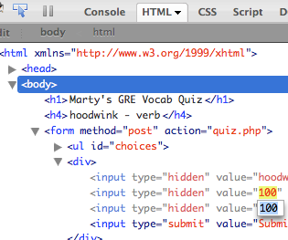
Tools that attackers use
Assume that the attacker knows about web dev and has the same tools you have:
Firebug
extensions e.g. Web Dev Toolbar
port scanners, e.g. nmap
network sniffers, e.g. Wireshark, EtherDetect, Firesheep

Slide 6
Some kinds of attacks
Denial of Service (DoS): Making a server unavailable by bombarding it with requests.
Social Engineering: Tricking a user into willingly compromising the security of a site (e.g. phishing).
Privilege Escalation: Causing code to run as a "privileged" context (e.g. "root").
Information Leakage: Allowing an attacker to look at data, files, etc. that he/she should not be allowed to see.
Man-in-the-Middle: Placing a malicious machine in the network and using it to intercept traffic.
Session Hijacking: Stealing another user's session cookie to masquerade as that user.
Cross-Site Scripting (XSS) or HTML Injection: Inserting malicious HTML or JavaScript content into a web page.
SQL Injection: Inserting malicious SQL query code to reveal or modify sensitive data.

Slide 7
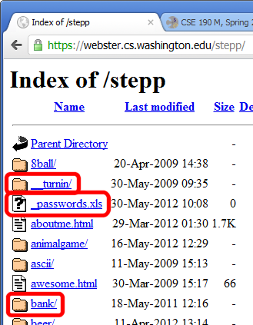
Information leakage
when the attacker can look at data, files, etc. that he/she should not be allowed to see
files on web server that should not be there
or have too generous of permissions (read/write to all)
directories that list their contents (indexing)
can be disabled on web server
guess the names of files, directories, resources
see loginfail.html, try loginsuccess.html
see user.html?id=123, try user.html?id=456
see /data/public, try /data/private

Slide 8
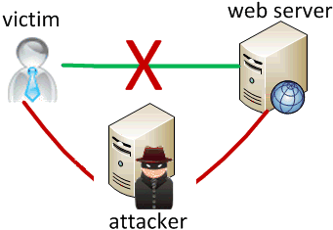
Man-in-the-middle attack
when the attacker listens on your network and reads and/or modifies your data
works if attacker can access and compromise any server/router between you and your server
also works if you are on the same local area network as the attacker
often, the attacker still sends your info back and forth to/from the real server, but he silently logs or modifies some of it along the way to his own benefit
e.g. listens for you to send your user name / password / credit card number / ...

Slide 9
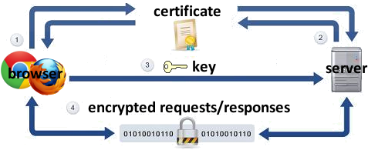
Secure HTTP (HTTPS)
HTTPS: encrypted version of HTTP protocol
all messages between client and server are encrypted so men in the middle cannot easily read them
servers can have certificates that verify their identity

Slide 10
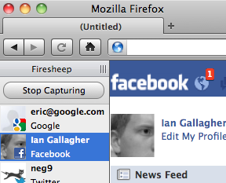
Session hijacking
when the attacker gets a hold of your session ID and masquerades as you
exploit sites that use HTTPS for only the initial login:
HTTPS: browser → server (POST login.html)
HTTPS: browser ← server (login.html + PHPSESSID cookie)
HTTP: browser → server (GET whatever.html + PHPSESSID cookie)
HTTP: browser ← server (whatever.html + PHPSESSID cookie)
attacker can listen to the network, get your session ID cookie, and make requests to the same server with that same session ID cookie to masquerade as you!
example: Firesheep

Slide 11
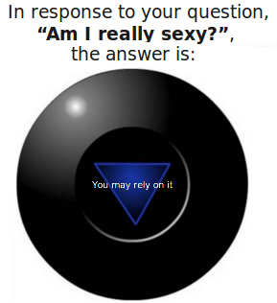
HTML injection
a flaw where a user is able to inject arbitrary HTML content into your page
This flaw often exists when a page accepts user input and inserts it bare into the page.
example: magic 8-ball (8ball.html)
What kinds of silly or malicious content can we inject into the page? Why is this bad?

Slide 12
Injecting HTML content
8ball_service.js?question=<em>lololol</em>
injected content can lead to:
annoyance / confusion
damage to data on the server
exposure of private data on the server
financial gain/loss
end of the human race as we know it
why is HTML injection bad? It allows others to:
disrupt the flow/layout of your site
put words into your mouth
possibly run malicious code on your users' computers

Slide 13
Cross-site scripting (XSS)
a flaw where a user is able to inject and execute arbitrary JavaScript code in your page
8ball_service.js?question=<script type='text/javascript'>alert('pwned');</script>
JavaScript is often able to be injected because of a previous HTML injection
Try submitting this as the 8-ball's question in Firefox:
<script type="text/javascript" src="http://panzi.github.com/Browser-Ponies/basecfg.js" id="browser-ponies-config"></script><script type="text/javascript" src="http://panzi.github.com/Browser-Ponies/browserponies.js" id="browser-ponies-script"></script><script type="text/javascript">/* <![CDATA[ */ (function (cfg) {BrowserPonies.setBaseUrl(cfg.baseurl);BrowserPonies.loadConfig(BrowserPoniesBaseConfig);BrowserPonies.loadConfig(cfg);})({"baseurl":"http://panzi.github.com/Browser-Ponies/","fadeDuration":500,"volume":1,"fps":25,"speed":3,"audioEnabled":false,"showFps":false,"showLoadProgress":true,"speakProbability":0.1,"spawn":{"applejack":1,"fluttershy":1,"pinkie pie":1,"rainbow dash":1,"rarity":1,"twilight sparkle":1},"autostart":true}); /* ]]> */</script>
injected script code can:
masquerade as the original page and trick the user into entering sensitive data
steal the user's cookies
masquerade as the user and submit data on their behalf (submit forms, click buttons, etc.)
...

Slide 14
Securing against HTML injection / XSS
one idea: disallow harmful characters
HTML injection is impossible without < >
can strip those characters from input, or reject the entire request if they are present
another idea: allow them, but escape them
You can do this yourself using regular expressions but a library is more reliable
Use a library called htmlspecialcharacters
npm install htmlspecialcharacters
var htmlspecialchars = require('htmlspecialchars');
$text = "<p>hi 2 u & me</p>";
$text = htmlspecialchars($text); # "&lt;p&gt;hi 2 u &amp; me&lt;/p&gt;"

Slide 15
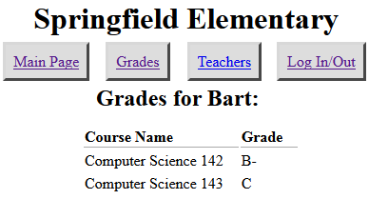
SQL injection
a flaw where the user is able to inject arbitrary SQL into your query
This flaw often exists when a page accepts user input and inserts it bare into the query.
What kinds of SQL can we inject into the query? Why is this bad?

Slide 16
A SQL injection attack
The query in the Simpsons Node code is:
let query = "SELECT * FROM students
WHERE username = '" + username + "' AND
password = '" + password + "'"; JS
Are there malicious values for the user name and password that we could enter?
Password:
This causes the query to be executed as: query = "SELECT * FROM students WHERE username = '" + username+ "' AND password = '' OR '1'='1'";
What will the above query return? Why is this bad?

Slide 17
Too true...
injected SQL can:
change the query to output others' data (revealing private information)
insert a query to modify existing data (increase bank account balance)
delete existing data (; DROP TABLE students; -- )
bloat the query to slow down the server (JOIN a JOIN b JOIN c ...)
...

Slide 18
Securing against SQL injection
similar to securing against HTML injection, escape the string before you include it in your query
con.escape | returns a SQL-escaped version of a string
username = con.escape(query.username);
password = con.escape(query.password);
query = "SELECT name, ssn, dob FROM users
WHERE username = $username AND password = $password"; PHP
replaces ' with \', etc., and surrounds with quotes

