Slide 1
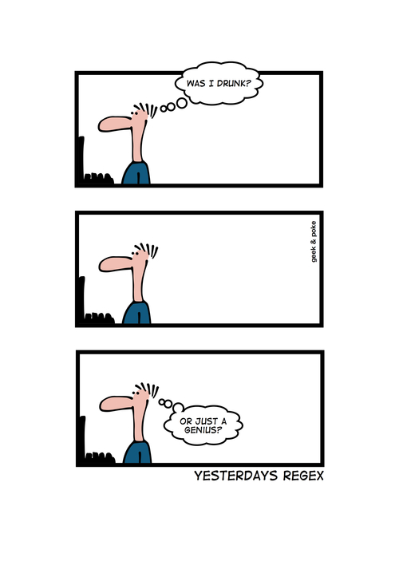
CSc 337
Lecture 25: Cookies

Slide 2
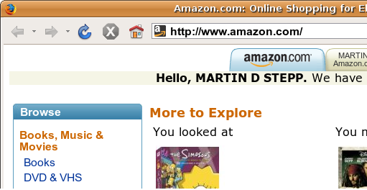
Stateful client/server interaction
Sites like amazon.com seem to "know who I am." How do they do this? How does a client uniquely identify itself to a server, and how does the server provide specific content to each client?
HTTP is a stateless protocol; it simply allows a browser to request a single document from a web server
today we'll learn about pieces of data called cookies used to work around this problem, which are used as the basis of higher-level sessions between clients and servers

Slide 3
What is a cookie?
cookie: a small amount of information sent by a server to a browser, and then sent back by the browser on future page requests
cookies have many uses:
authentication
user tracking
maintaining user preferences, shopping carts, etc.
a cookie's data consists of a single name/value pair, sent in the header of the client's HTTP GET or POST request

Slide 4
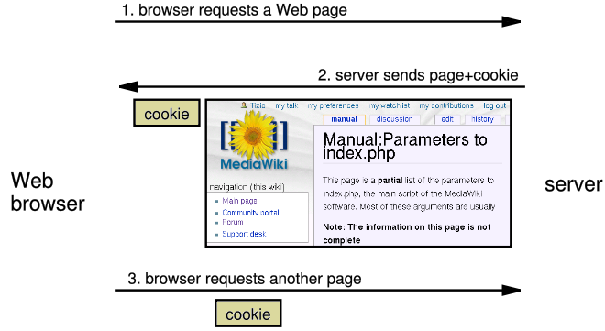
How cookies are sent
when the browser requests a page, the server may send back a cookie(s) with it
if your server has previously sent any cookies to the browser, the browser will send them back on subsequent requests
alternate model: client-side JavaScript code can set/get cookies

Slide 5
Myths about cookies
Myths:
Cookies are like worms/viruses and can erase data from the user's hard disk.
Cookies are a form of spyware and can steal your personal information.
Cookies generate popups and spam.
Cookies are only used for advertising.
Facts:
Cookies are only data, not program code.
Cookies cannot erase or read information from the user's computer.
Cookies are usually anonymous (do not contain personal information).
Cookies CAN be used to track your viewing habits on a particular site.

Slide 6
A "tracking cookie"
an advertising company can put a cookie on your machine when you visit one site, and see it when you visit another site that also uses that advertising company
therefore they can tell that the same person (you) visited both sites
can be thwarted by telling your browser not to accept "third-party cookies"

Slide 7
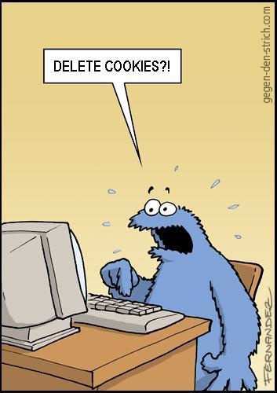
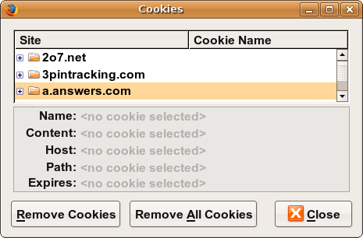
Where are the cookies on my computer?
IE: HomeDirectory\Cookies
e.g. C:\Documents and Settings\jsmith\Cookies
each is stored as a .txt file similar to the site's domain name
Chrome:
C:\Users\username\AppData\Local\Google\Chrome\User Data\Default
Firefox: HomeDirectory\.mozilla\firefox\???.default\cookies.txt
view cookies in Firefox preferences: Privacy, Show Cookies...

Slide 8
How long does a cookie exist?
session cookie : the default type; a temporary cookie that is stored only in the browser's memory
when the browser is closed, temporary cookies will be erased
can not be used for tracking long-term information
safer, because no programs other than the browser can access them
persistent cookie : one that is stored in a file on the browser's computer
can track long-term information
potentially less secure, because users (or programs they run) can open cookie files, see/change the cookie values, etc.

Slide 9
Setting Cookies
You will need to install cookie-parser in order to use cookies in NodeJS:
npm install cookie-parser
In order to use cookie-parser in your code you will need to include the following lines:
const cookieParser = require('cookie-parser');
app.use(cookieParser());

Slide 10
Setting a cookie in NodeJS
res.cookie(cookie_name , cookie_value)
res.cookie('username' , 'allison')
you can set multiple cookies (20-50) per user, each up to 3-4K bytes
by default, the cookie expires when browser is closed (a "session cookie")
you can check whether a cookie has been sent by typing document.cookie into the browser console

Slide 11
Retrieving information from a cookie
req.cookies // retrieve value of the cookies
var name = req.cookies.name;
Cookies can be retrieved from the request

Slide 12
Expiration / persistent cookies
res.cookie(name , 'value', {maxAge : 10000});
var expireTime = 60*60*24*7; // 1 week from now
res.cookie("CouponNumber", "389752", {maxAge : expireTime});
res.cookie("CouponValue", "100.00", {maxAge : expireTime});
to set a persistent cookie, pass a third parameter for when it should expire
time is in milliseconds
indicated as an integer representing a number of seconds, often relative to current date
if no expiration passed, cookie is a session cookie; expires when browser is closed

Slide 13
Deleting a cookie
res.clearCookie(cookie_name);
res.clearCookie('name');
takes the name of the cookie to delete as a parameter
remember that the cookie will also be deleted automatically when it expires, or can be deleted manually by the user by clearing their browser cookies

Slide 14
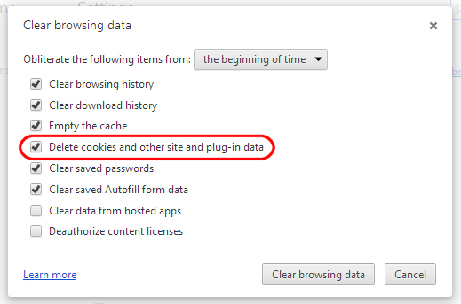
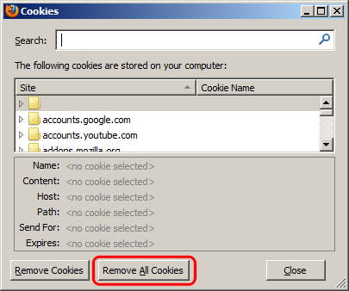
Clearing cookies in your browser
Chrome: Wrench → History → Clear all browsing data...
Firefox: Firefox menu → Options → Privacy → Show Cookies... → Remove (All) Cookies

Slide 15
Cookie and Session error fix
Some students have trouble getting cookies and sessions to work on their machines. If you can't get them to work, try the following:
Use Firefox not Chrome
change your fetch call to: fetch(url, {method: "GET", credentials: "include"})
Include httpOnly : false when you set your cookie
example: res.cookie("luckynum", number, {maxAge : 10000, httpOnly : false});
Access your html page from http://localhost:3000/page_name.html
to do this you will need to move your .html files to a folder called public located in the folder that your service is stored in.

