Slide 1

CSc 337
Lecture 26: Sessions and wrapping up

Slide 2
What is a session?
session: an abstract concept to represent a series of HTTP requests and responses between a specific Web browser and server
  HTTP doesn't support the notion of a session, but PHP does
sessions vs. cookies:
  a cookie is data stored on the client
  a session's data is stored on the server (only 1 session per client)
sessions are often built on top of cookies:
  the only data the client stores is a cookie holding a unique session ID
  on each page request, the client sends its session ID cookie, and the server uses this to find and retrieve the client's session data

Slide 3
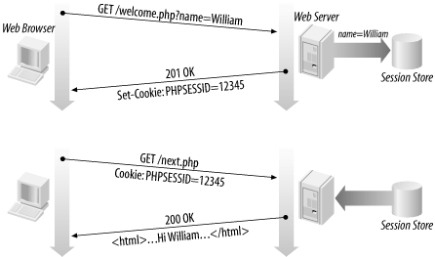
How sessions are established
client's browser makes an initial request to the server
server notes client's IP address/browser, stores some local session data, and sends a session ID back to client (as a cookie)
client sends that same session ID (cookie) back to server on future requests
server uses session ID cookie to retrieve its data for the client's session later (like a ticket given at a coat-check room)

Slide 4

Cookies vs. sessions
duration: sessions live on until the user logs out or closes the browser; cookies can live that long, or until a given fixed timeout (persistent)
data storage location: sessions store data on the server (other than a session ID cookie); cookies store data on the user's browser
security: sessions are hard for malicious users to tamper with or remove; cookies are easy
privacy: sessions protect private information from being seen by other users of your computer; cookies do not

Slide 5
Using Sessions
You will need to install client-sessions in order to use sessions in NodeJS:
npm install client-sessions
In order to use cookie-parser in your code you will need to include the following lines:
var session = require('client-sessions');
app.use(session({
cookieName: 'session',
secret: 'random_string_goes_here',
duration: 30 * 60 * 1000,
activeDuration: 5 * 60 * 1000,
}));

Slide 6
Sessions in NodeJS
Check if a session exists with the following code:
if(req.session) { … }
Halt the current session, getting rid of all session data:
req.session.reset()
To access or set session data use req.session.variableName:
var name = req.session.name;
req.session.email = name + '@email.arizona.edu';

Slide 7
Session timeout
because HTTP is stateless, it is hard for the server to know when a user has finished a session
ideally, user explicitly logs out, but many users don't
client deletes session cookies when browser closes
server automatically cleans up old sessions after a period of time
  old session data consumes resources and may present a security risk
  you can explicitly delete a session by calling session.reset()

Slide 8
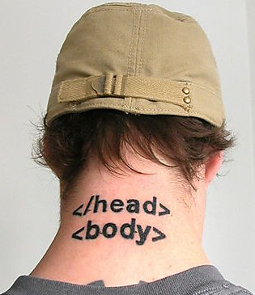
Congratulations!
You now know more than the average web developer. (Really!)
You know an introductory amount about many topics/languages
You're capable of teaching yourself more...

Slide 9

The #1 question I hear about web programming: How do I stay up to date??
There are so many changing technologies…
How do I know which ones to use?
How do I learn about new libraries?
Won't everything I learn be obsolete in 2 months?!?!

Slide 10
Q: How do I stay up to date??
A: This is the wrong question to ask.
Staying "up to date" is not that important.
Tech doesn't fundamentally change very often or very fast.
Most new web technology makes your life easier but is not necessary.
Everything* you want to do can already be done with the web technology available not just today, but 10 years ago.
*You know, within reason

Slide 11
Fundamentals don't change
Tech doesn't change that quickly
Much of Facebook is still written in PHP
Most of Google is written in Java and C++
You will not (and should not) totally rewrite your codebase every year
Tons of parallel problems, patterns, etc across tech

Slide 12
The real question to ask
Also: Many new libraries are bad.
Literally anyone can post a library on npm - there is no
Most libraries on npm are therefore garbage
Even popular libraries can be poorly written.
So the real question to ask:
How do I distinguish good web technology from bad web technology?

Slide 13

Choosing good tools
Either:
You have enough knowledge to be able to decide whether a tool or technology is beneficial

Slide 14
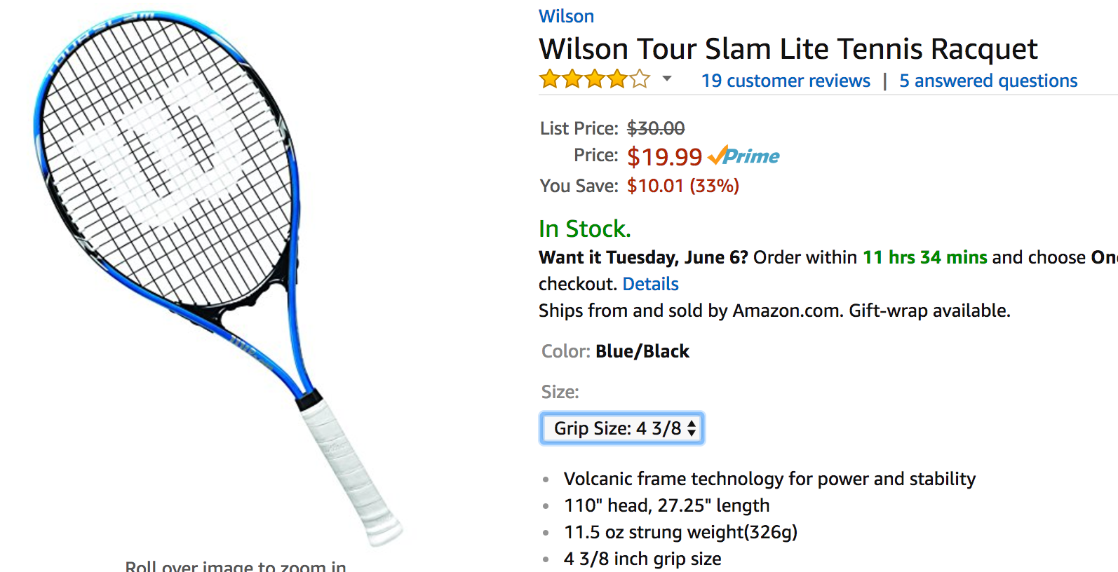
Choosing good tools
Or:
You don't have enough knowledge to tell the difference
Therefore it doesn't really matter
And you should choose the simplest / cheapest thing that other people say is good

Slide 15



Choosing good tools
If you keep getting better at tennis, someday you'll look back at your first racquet and think
"OMG how was I using this terrible racquet" or,
"Lol I had a $300 racquet and had no idea how to use it", or
"Huh, that cheap one was actually pretty good"
But the ability to choose good tools takes expertise and experience that you don't have as a beginner.
And sometimes there's just a bit of personal preference

Slide 16
General advice
Don't be afraid or intimidated by new technology.
When you confront a new web thing, like a library or framework, one of two things will happen:
You will be excited by it, and you will want to use it.
You will not be excited by it, and you can safely ignore it.
Simpler is always better.
ALWAYS delete code if you can
ALWAYS remove a library if you can
ALWAYS remove a framework if you can

Slide 17
What next?
CSC 337 is a fundamentals course, meaning we covered the critical stuff, but we just scratched the surface.

Slide 18
Helpful CS classes
Recommended CS classes:
Databases
As many systems classes as you can take
  Networking
  Operating Systems
Compilers
Programming languages

Slide 19
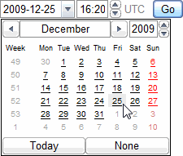


Learn more about HTML5
semantic tags: nav, aside, header, footer, section, aside, article
Forms 2.0: sliders, search bars, color/number/email/url/date/time, placeholders, ...
audio and video tags for embedding multimedia
<video src="video.ogv" width="425" height="350"></video>
canvas tag for drawing 2D shapes in HTML/JS (like DrawingPanel) (ref 1, 2, 3)

Slide 20

Learn more about CSS3
Flex and grid layouts
new selectors: nth-child, inline-block, :not, +
ability to embed fonts in a page (yay)
easy built-in support for multi-column layouts
transparency/opacity, color gradients, shadows
animations and transitions
affine transformations (scaling, rotation, perspective)

Slide 21

Learn more about JavaScript
Support older browsers with BableJS
  Write code with the latest features in JavaScript
  Support older browsers without having to rewrite anything
Frameworks:
  AngularJS
  Backbone.js
  Bootstrap
  Ember.js
  ReactJS
  Vue.js
  Flask (backend)
  Ruby on Rails (backend)
  Django (backend)

Slide 22
How do I use a Framework? Just try it out
General advice:
Go to the official website
Use the official website's tutorials
  Like, actually follow along; don't just skim the docs
Then build a small app of your own on the framework
  The only way to "learn" a framework is to build something using it, beyond just following a tutorial
  Suggestion: Choose something you could build in 24 hours using the tech you already know
Most well-known frameworks have tutorials, excellent documentation, strong developer communities, etc.

Slide 23
Publishing to the web

Slide 24
Protecting web resources
Please don't post your HW solutions on the web unprotected!
(we want to be able to assign some of these programs again)
posting resources with a shared password:
  create files named .htaccess and .htpasswd with proper contents and put them in your HW root folder on UA
  doesn't require a UA NetID
  can give password to friends / family / employers

Slide 25
Example htaccess, htpasswd files
.htaccess :
AuthUserFile full/path/to/.htpasswd
AuthName "Restricted Access"
AuthType Basic
require user username
.htpasswd :
username:encryptedPassword
place these files in the top folder of the content you want to protect
htpasswd generator (gives you the text to copy-paste into your .htpasswd file)
or from *nix terminal: htpasswd -c .htpasswd username

Slide 26
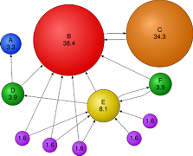
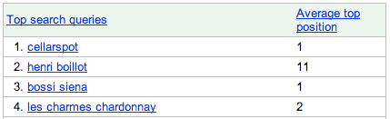
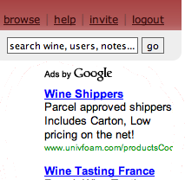
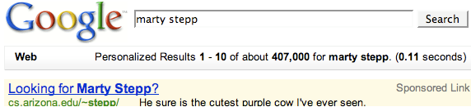
Taking a web site "live"
buy your own domain name (e.g. allisonobourn.com): DreamHost
learn about (stalk) your users with Google Analytics
improve your page / improve PageRank: SEO, meta tags
make a few bucks with ads: Google AdSense
get the word out: Google AdWords, Webmaster Tools

Slide 27
Publishing web pages
Domain name registration:
Reserves a custom URL: myawesomesite.com
But doesn't usually include web hosting; all you own is the name.
Web hosting:
Provides a location on the internet to upload files
Usually with some crummy URL, like http://bucket.s3-website-us-west-2.amazonaws.com/
Domain name registration and web hosting are sometimes provided by the same company, but not always.

Slide 28
Publishing static web pages
You can register your own domain name through many companies:
Google Domains: Only domain name registration
Amazon S3: Only web hosting
Dreamhost: Domain name and web hosting options
Domain name registration is usually ~$12/year
Web hosting is usually ~$10/month
Amazon S3 is significantly cheaper (virtually free for low-traffic websites) but more complicated to set up

Slide 29
Publishing server-side code
If you want to host both a frontend and a backend, you may want a web host that allows you to configure a server.
There are an immense number of options, with different levels of configuration. Here are some:
Heroku: Super easy to use, but offers less control. Also a lot more expensive.
AWS: Cheap, lots of options, but more complicated
Google Cloud: Basically the Target brand of AWS: Cheaper than AWS; as complex as AWS; fewer products than AWS

